Slide 1



IO Link First step towards Industry 4.0
ifm electronic – we connect you

Slide 2
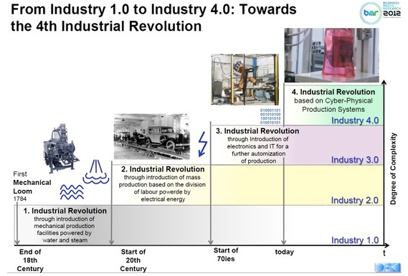

Slide 3
Overall Equipment Efficiency (OEE)
= Material Availability X
Machine Availability X
Quality of production

Slide 4
Machine Availability = Predicative Maintenance by monitoring Vital machine operating parameters
Quality of Production = Minimum Rejection rate by monitoring process / machine operating parameters which affect Quality of production / work pieces

Slide 5
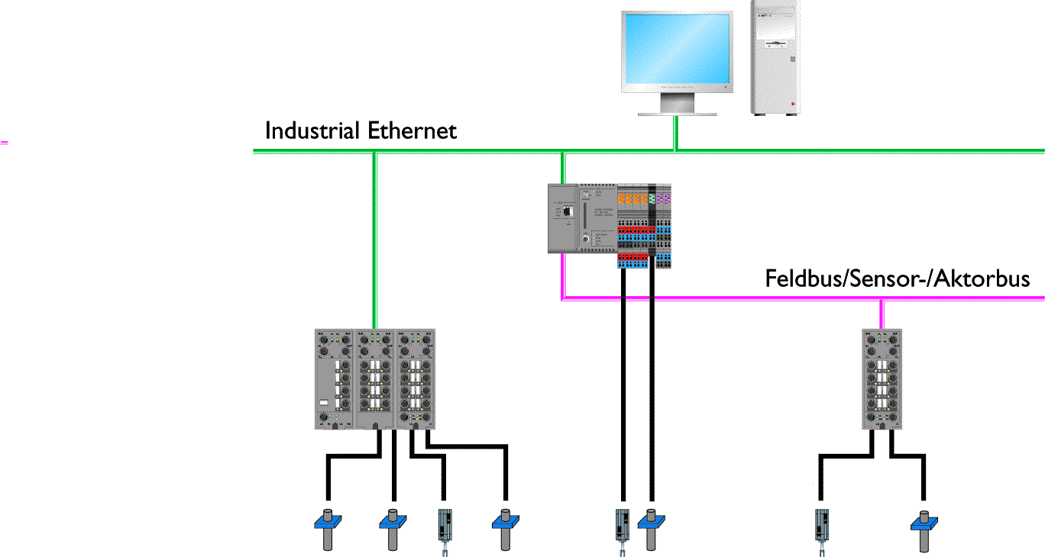

Present technology
Information
Communication
Fieldbus/Sensor Actuator Bus
Present technology –Ideas for improvements
• Communication towards sensors and actuators
• Combined transmission mesurement values and binary signals
• Reduced cabling
• Consistent parameter data storage
• Noise immune analogue data transmission

Slide 6
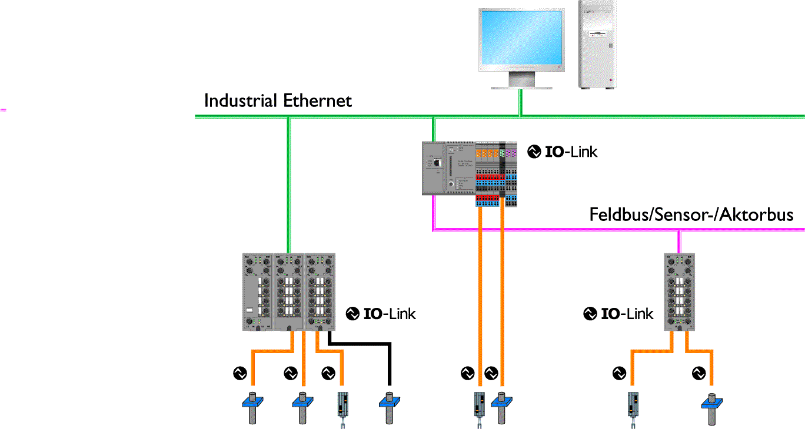


Communication towards sensors and actuators
Information
Communication
Previous technology –Sustainment of benefits
• Point-to-point connection remains
• Easy integration of well-established fieldbus systems
• Full coverage of sensors and actuators functionalities
• Good market coverage, manufactorer variety
• Simple 3-wire connection

Slide 7
On/Off
1
Bit
16 bits
1
1
1
1
1
1
1
0
1
0
0
0
0
0
0
0
Analog
1
1
1
1
1
1
1
0
1
0
0
0
0
0
0
0
IO-Link
1
1
1
1
1
1
1
0
1
0
0
0
0
0
0
0
1
1
1
1
1
1
1
0
1
0
0
0
0
0
0
0
:
:
:
256 bits
(16x more)
1
1
1
1
1
1
1
0
1
0
0
0
0
0
0
0

Slide 8
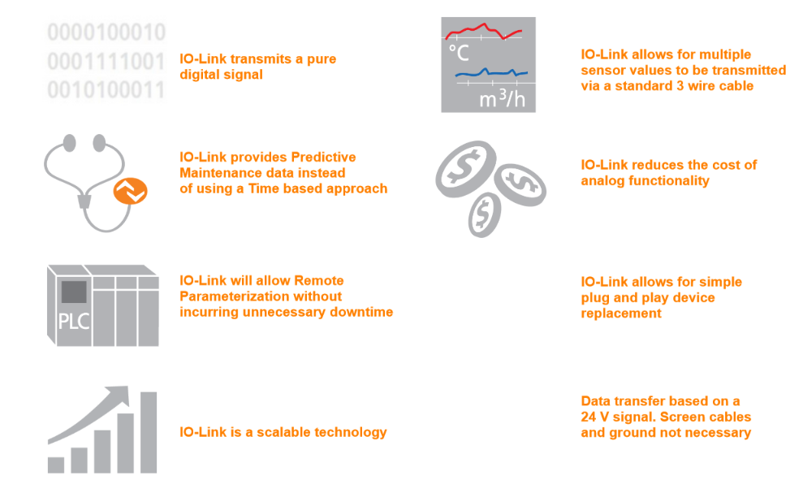



Slide 9



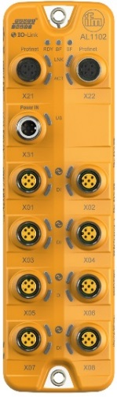

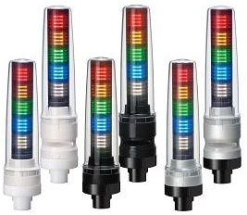
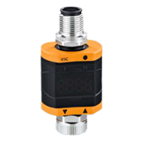
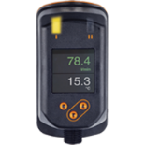
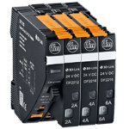
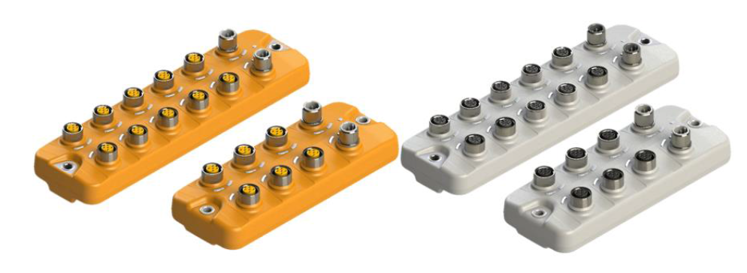
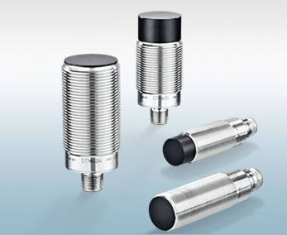
IO Link Master
IO Link Sensors
Input/Output
Sensors hubs
RFID IO Link
antenna
IO Link stack lights
Analog I/O solution
Display solution
Circuit protection

Slide 10
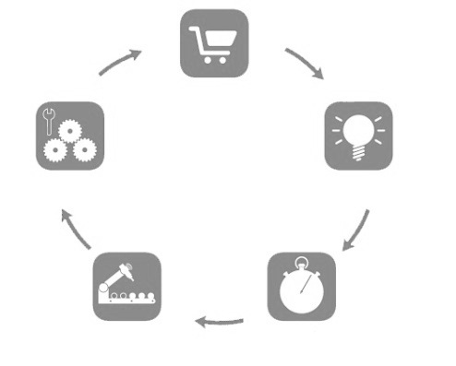
Market and Demand
New Innovative Machine Concepts
• Simplified installation
  • Replacement of analogue signals
  • Quick and easy wiring
• Automated parametrization
  • „Copy and Paste“ of parameter data
  • Remote parametrizing
• Advanced diagnostics
  • Information from sensor/actuator level
  • Remote diagnostics from anywhere
✓ Solution with IO-Link

Slide 11
Research and Development
Optimized Development
• Less interfaces
  • One interface for all sensor data
  • Data to PLC, HMI, Scada & Server
• Simplified integration
  • Consistent IO-Link Device Description (IODD)
  • Standardized function blocks
• Consistent engineering tools
  • Integrated development processes
  • One tool for all devices
✓ Solution with IO-Link

Slide 12
Installation and Startup
Efficient Installation
• Reduce assembly time
  • Optimized mechanical assembly
  • Standard wiring instead of communication cables
• Simplified wiring
  • Use of unshielded M12 standard jumper cables
  • 3 instead of 19 core-installation
• Automated startup
  • „Pushbutton“ configuration
  • Pre-configured setups reduce commissioning
✓ Solution with IO-Link

Slide 13
Machine Operation
Higher Productivity
• Machine availability
  • Reduction of machine breakdowns
  • Predictive maintenance
• Maximum transparency
  • Transparency up to the sensor and actuator data
  • Remote machine diagnosis
• Increase of efficiency
  • Parameter change in operation
  • Online observing, alarm management
✓ Solution with IO-Link

Slide 14
Maintenance
User-friendly Maintenance
• Decrease of maintenance costs
  • Preventive maintenance
  • Less unplanned break-downs
• Scalable diagnostics
  • Information on demand
  • Flexible alarms / events management
• Easy and cost-effective trouble-shooting
  • Reduction of replacement costs
  • Less spare parts needed
✓ Solution with IO-Link

Slide 15
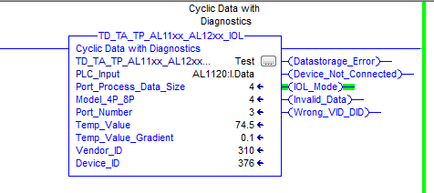
How is this information integrated into the PLC world?
AOIs (Add On Instructions) are available for quick integration of sensor data
for Allen Bradley and Siemens PLC systems.

Slide 16
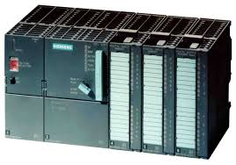
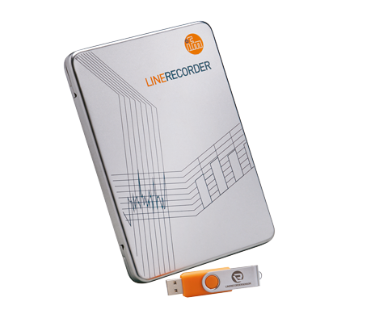
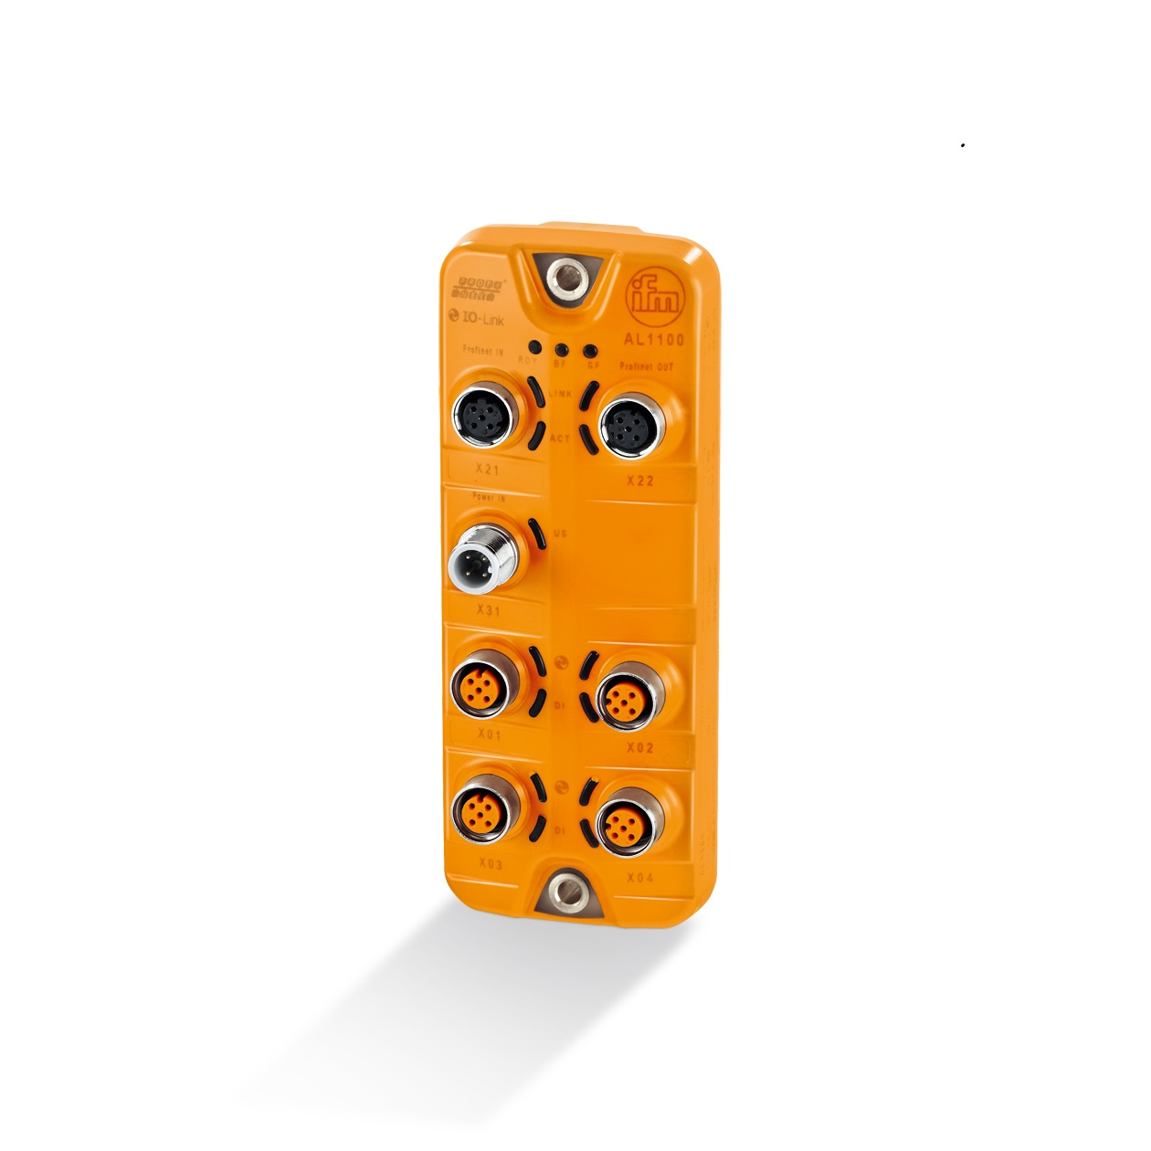
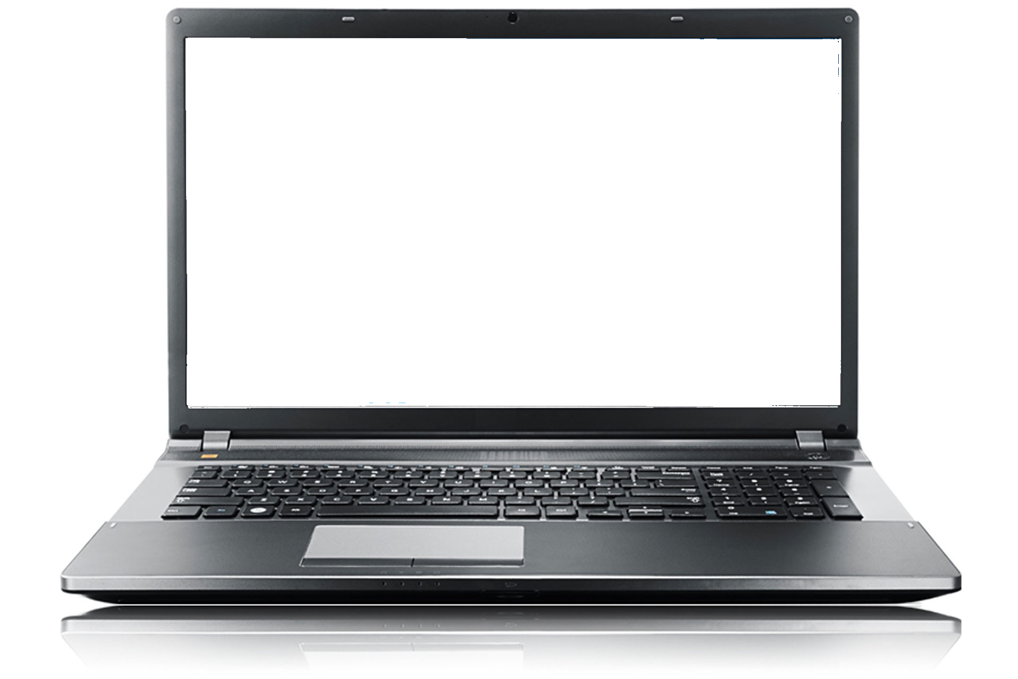
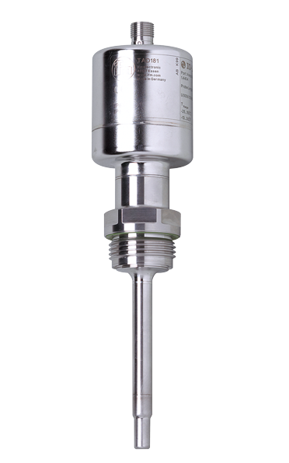
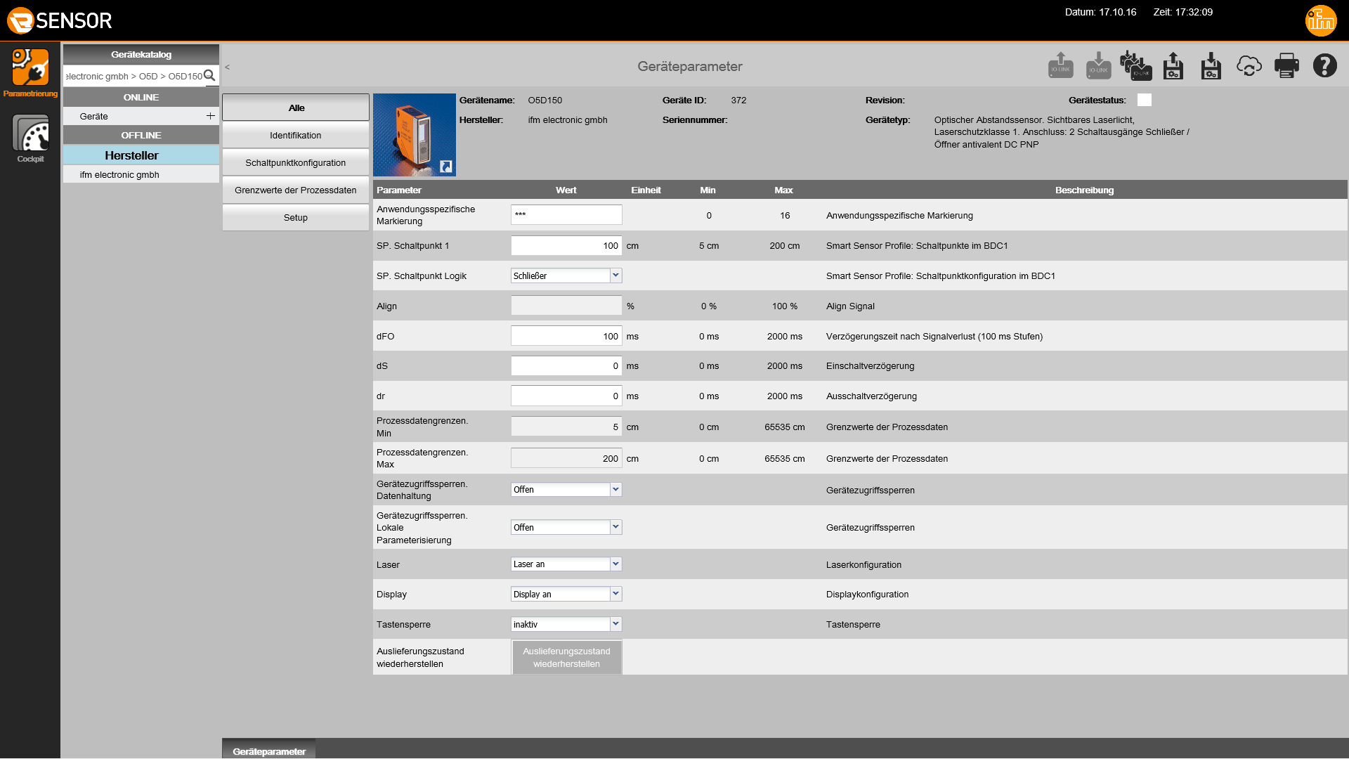
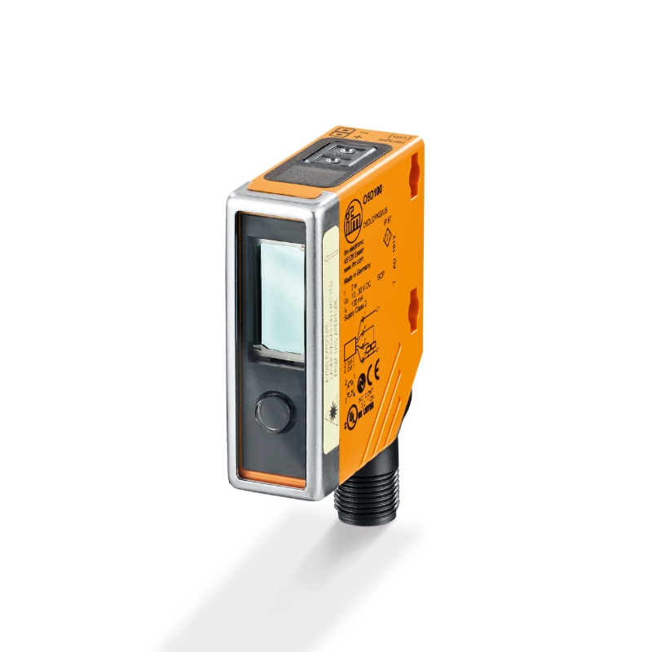
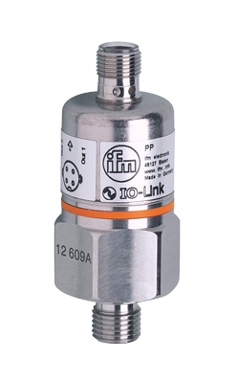

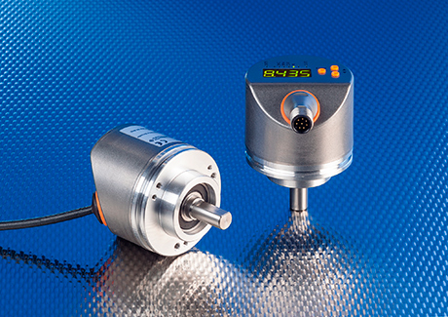

IO-Link Online-Parametrizing Tools for PC
QA0011
• LineRecorder Device 1.0
• Software for parametrization
and commissioning of IO-Link
sensors and masters
AL1100
P1: TAD1234
P2: PP7751
P3:
P4: O5D150
RUP500 / RVP510
Solid shaft with display
Resolution freely programmable between 2…10,000 pulses
Parameter settings and diagnostic data are transmitted via IO-Link
IO-Link Basics, Technology and Customer Benefits

Slide 17
Basic Machine Tool Monitoring
BOM:
VTV122 X 1
TS5289 X 1
EVC014 X 1
DP2200 X 2
TP3237 X 1
EVC126 X 4
PN7571 X 1
E11504 X 1
AY1000 X 1
DN4011 X 1
Patch cord X1
PC X 1
SQL Express X 1
QLS025 X 1
PC
8 GB RAM
10 GB SSD space
Quad Core
2.5 G Hz
QA0011 LR Device
or
QLS015 SMOB CE
EVC014
DP2200
EVC126
VTV122
TS5289
TP3237
Machine Spindle
EVC126
Patch cord
AY1000
Profinet
PN7571
EVC126
Hydraulic Power pack
EVC126
DN4011
DP2200
E11504
230 VAC input
Spindle power
Feedback 4-20mA

Slide 18
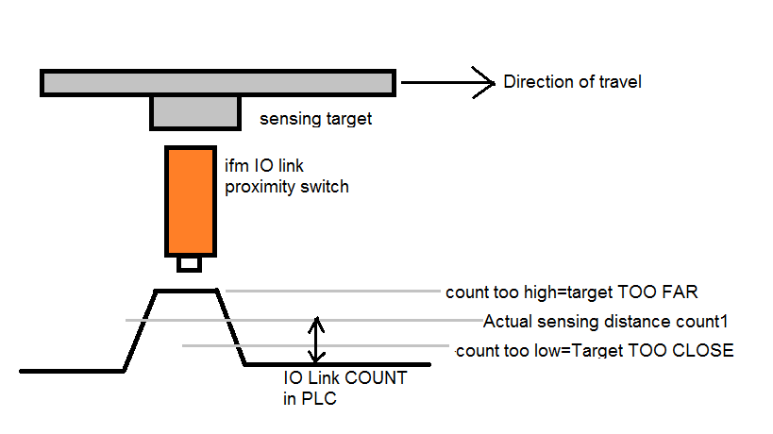
Breakdown time caused by Proximity Switch Damage in Heavy Equipment? No More!!!
Many times, proximity switches are damaged by the larger than ideal mechanical play in the moving machine components. So, the sensing target or the proximity moves either too close to proximity switch and proximity switch gets mechanically damaged. OR The sensing target moves away from the proximity switch and does not get sensed at all. Both these conditions cause break downs, which can cause big down time costs for the equipment and also product loss.
Solution:
Monitor the actual sensing distance of critical applications with ifm IO link proximity switches connected to ifm IO link masters (PLC remote IOs which can read and write values to IO link devices).

Slide 19
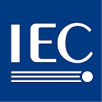






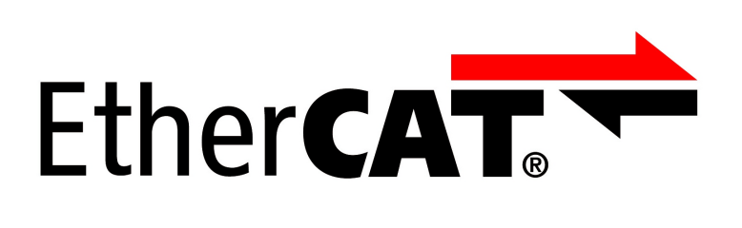


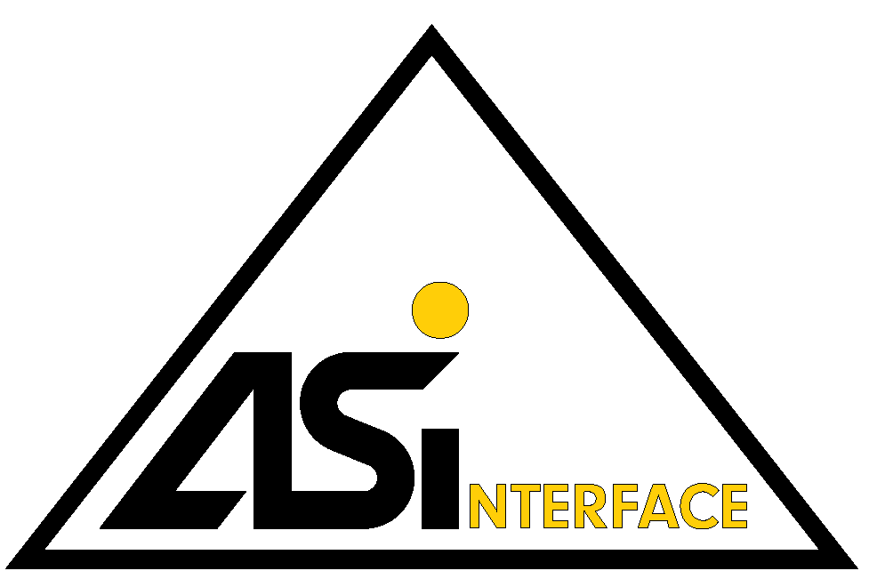











IO-Link as a global standard
The IO-Link group of companies incorporates more than 110 member companies as of end of 2015. The member
companies came from 4 different areas: sensors, actuators, PLCs and integrators. ifm electronic was one of the
founding members. IO-Link is an international standard under IEC61131-9.
Sensor companies:
All major sensor companies are involved. The SmartSensor Profile gives the customer the ability to have an interoperability between different sensors. There are more than 400 sensors with IO-Link available only from ifm. In total ifm has sold more than 2 million IO-Link sensors so far.
PLC companies:
The world market leaders support the IO-Link technology via their fieldbusesor dedicated PLC master cards.
Supported Fieldbuses:
Among others there are many IO-Link master modules available for CANopen, Devicenet, CC-Link, Sercos III, Powerlink,
Actuator companies:
From motor starters to pneumatic modules many actuator companies work with IO-Link:
Integrators & Chip manufacturers:
For more refer to IO-Link.com.

Slide 20
IO-Link uses the same cabling and controls structures as today
IO-Link doesn’t add additional cost to sensors
IO-Link isn’t complex to use
IO-Link implementation offers no software barriers

