Slide 5
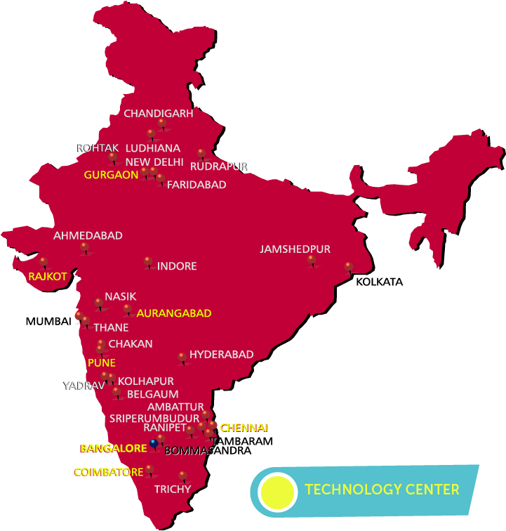
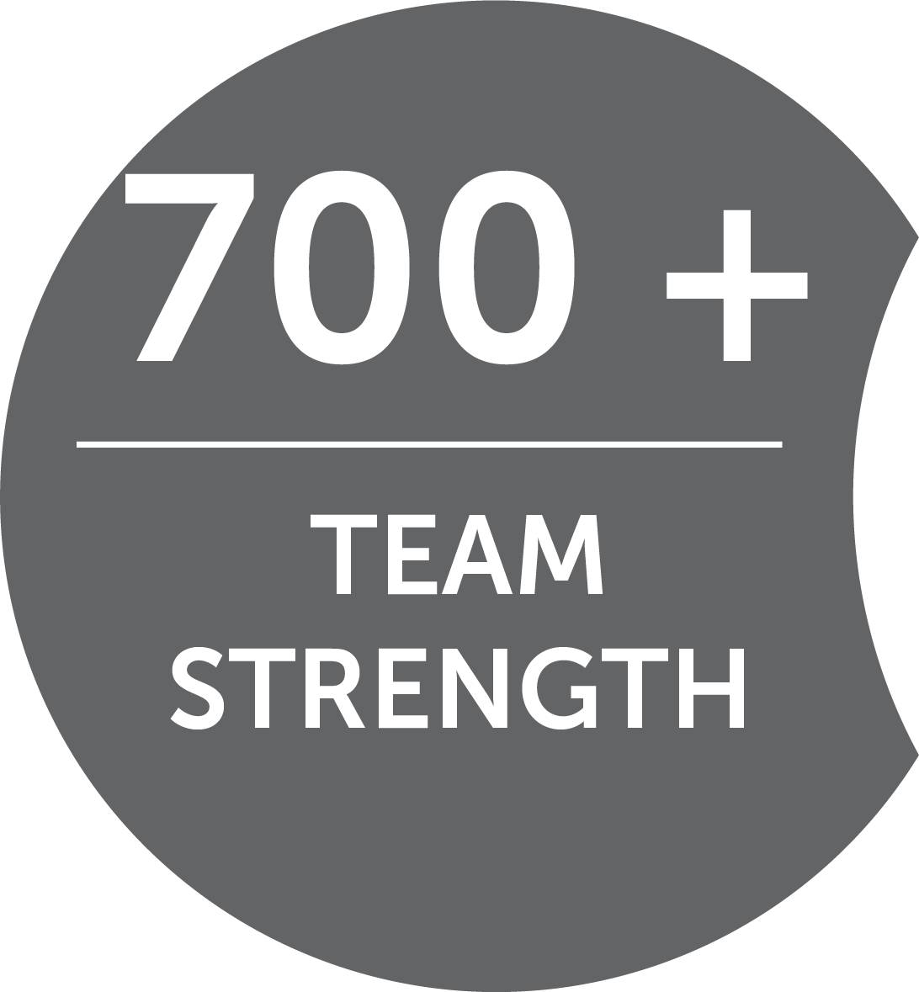

Slide 7
Check using your own data!
My Company
Description | Value
Avg. machine hour rate ₹ $ € ¥ | 800
Improvement in productivity | 10%
Increase in machine hour rate | 80
Work hours in a month | 600
Regular monthly revenue | 4,80,000
Monthly productivity increase | 48,000
Total revenue, after increase | 5,28,000
Increase in Annual revenue | 5,76,000
Investment, 1-time | 2,00,000
Months for full realization | 4
Your 1st Year R.O.I. | 288%

Slide 9
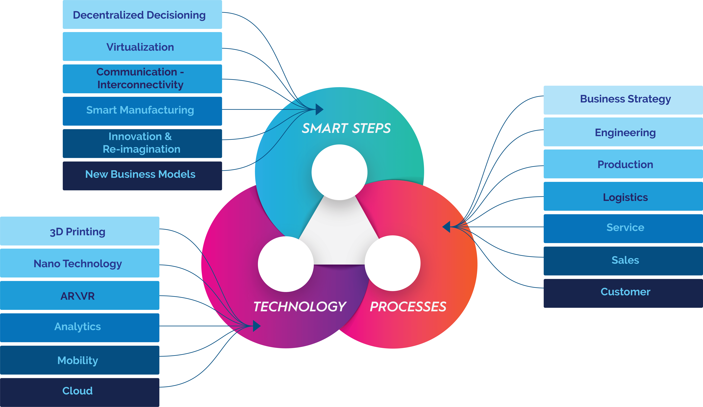

Slide 12
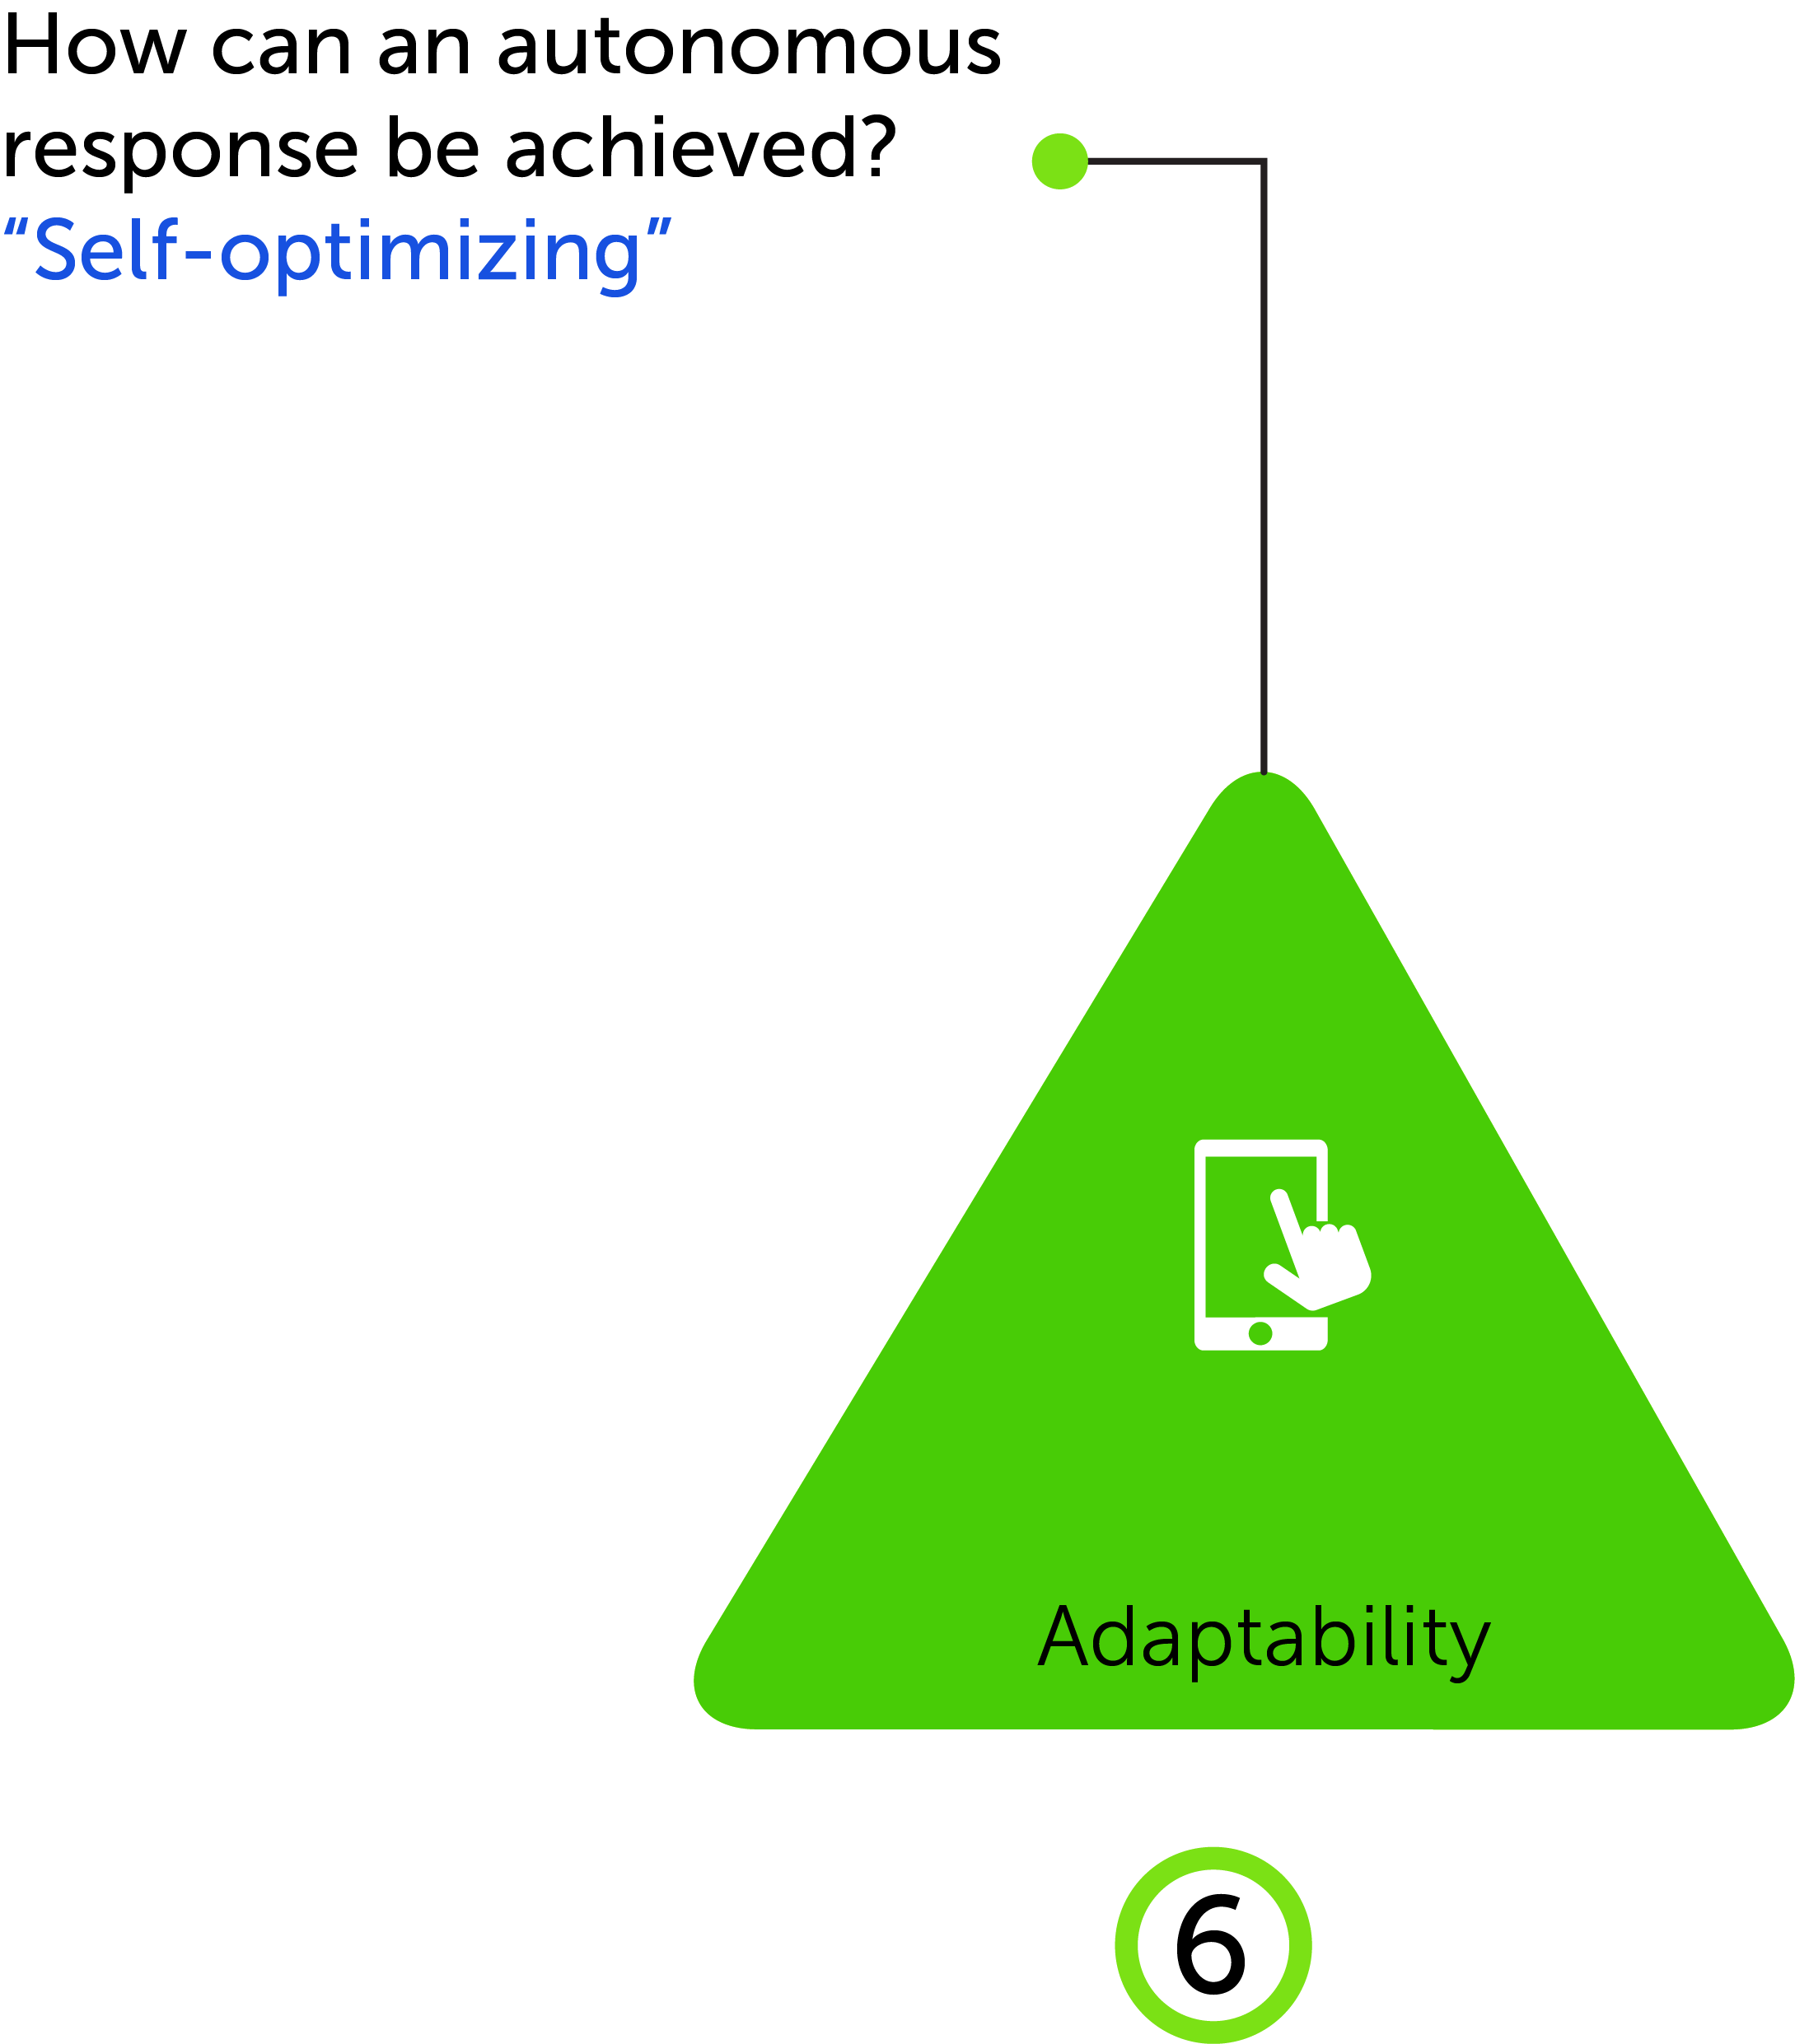
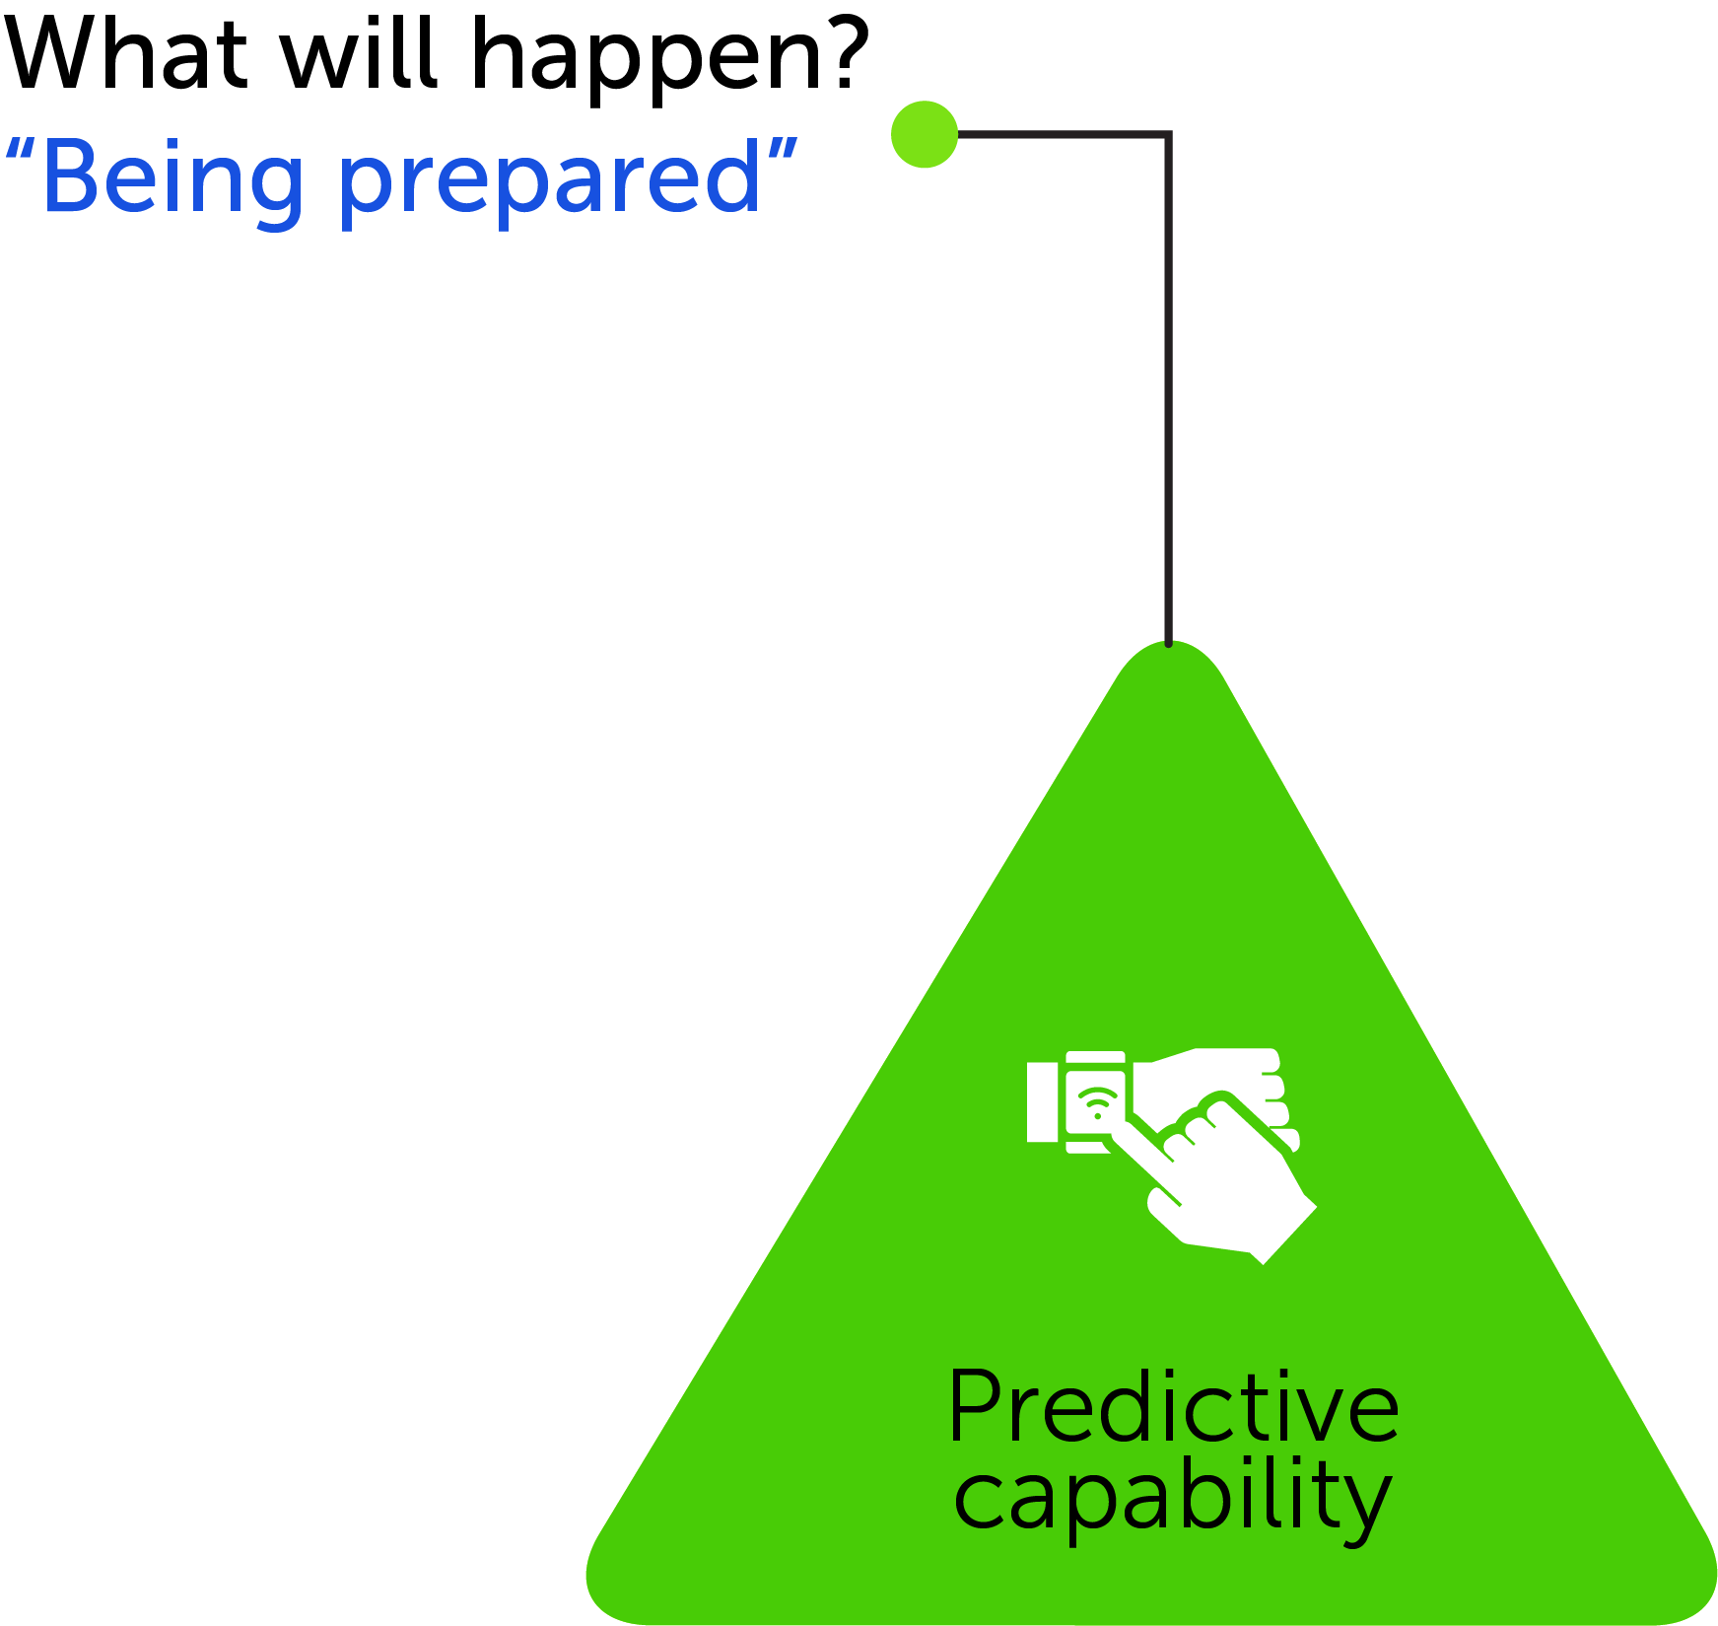
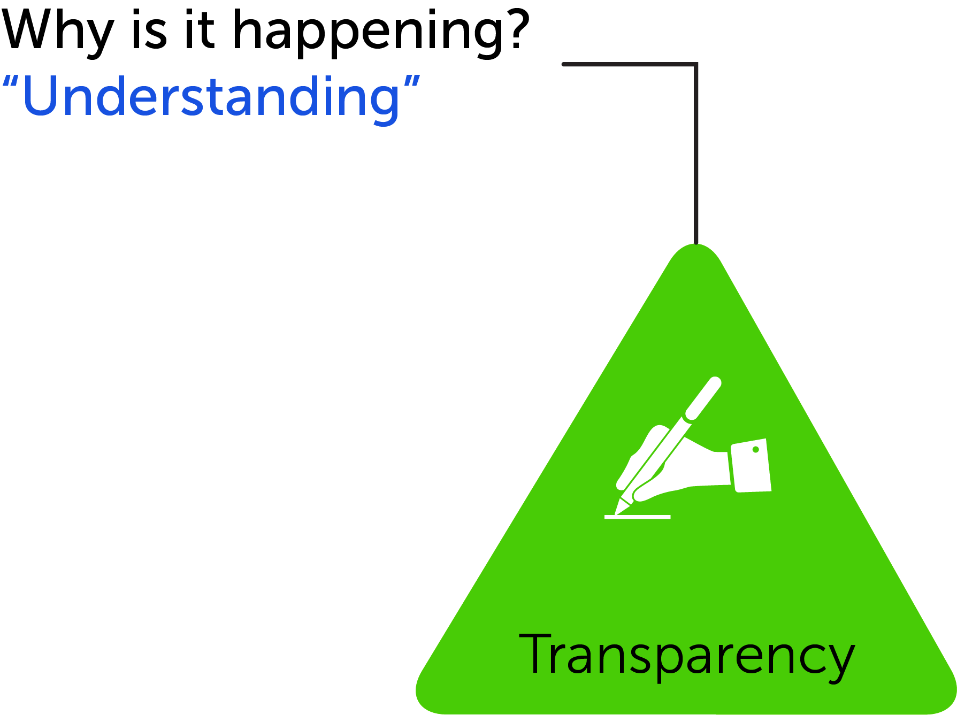
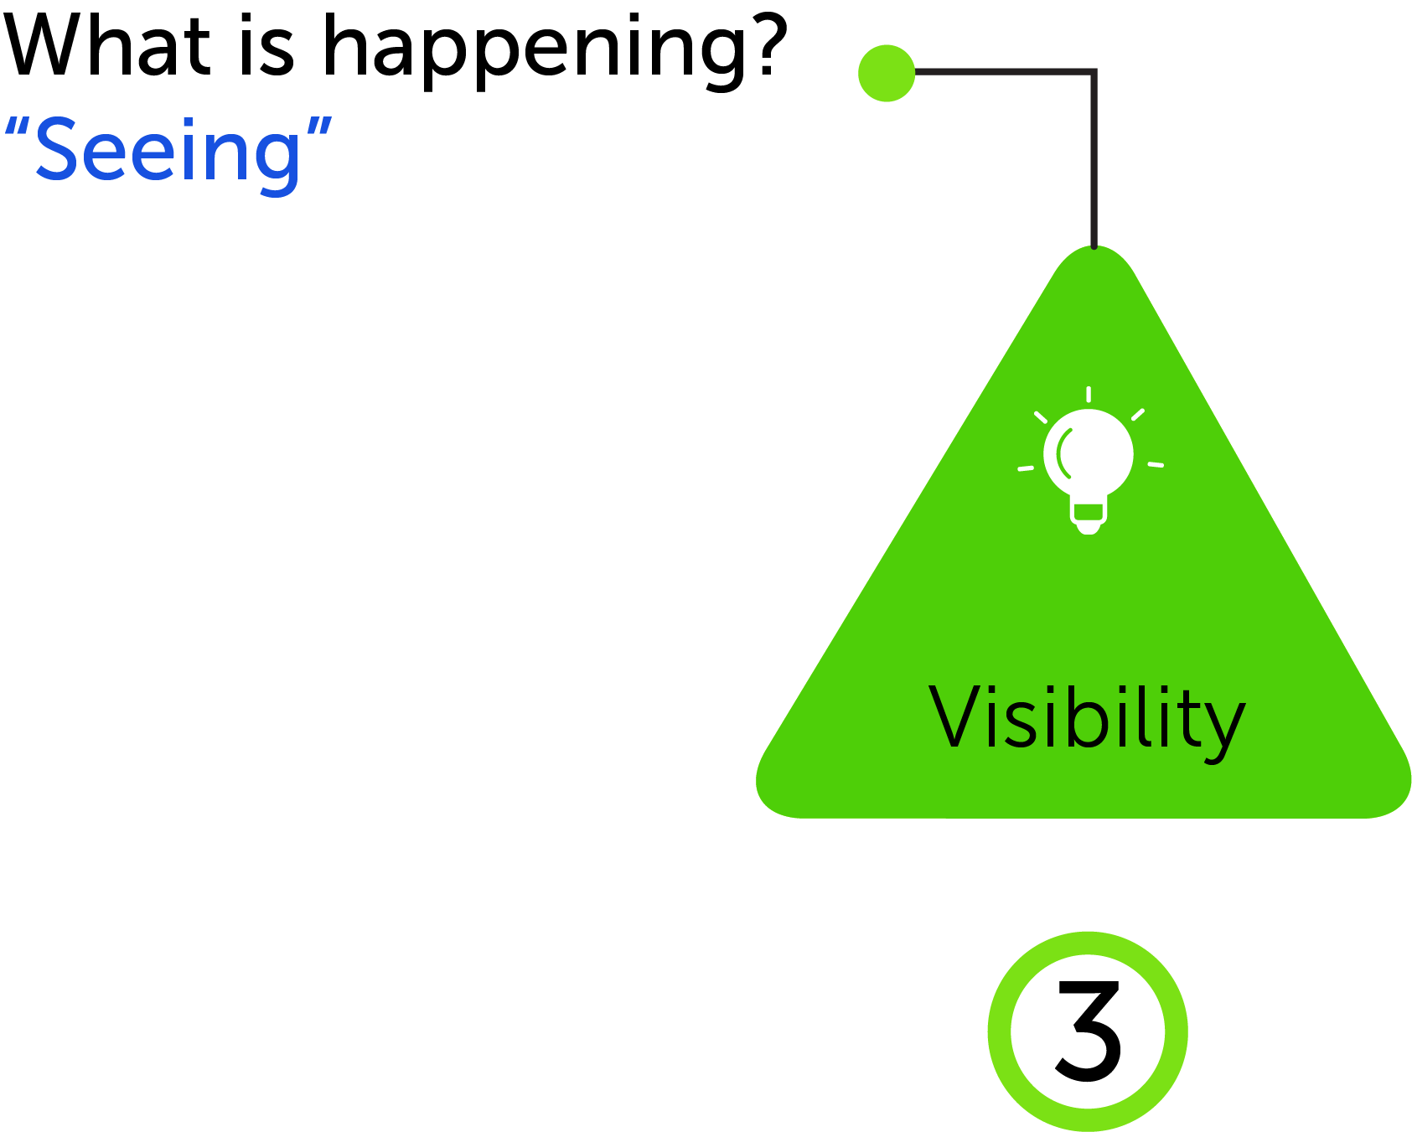
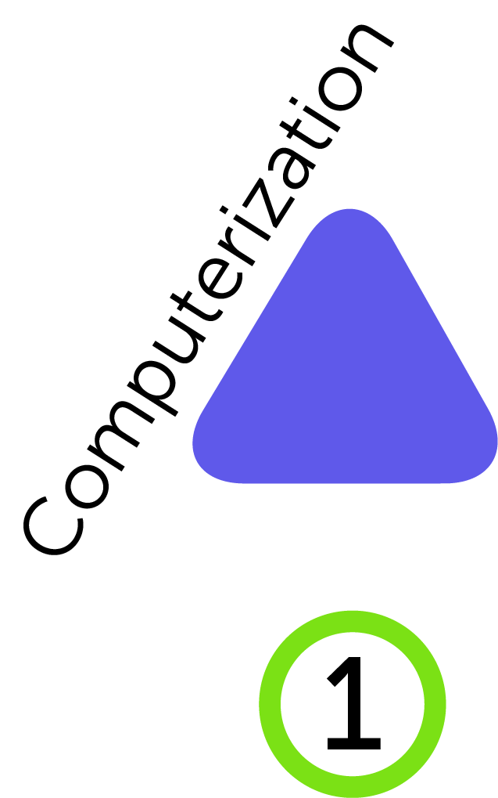
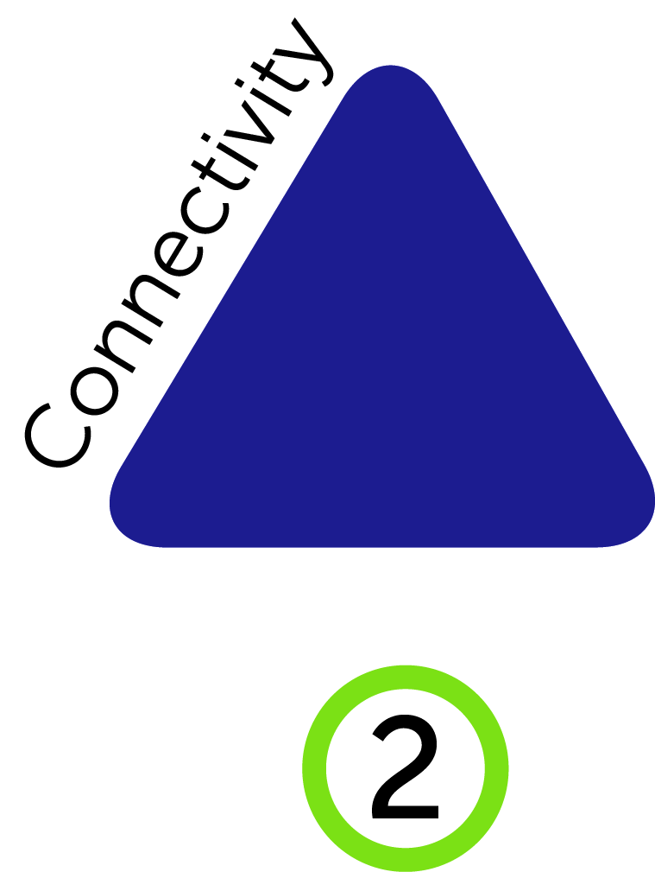

Slide 13
Productivity = Profits!
$ € ¥ ₹ £

Slide 14
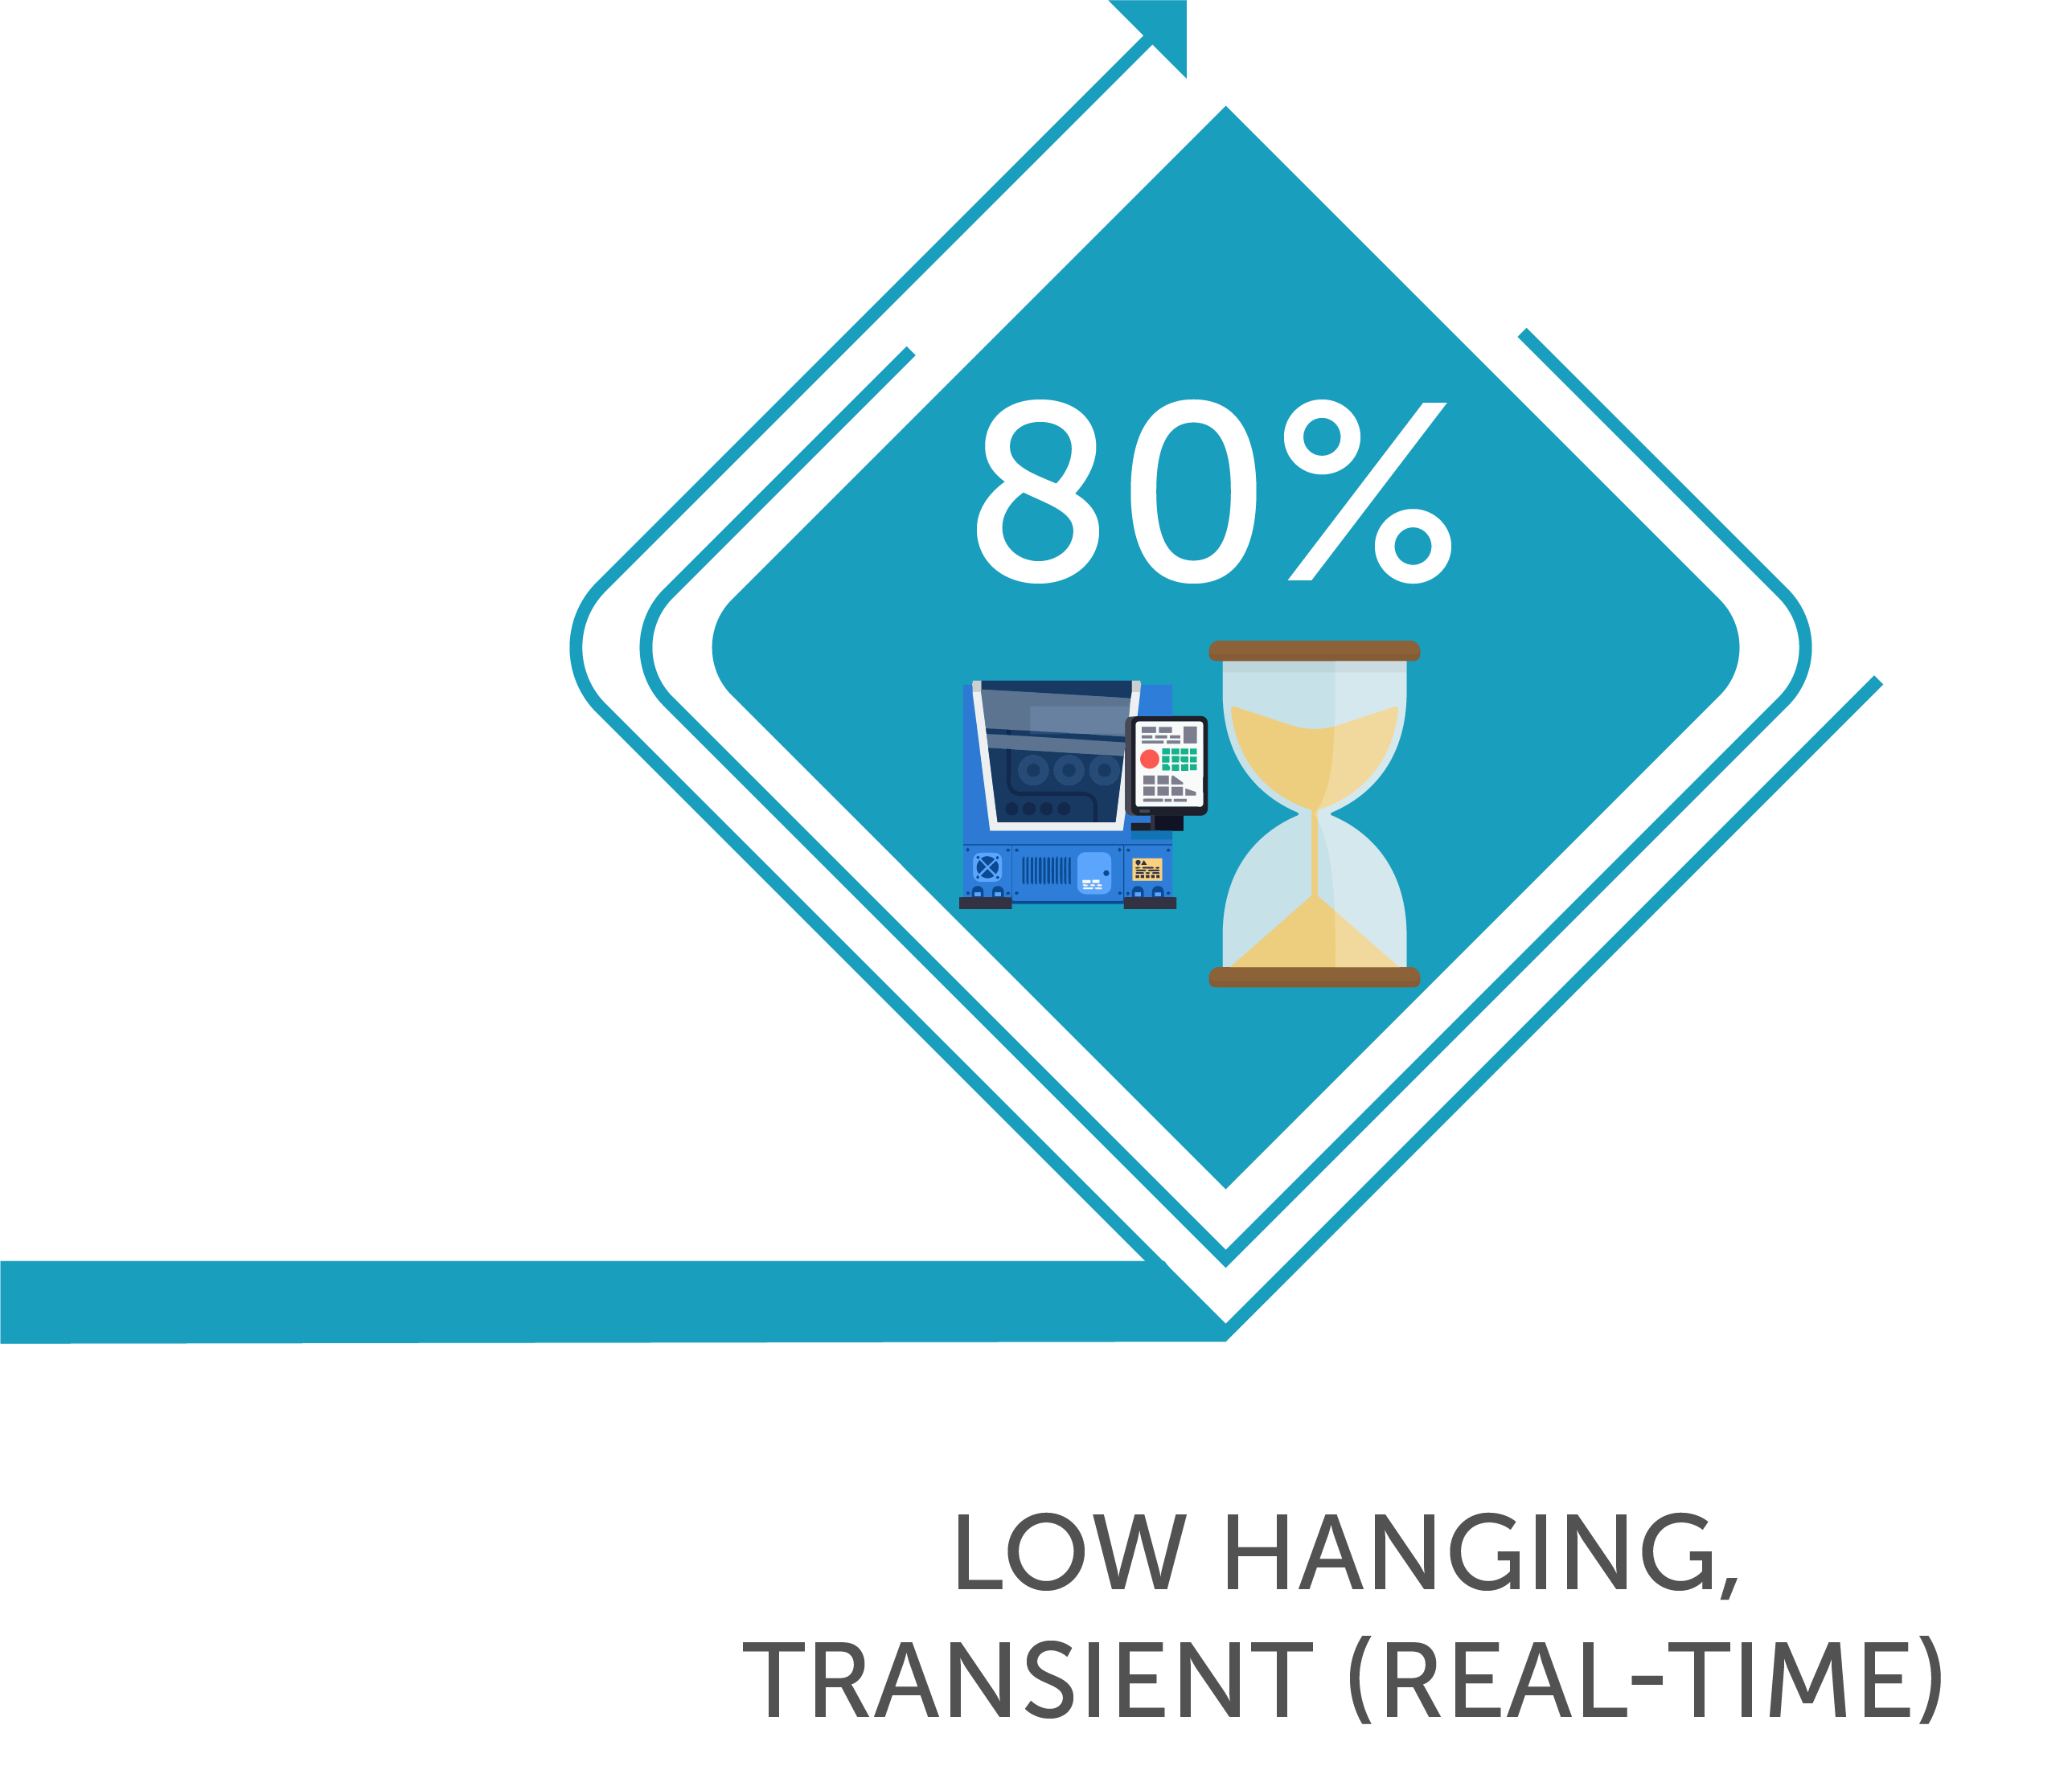
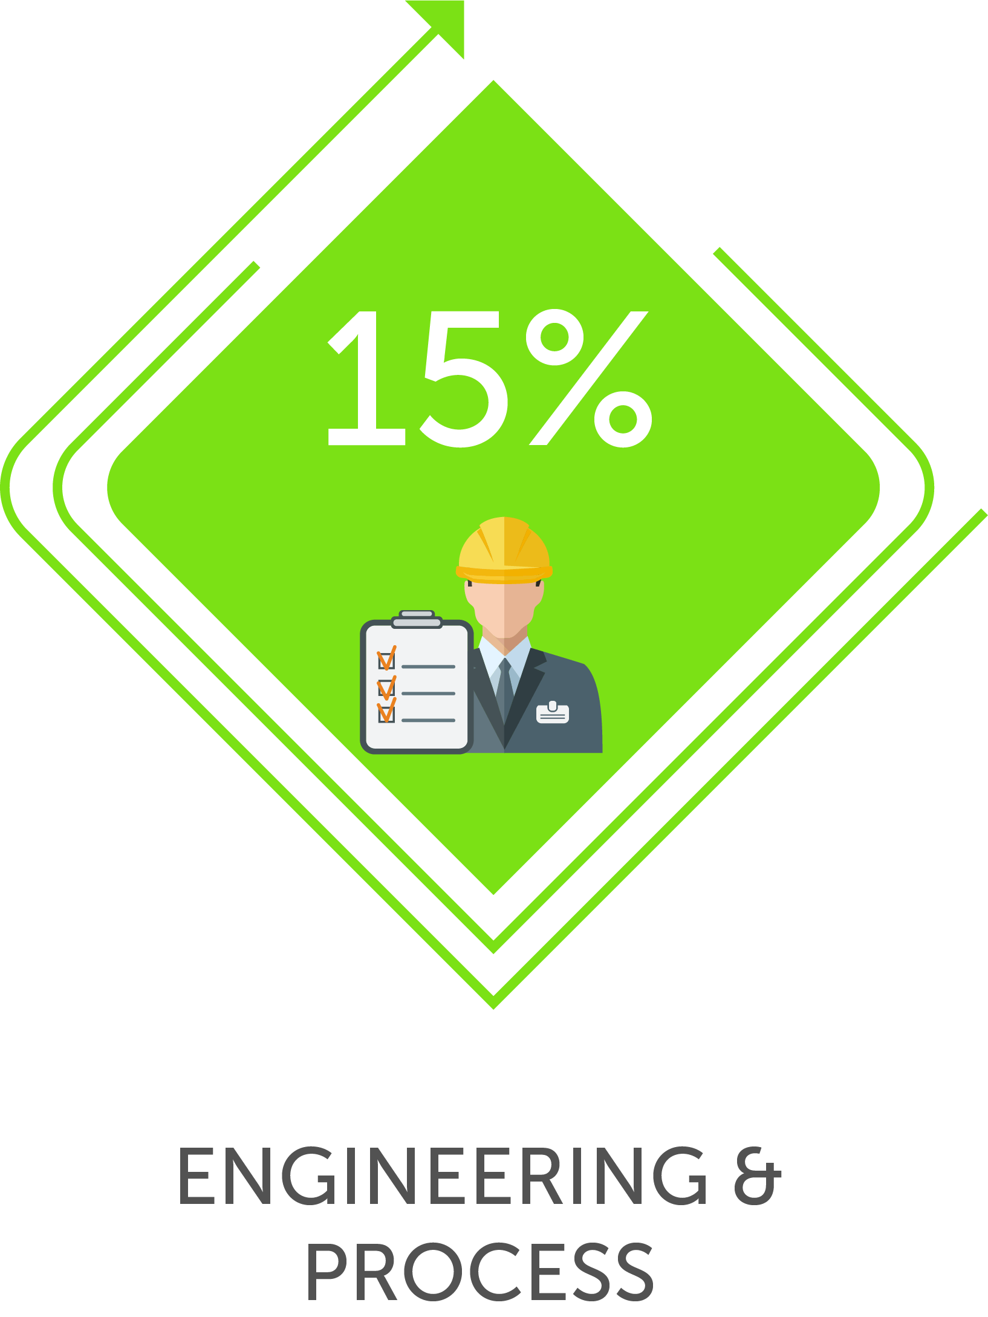
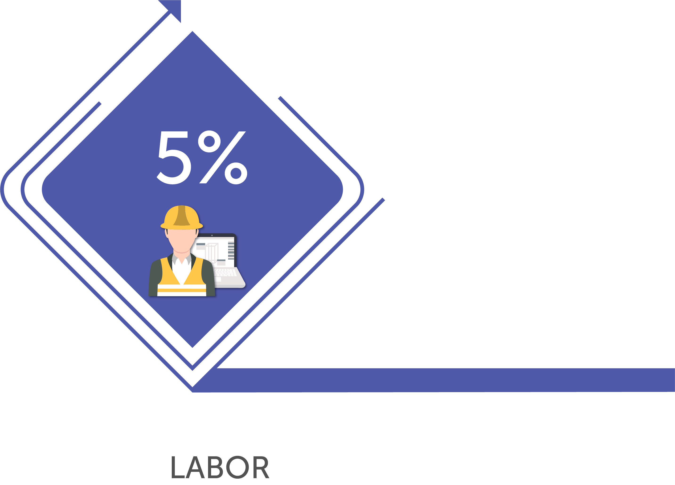

Slide 16
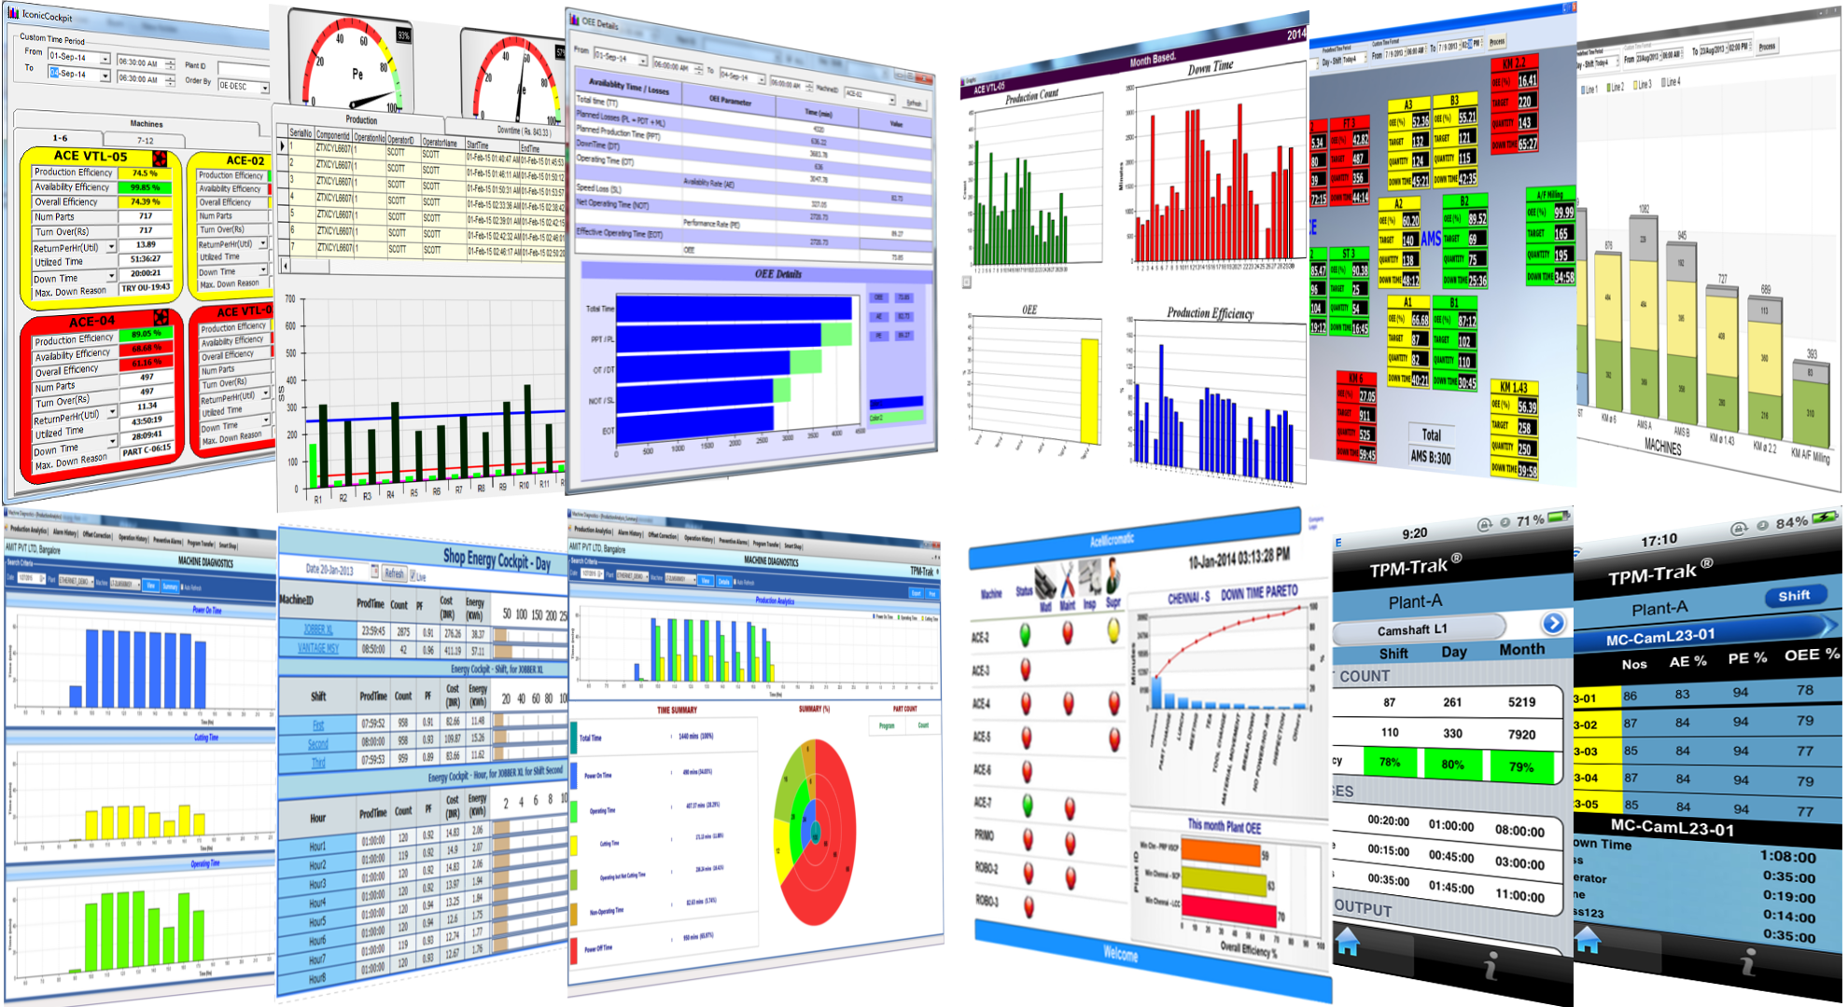

Slide 17
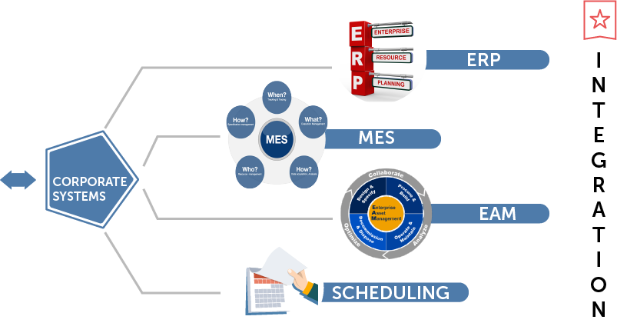
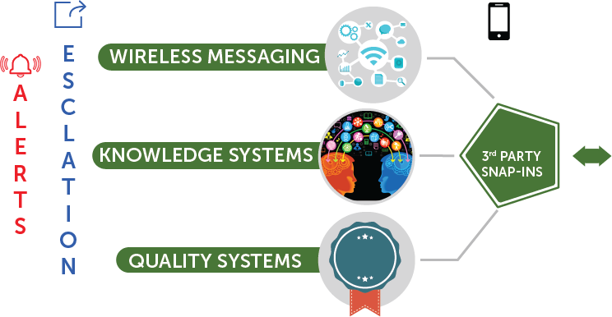

Slide 20
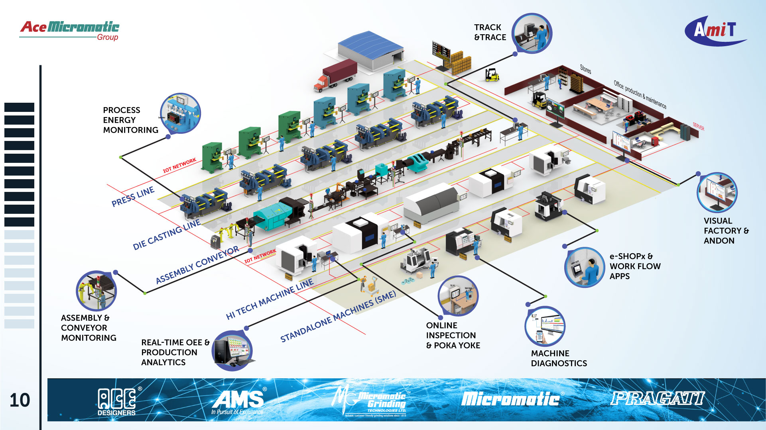
11

Slide 22
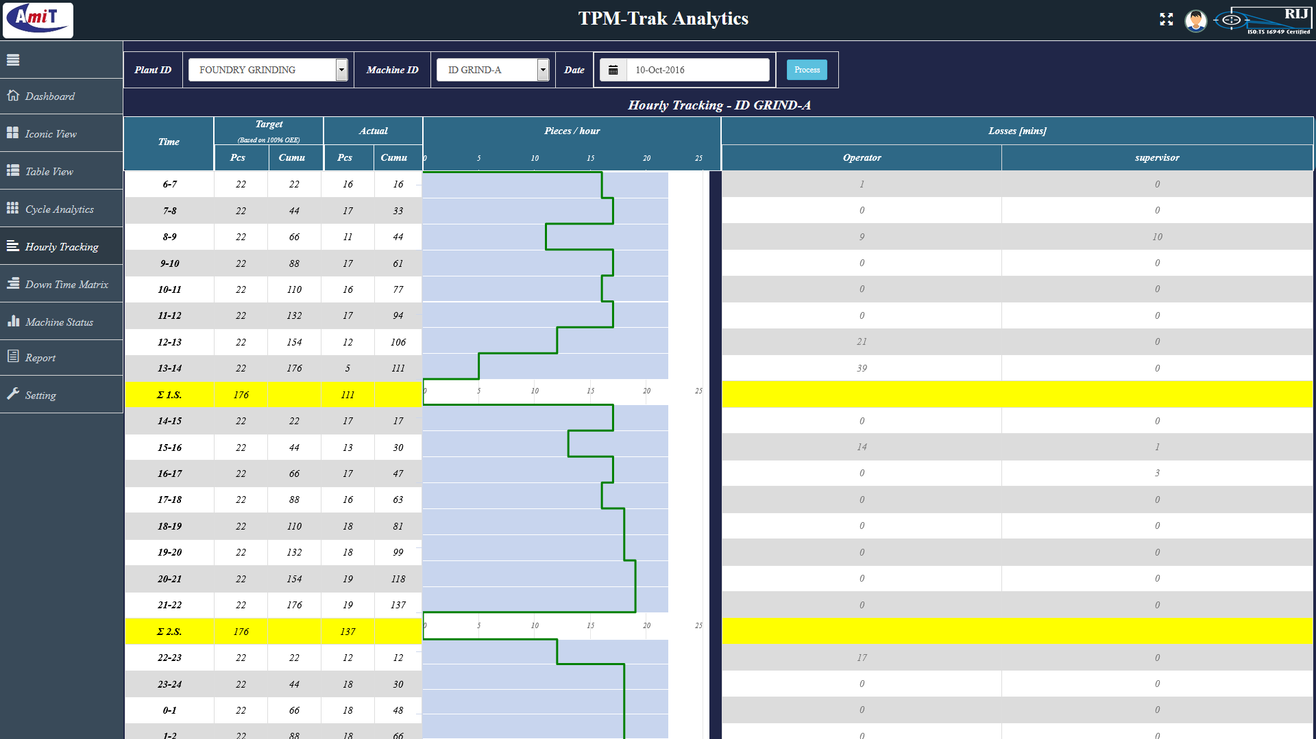

Slide 23
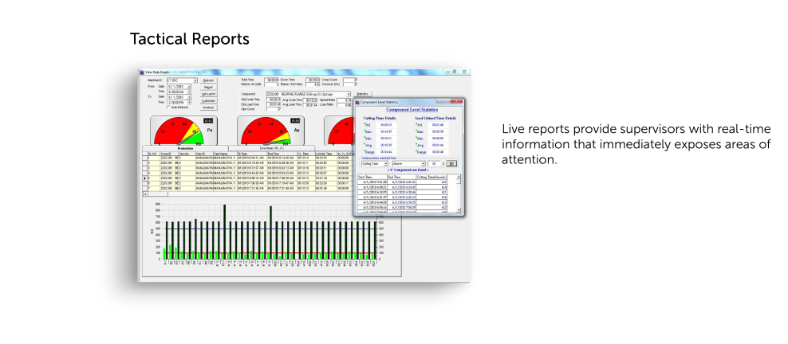

Slide 24
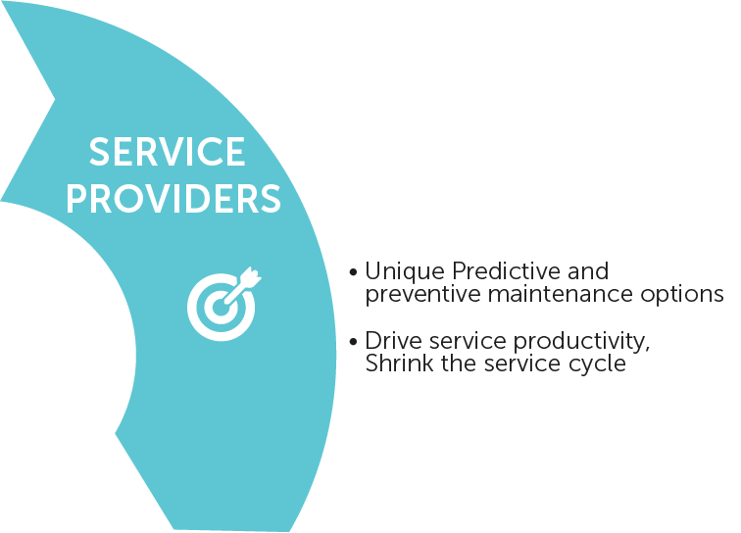
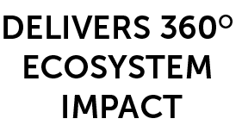
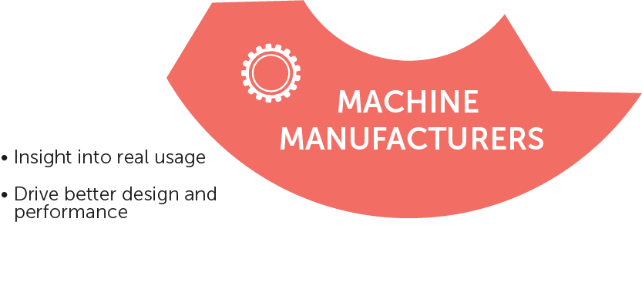

Slide 28
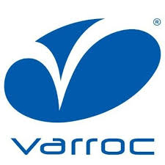
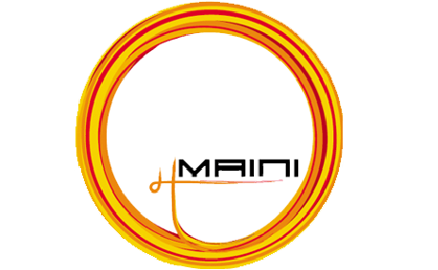

Slide 29
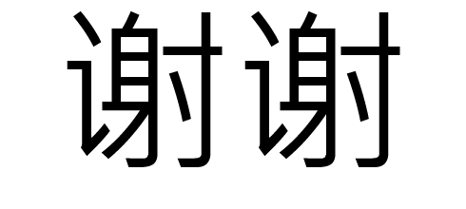

Slide 30
Industry 4.0 case study presentation by Triveni Turbines Ltd, Bangalore
By: Chandrashekhar D Shetty, G.M
Date: 26.10.18

Slide 31
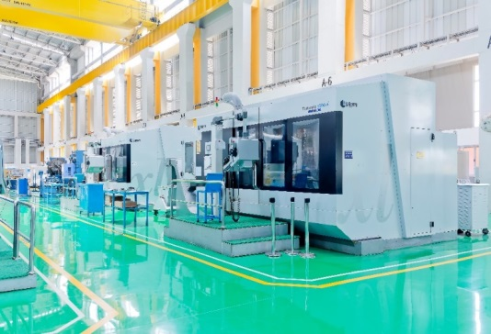
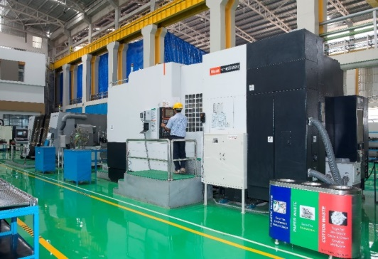
Over 3000 steam turbines installed globally
Over 12 GW power generation capacity
Presence in over 70 countries
One of the world’s largest manufacturers of steam turbines up to 30 MW range for providing industrial & renewable power solutions
Market leadership position in India, with around 60% market share for a decade
Joint Venture with General Electric (now BHGE), GE Triveni Ltd, with majority stake for the range above 30 MW to 100 MW

Slide 32
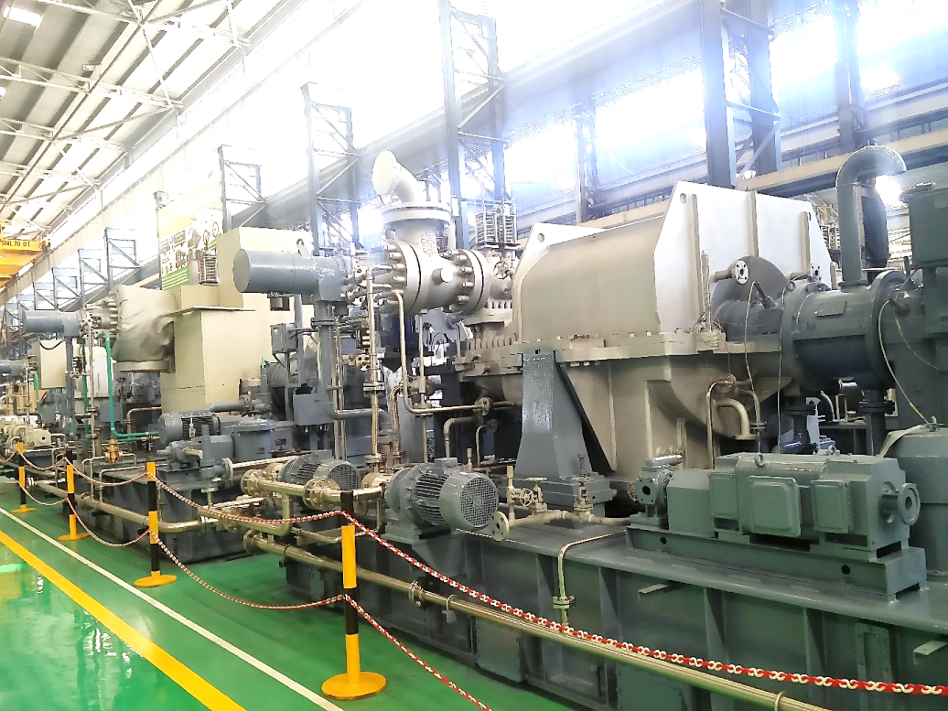
Reliable & Robust Steam Turbines
Robust back-pressure and condensing steam turbines up to 100 MW that work across a wide range of pressure and flow applications
Upto 30 MW
Upto 100 MW
Condensing Steam Turbines
Straight Condensing Type
Extraction Condensing Type
Bleed Condensing Type
Injection Condensing Type
Condensing Steam Turbines
Uncontrolled Extraction
Controlled Extraction
Back Pressure Steam Turbines
Straight Back Pressure Type
Extraction Back Pressure Type
Bleed Back Pressure Type
Back Pressure Steam Turbines
Uncontrolled Extraction
Controlled Extraction

Slide 33
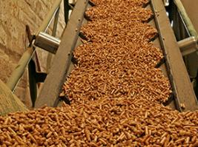
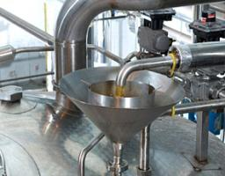
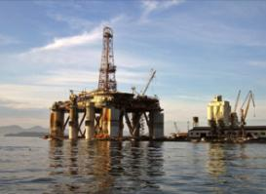
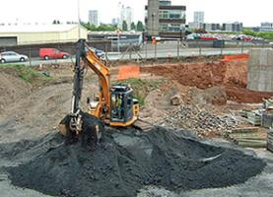
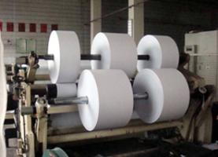
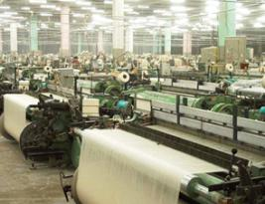
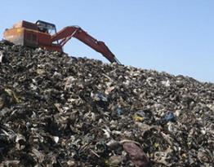
Industries
&
Applications
Sugar
Palm Oil
Biomass Power
Distillery
Oil & Gas
Cement
Paper
Textile
Waste to Energy
Food
Chemical
Steel
IPP – Barge Mount
Carbon Black
District Heating

Slide 34
New manufacturing facility & CNC shop

Slide 35
Triveni CNC Production Shop Overview
Machine Description | Components machined | No. of Shifts operating
VMCs – DMG / Makino | Turbine Blades | 3
HMCs - Mazak | Turbine Blades | 3
5-Axis Machines - Liechti | Turbine Blades | 3
Mill Turn Centres - WFL | Rotor Shaft | 3
Gantry Machines - Mitsubishi | Turbine Casings | 3
VTLs - WMW | Turbine Casings | 3
Turn Mills - Mazak | Laby Packing | 3
Total CAPEX installed > INR 50 CRORES

Slide 36
Top management drive
Top management drive to implement Industry 4.0 and digitization initiatives in our newly built state of the art factory at Bangalore

Slide 37
TPM-Trak® in Triveni
• Partnered with AceMicromatic
• Prototype implementation – 4 weeks
• Complete shop deployment – 8 weeks

Slide 38
Reports – On initial implementation

Slide 39
Data
Analysis –
Top 5
Downtime reasons

Slide 40
Data Analysis- Root causes
Waiting for CMM – As we need CMM inspection report for Ist piece qualification & subsequently every 5th blade, the blades are queued in CMM and machine has to wait till the report comes.
No Operator – Cause is absenteeism of operators.
Low air Pressure – Cause is not able to provide the required pressure and pressure was reduced when air was used for other purposes like cleaning.
Setting Time – Setting time taken average 2 hrs for blades & 8 hrs for shafts & casings.
Development time – This was due to frequent corrections in CNC programs, fixture fouling correction and tool interference.

Slide 41
Corrective Action- Implemented
For Top 5 Down times:
Waiting for CMM – This was reduced by procuring additional CMM machine and Trained the CNC operators for operating & Inspection in CMM.
No Operator – This was reduced by counseling with particular operators, New operator recruitment and multitasking of operators with different machine.
Low air Pressure – This was reduced by adding additional accumulator.
Setting Time – Setting time is reduced with SMED concept. Reduced by 50%
Development time – This was reduced by adding Vericut simulation software where the programs are checked before running on machine. Reduced by 40%

Slide 42
Comparison of results

Slide 43
Benefits from AceMicromatic TPM-Trak®
OEE increased from 35% to 66%
Productivity Increase by around 30%
Overall cost Saved per Year is Rs. 1.6 Crores!

Slide 44
e-SHOPx™ Digital Factory
Before
After
Production Documents
Job card, Drawings, Process sheets, Programs, Check sheets and tool data sheets.

Slide 45
e-SHOPx™ Digital Factory
Results:
Savings on Print Cost & Average of 500 papers per month.
Documents are centrally stored in server with latest revision index
Overall cost saving of average Rs. 10 lakh per annum
User feedback on e-SHOPx:
Faster communication to the Shop floor
Paperless production shop

Slide 46
Process Parameters Monitoring (eg. Energy)
Benefits:
Measure energy consumed by each machine
Accurately measure energy cost per part
Identify changes in energy usage profile from set targets, and areas of improvement
Reduce energy losses
Improve machine and process performance

