Slide 1
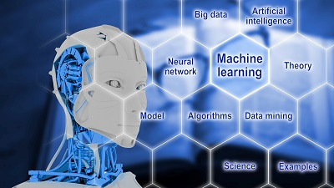
Artificial Intelligence in Manufacturing
Dr. Ganesh Natarajan

Slide 2
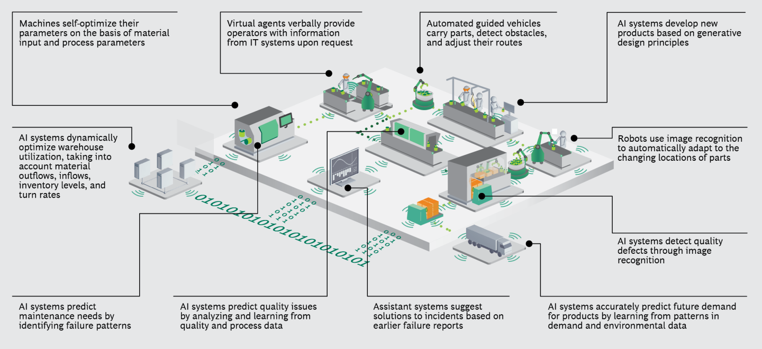
The Factory of the Future
Source: BCG

Slide 3
Trends shaping the Manufacturing sector – AI and Advanced Analytics is at the core of Smart Manufacturing
Predictive Maintenance
Human Robotics Collaborative Ecosystems
Using the power of machine learning to provide manufacturers with contextual insight and intelligence based on data captured form machinery performance and processes across the plant floor.
New generation of robotics capable of image and speech recognition are taking over precision operations in the factory with human workers undertaking higher-level jobs such as programming, maintaining and coordinating robotic operations.
Demand Forecasting and Inventory optimization
Intelligent Factory Operations
AI is defining Manufacturing
IoT is revolutionizing many aspects of manufacturing operations including real-time production monitoring, improving the accuracy of key metrics including Overall Equipment Effectiveness (OEE), production yield rates and production efficiency.
Robust demand forecasting based on critical demand drivers; improved decision making through structured scenario analysis. Inventory optimization using statistical modelling
techniques to perform inventory stock level vs lost sales scenario analysis
Intelligent data security solutions
Application of Digital Twins
The role of cybersecurity becomes even more essential today as significant operational risks for connected, smart manufacturing, digital supply networks, and entire manufacturing ecosystems emerge, highlighting risks at the intersection of cyber and physical infrastructure.
The Digital design, simulation, and integration (DDSI) market are predicted to grow from $25B in 2016 to $45B in 2021. Simulation will enable the virtual testing of plant production system at planning stage to prevent any potential faults.
Source: News Analysis, PWC, BCG

Slide 4
Roadmap for developing the AI and Analytics Strategy
01
02
03
Understand your starting position
Find a Champion
Define your strategy
Understand the consumer expectations and then review your current maturity and identify areas for improvement
Identify the right leader to sponsor innovation and change. Your COO, CFO, and CDO can help minimize internal resistance and define your new organization as you start to implement changes.
Determine your target maturity level and the vision that best supports your business strategy
06
05
04
Segmented rollout and
capability development
Deploy small pilots
Develop the appropriate road map
These “lighthouse” projects should aim at testing the end-to-end flow for a specific function, rather than implementing a limited set of technologies on a broader scale
Settle on the necessary implementation steps and work them into a detailed road map
After a successful pilot, the rollout should start with those business areas where expected benefit is highest.

Slide 5
e-mail : ganeshn@5fworld.com

Slide 6
Thank You !

