Slide 1
Industrie 4.0 - from vision to implementation Dr. Norbert Gaus | October 26, 2018 4th CII Smart Manufacturing Summit 2018
siemens.com/innovation
Restricted © Siemens AG 2018

Slide 2
Digitalization is changing everything …
…and needs a holistic approach
15_84 77_84 80_84
Design
Operate
Service
Value creation processes Smart factory, smart plant, smart buildings
IoT – Consulting & Integration
Siemens software and digital services
Digitally enhanced products Smart products and solutions
MindSphere – the IoT operating system
Digitally optimized automation and electrification
Business models Smart services
Digital twin (products and infrastructure)

Slide 3
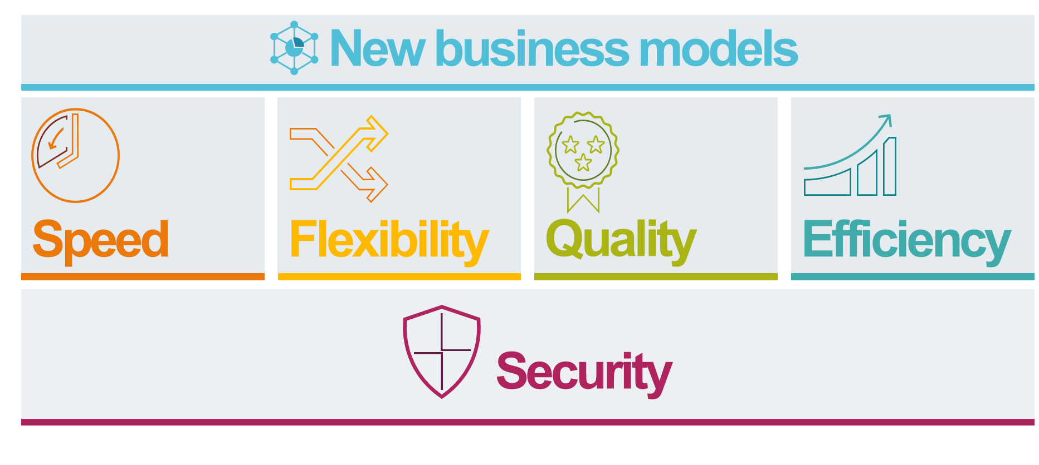
Industrie 4.0 is driven by the needs of our customers
Customer needs
Future of Automation
From automated towards autonomous systems
Enabling Technology
…

Slide 4
Let’s make it tangible!

Slide 5
Edge devices bring intelligence, flexibility and fast innovation
281_84 7_84 590_84 591_84
Edge Management
Device Management
App-Management
App-Store
Apps
In-Cloud (Cloud level)
MindSphere
Edge Apps developed by Siemens, customers, partners (OEM), 3rd-party
Selected data: M2M communication, non RT optimization,…
Selected data
(Edge-) Apps
In-Machine (Field/Edge level)
Edge Devices
Secure and decoupled edge runtime infrastructure for edge apps
Local activity
High frequency
data
Field device
Edge device
Notes:
Edge Management: centralized infrastructure, to manage and administrate all connected Edge-Devices: condition monitoring, installing Edge-Apps and therefore deploying cloud functions to the cloud to the field level.
Edge-Apps: Apps of Siemens, Partners or consumers – Executing functionality locally on Edge-Devices.
Edge-Devices: Collecting and Processing of data – at the source
Possible application scenarios of Edge Computing:
SINUMERIK EDGE: Intelligent workpiece analysis based on it‘s digital twin
SIMATIC EDGE: Inventory listing of connected automation components

Slide 6
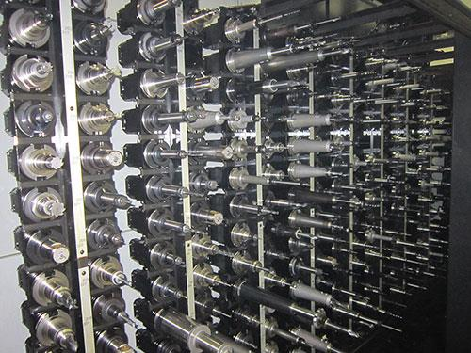
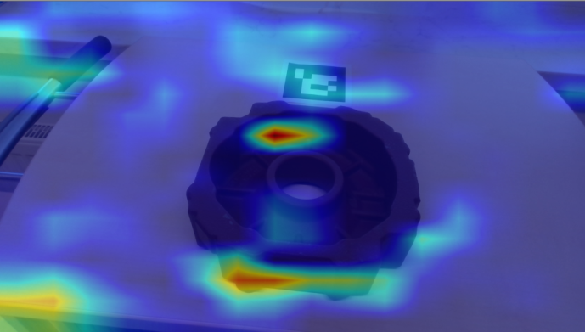
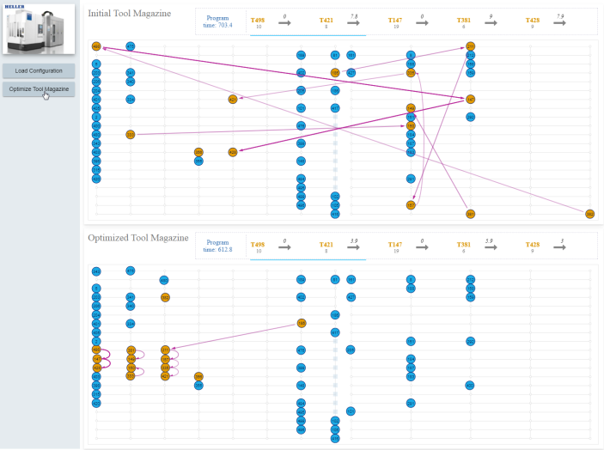
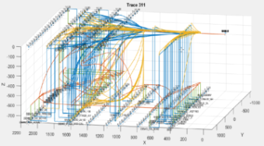
SINUMERIK Edge – an open system to provide local machine intelligence as add-on functionality
PoC
Manage MyResources / magazine optimization
Analyze MyWorkpiece
Optimize tool placement in large magazines
Shortened idle times in machining
Machine awareness: detecting incorrect or displaced workpieces
Preventing machine damages and faulty workpieces
Notes:
Example 1: Edge App – Operation optimization
Magazine optimization
Shortening idle times in machining – machine performance improvement
Add-on functionality of a CNC Machine – also for brown field
Program dependent tool placement optimization in large magazines utilizing advanced mathematical optimization
CPU intensive calculation on the SINUMERIK Edge
Technology: advanced optimization
Status: PoC study/in-development
Release: Incubation starting in Q1 FY19
Example 1: Safety analytics
Workpiece displacement
Preventing machine damages and faulty workpieces – machine availability improvement
Add-on functionality of a CNC Machine – also for brown field
Machine awareness – detection of incorrect or displaced (e.g., rotated) workpieces in a machine before machining started
CPU intensive calculation per-formed on the SINUMERIK Edge
Technology: MI Core Engine image analytics & deep neural networks
Status: PoC study/in-development
Release: Incubation starting in Q2 FY19

Slide 7
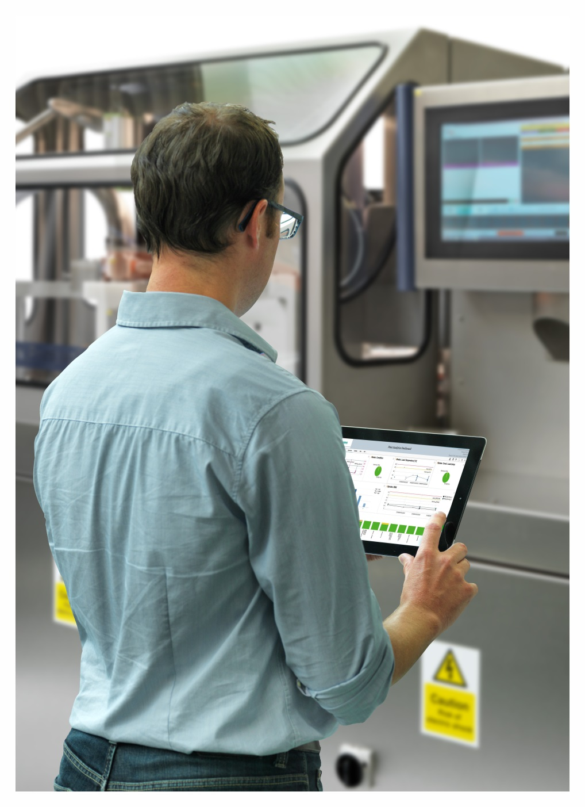
Implementing “data driven services” to optimize service delivery and to generate new business
Motivation
Optimizing service delivery via remote access
New service offerings and new business models
End-customer benefit
Higher uptime, more efficient service
Faster access to innovation
Implementation – connecting assets to Mindsphere
Providing/implementing basic network connectivity to assets where not yet available
Configuration to allow remote access
Mindsphere enables connectivity and provides applications for Industrie 4.0 businesses
Notes:
Example 1: Edge App – Operation optimization
Workpiece displacement
Shortening idle times in machining – machine performance improvement
Add-on functionality of a CNC Machine – also for brown field
Program dependent tool placement optimization in large magazines utilizing advanced mathematical optimization
CPU intensive calculation on the SINUMERIK Edge
Technology: advanced optimization
Status: PoC study/in-development
Release: Incubation starting in Q1 FY19
Example 1: Safety analytics
Workpiece displacement
Preventing machine damages and faulty workpieces – machine availability improvement
Add-on functionality of a CNC Machine – also for brown field
Machine awareness – detection of incorrect or displaced (e.g., rotated) workpieces in a machine before machining started
CPU intensive calculation per-formed on the SINUMERIK Edge
Technology: MI Core Engine image analytics & deep neural networks
Status: PoC study/in-development
Release: Incubation starting in Q2 FY19
Ein mittelständischer Hersteller von Maschinen für die Druckindustrie hat über die letzten Jahre Maschinen an Kunden, die überall auf der Welt verteilt sind, verkauft. Die Nutzer dieser Maschinen sind im Fehlerfall darauf angewiesen, dass der Hersteller der Maschinen vor Ort eingreift, denn in der Vergangenheit wurde ein Fernzugriff auf die Maschinen nicht diskutiert. Der Hersteller der Maschine hatte bisher auch nicht die Fähigkeiten, einen im Hinblick auf Aufwand/Nutzen adäquaten Fernzugriff auf die von ihm gelieferten Maschinen einzurichten. Unter Nutzung von Siemens MindSphere kann er nun solch einen Fernzugriff realisieren und hat zusätzlich die Möglichkeit, über Software-Applikationen die weltweit verteilten Maschinen automatisiert zu überwachen. So kann er die Dienstleistungserbringung seinen Kunden gegenüber optimieren. Er erwartet eine Erhöhung der Fehlerfallbehebung über Fernzugriff um 20% und eine zusätzliche Einnahmequelle durch das Abonnieren der automatisierten Überwachungs-Dienstleistung.
What has to be done?
Nanobox (industrial grade PC with adjusted functionality – can be described as an “edge device” with “gateway fucnctionality) will be connected via Ethernet to the machine. If use of SIMTIAC S7-1500 Nanobox not needed. Function blocks for connectivity available
Nanobox directly connected to MindSphere “automatically” , if the network infrastructure from customer has connectivity to cloud and on-boarding to MindSphere was established
Customer has to map his internal machine specific data to what he wants to share or needed e.g. maintenance.
Customer can download his own “mapping” app on MindSphere
System is running
Normally the step a/b/d takes less than 1 hour if customer network is properly configured (e.g. cloud connectivity). Of course to install a serie of machines needs in average much less than 1 hour!
Step c is depending on the customer machine specific data and which data the customer wants to share
PS if the machine has e.g. OPC UA server fucntionality connectivity can be achieved to MindSphere “directly”

Slide 8
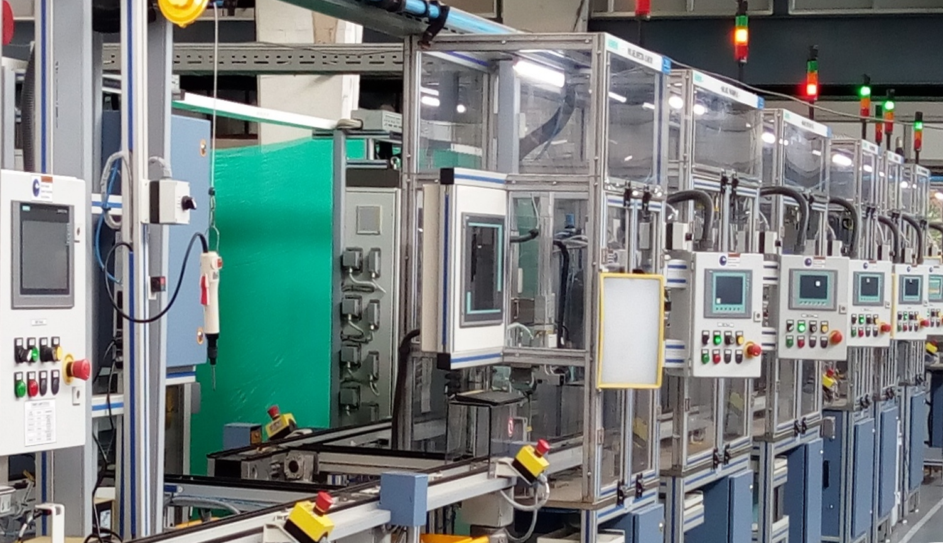
Industrie 4.0 @ work in India – transforming the manufacturing process of low voltage switchgear at Kalwa Works
>180 product
variants in 1 line
~9 sec cycle time in spite of varied product-mix
68 quality parameters
check in 9 secs
Local for local & global market

Slide 9
Connectivity and a structured approach to data are driving forces towards Industrie 4.0

Slide 10
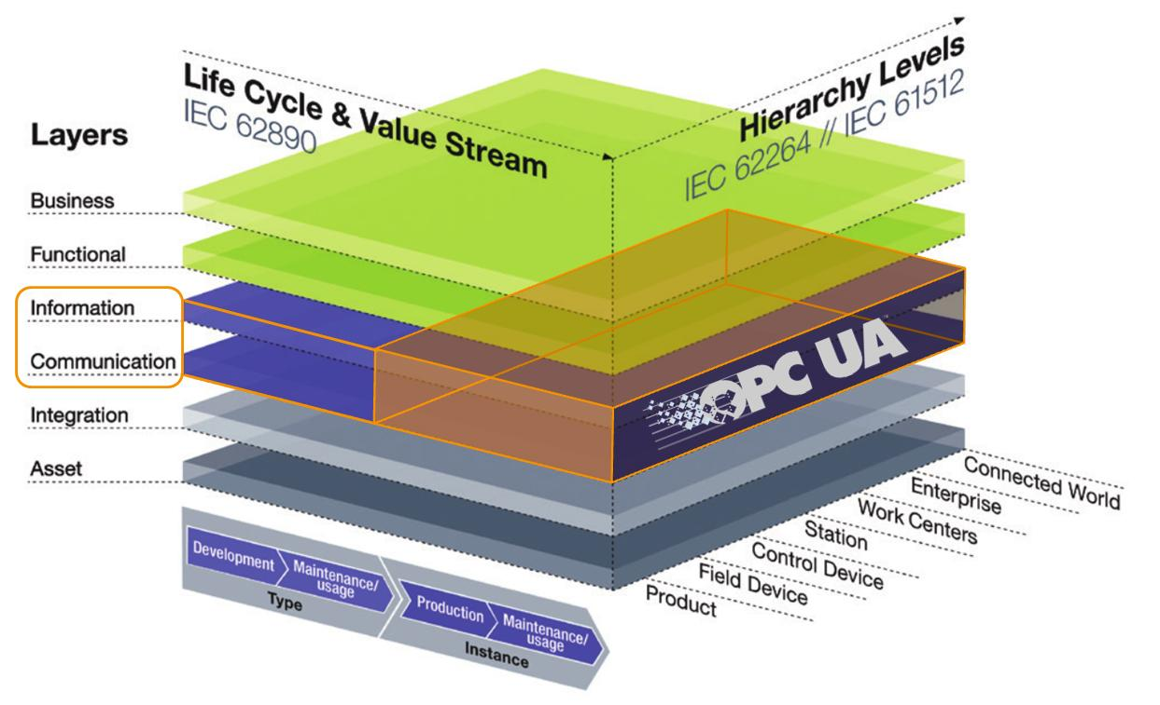
OPC-UA as THE backbone for communication and information modeling – Industrie 4.0 is becoming reality
Standardized Communication „How“
OPC UA: from OPC Foundation, Open Source
Standardized, the leading IoT standard in the manufacturing industry
basic prerequisite: IP based network
Modeling data structures „What“
Standardized information models: core functionality of machines from different vendors
standardized to enable easy integration, uniform usage and interoperability
provided by industry associations
Beispiel T.Hahn
Source: VDMA, VDW, ZVEI, Plattform Industrie 4.0, Labs Network Industrie 4.0, Standardization Council Industrie 4.0, OPC Foundation

Slide 11
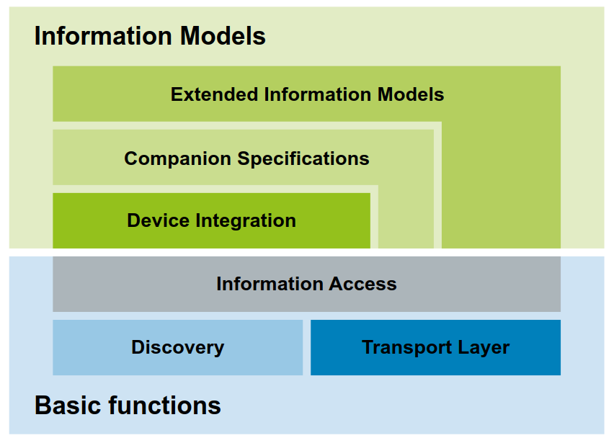
Connecting assets and enhancing data with context – the key to a successful Industrie 4.0 / Digitalization strategy
OPC UA Connectivity
Platform independence and OpenSource code stacks
Scalability through profiles
Built in security features
Standard internet based protocols
OPC UA Companion Specification: standardized information models
E.g. for robotics, plastics and rubber machines, machine tools and manufacturing systems, machine vision, electrical automation, integrated assembly solutions, …
OEM specific extensions possible
Source: Industrie 4.0 Communication Guideline Based on OPC UA • VDMA • Fraunhofer IOSB-INA • 2017

Slide 12
4 steps to a successful OPC-UA implementation – Implementation guideline available from VDMA
Source: Industrie 4.0 Communication Guideline Based on OPC UA • VDMA • Fraunhofer IOSB-INA • 2017
https://industrie40.vdma.org/documents/4214230/20743172/Leitfaden_OPC_UA_Englisch_1506415735965.pdf/a2181ec7-a325-44c0-99d2-7332480de281
Notes:
How to do this…
Setup/configure the network
Manage certificates and access rights
Configure communication
Model information
First Migration Step
Industrie 4.0 communication based on OPC UA can be implemented step by step. Basic prerequisite for Industrie 4.0 communication based on OPC UA is a network based on the Internet Protocol (IP). If an IP based network exists, OPC UA can be used as a uniform inter-face to access information from machines from different manufacturers. For example, condition monitoring systems can access information from machines via Industrie 4.0 communication. In a first step, relevant parameters for machine or system monitoring are manually integrated into the condition monitoring system. This approach is already beneficial compared to today’s integration via many different communication solutions.
Second Migration Step
In a next migration step, the use case plug & work is made possible by using standardized information models, so called Companion Specifications for OPC UA. The core functionality of machines and plants from different vendors is modeled equally to enable identical integration and usage of these machines. More and more operators request this interoperability, for example from plastic and rubber machines and devices for automatic identification via RFID.
Third Migration Step
In a third migration step, an extended information model can contain functionality that should not be standardized. This way, also in Industrie 4.0 machines and systems will differ in terms of performance and efficiency. It is not intended to standardize all aspects of machines and systems. Expertise of machine and plant builders, e.g. functions for the optimization of their machines, can be granularly protected by role-based authorization in OPC UA.

Slide 13
Industrie 4.0 is becoming reality with OPC-UA as its backbone for communication and information modeling
Framework
Implementation
To provide industry knowledge
Source: VDMA, VDW, ZVEI, Plattform Industrie 4.0, Labs Network Industrie 4.0, Standardization Council Industrie 4.0, OPC Foundation

Slide 14
Industrie 4.0 has become a worldwide effort for the manufacturing industry

Slide 15
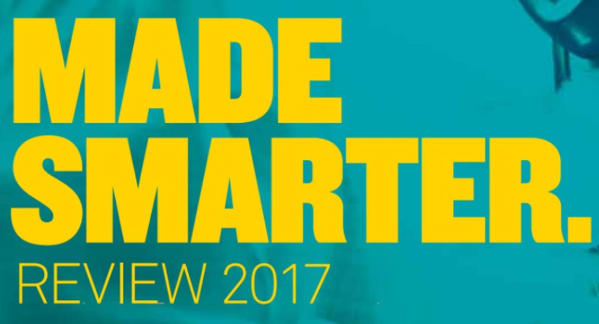
“Industrie 4.0” for India – first steps achieved
10_84
Plattform Industrie 4.0 and Siemens cooperates with all these initiatives worldwide
OPC Foundation hub in India founded October 23rd at the
OPC day in Bengaluru, hub is hosted by Siemens in strong cooperation with CII and others industrial partners
and many others…
CII can take the lead to build a systematic approach to Industrie 4.0 in India
Industry must transform on a global scale – reaching out for international collaboration
Notes:
http://corporate.siemens.com.au/en/home/news-centre/press-releases/australian-german-agreement-modernise-manufacturing.html
https://industry.gov.au/industry/Industry-4-0/Pages/PMs-Industry-4-0-Taskforce.aspx

Slide 16
Thank you.
siemens.com/innovation
Restricted © Siemens AG 2018

