Slide 1
Smart Manufacturing with 3D Printing
Rajiv Bajaj

Slide 2
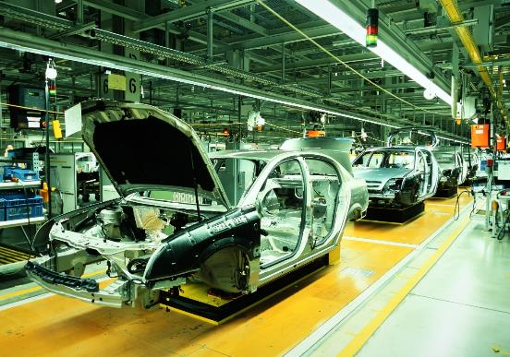
TODAY’S MANUFACTURING SCENARIO
Today’s world of mass production is based on one simple rule: the more things you make, the lower the cost of each of those things
This equation is literally pushed to its extreme limits
Henry Ford Perfected the model of mass production and by 1915 he had reduced the time it took to build an automobile by 90%
The Famous Statement !!!!
Mass production is not the end of this story, but rather just a stop along the way to something completely different. What if a technology came along that could turn everything upside down all over again?

Slide 3

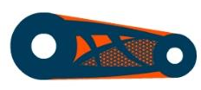


3D PRINTING ENABLES THE SHIFT OF DESIGN CONTEXT TO A HIGHER LEVEL – FROM SINGLE COMPONENTS TO SYSTEMS
Consolidation
Multi-functionality
Design Freedom
DFM to DFAM
Building a design environment that enforces shifting the context of design from the start.
Notes:
Our internal development teams are also working with our software partners like Siemens, PTC and Dassault, to build design environments for additive.
Better tools are needed to provide the ability to consolidate assemblies or systems into singular or lower part count components for additive manufacturing.
Design thinking and toolsets to easily enable multi-functionality can improve designs. For example, an antenna can include embedded circuitry as well as integrated structural bracketry.
The design freedom of additive manufacturing can improve aerodynamics, acoustics, or fluid flow.
Design for additive manufacturing tools that can simulate and design for the process, can unlock advanced, light weight, high strength geometries and topologies, or eliminate non-cost-effective and potentially poor performing parts.
Working with our partners and customers on specific application requirements we are working to bring the context of design to a higher level – from single components to systems.

Slide 4
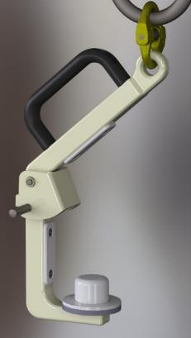
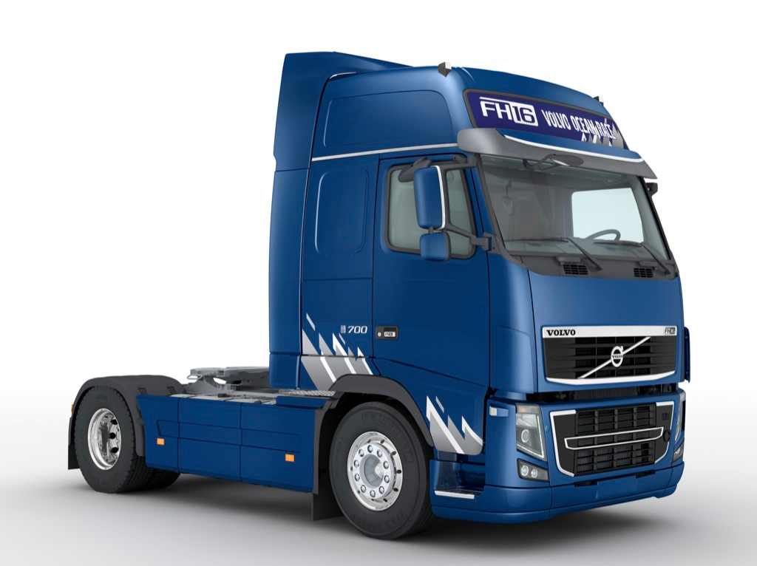
Automotive - Manufacturing Tools
Volvo Trucks replacing metal lift tool with thermoplastic tool
From 28 Traditional to 6 FDM Components
Notes:
Volvo replaced metal lift tool with thermoplastic tool reducing weight and complexity, while improving safety and standardization
From 28 components to 2
Thermoplastic part can lift 550kg or 1212 lbs
Integrated sensors to improve safety
Instantly distributed for production at facilities worldwide

Slide 5

Smart Factory Solutions with 3D Printing

Slide 6
INNOVATION FOR THE DIGITAL FACTORY WITH HONDA CARS INDIA

Slide 7


Smart Manufacturing
with 3D Printing

Slide 8
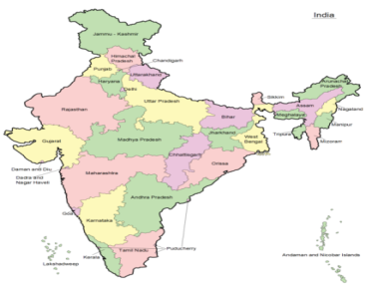
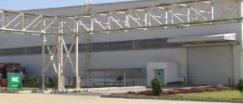
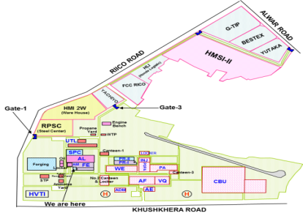
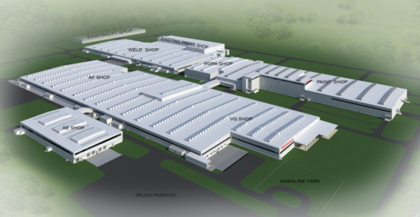





Introduction
PLANT OVERVIEW
2
HCIL – GNU
WELDING
TKR WELD SHOP
WELDING-TKR
HCIL – TKR
HCIL – TKR
LOCATION
FRAME DIVISION
ALWAR, RAJASTHAN
APPROX 67 KMS FROM
NEW DELHI
JOURNEY STARTED
3RD May 2007
AREA
TOTAL AREA - 611 ACRES
HCIL – 437 ACRES,
SUPPLIERS AREA - 174 AREA
PRODUCT
AMAZE,CITY,JAZZ,BRV,WRV,.
Amaze
City
Jazz
BRV
WRV
WELDING IS PART OF FRAME DIVISION

Slide 9
Agenda
Innovation on Shop floor with 3D Printing
Line Layout & Importance of Q checking assists
Current SA & DA for 3D printing Introduction
Methodology and Scope Fixation
Project Execution & Implementation
Learning's & Benefits of 3D printing
Way Forward…..

Slide 10
Agenda
Innovation on Shop floor with 3D Printing
Line Layout & Importance of Q checking assists
Current SA & DA for 3D printing Introduction
Methodology and Scope Fixation
Project Execution & Implementation
Learning's & Benefits of 3D printing
Way Forward…..

Slide 11
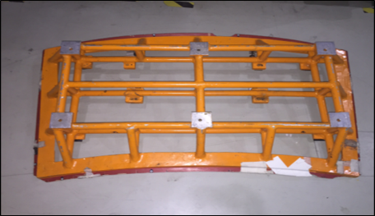
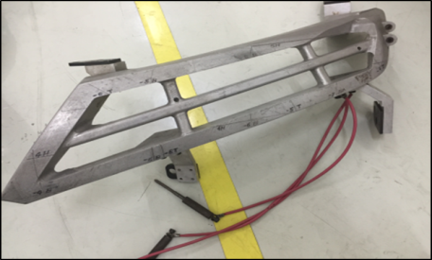
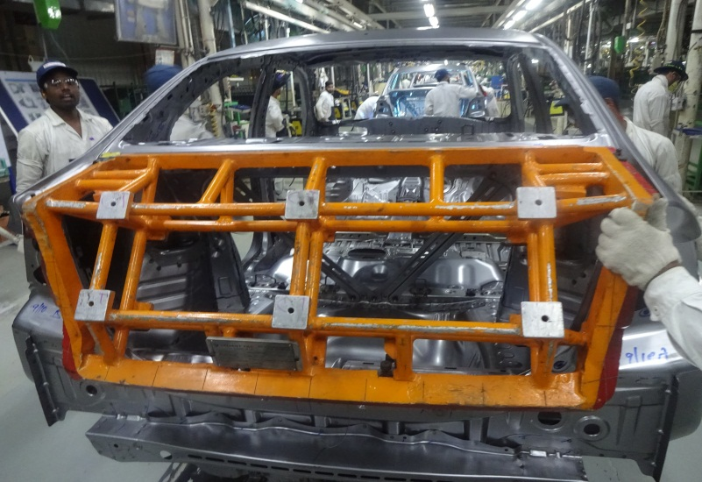
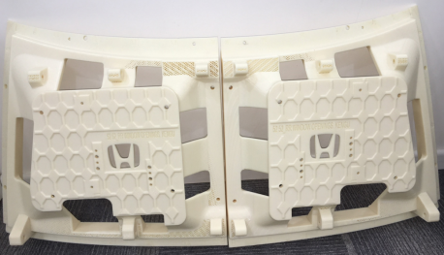
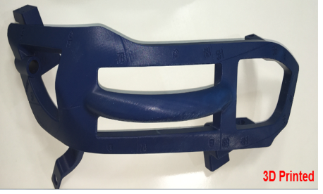
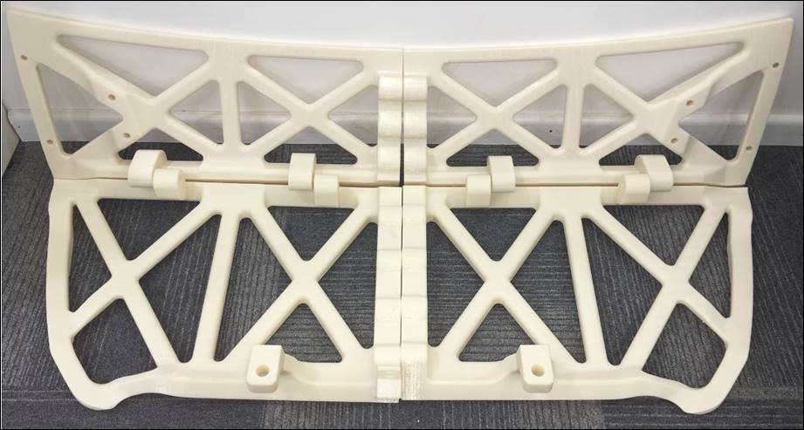
Innovation on Shop floor with 3D printing
Car Windshield mounting dimension verification Jig
Car Headlights mounting dimension verification Jig
Trunk lid mounting dimension verification Jig
Conventional
(Made of Metal & Ciba)
3D Printed
(Made of Thermo-Plastics)
INSPECTION JIGS CONVERTED TO 3D PRINTED JIGS

Slide 12
Agenda
Innovation on Shop floor with 3D Printing
Line Layout & Importance of Q checking assists
Current SA & DA for 3D printing Introduction
Methodology and Scope Fixation
Project Execution & Implementation
Learning's & Benefits of 3D printing
Way Forward…..

Slide 13
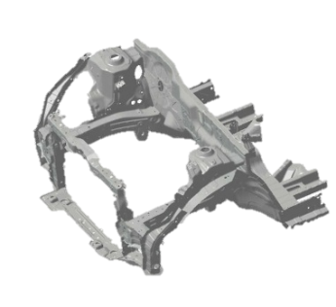
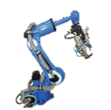
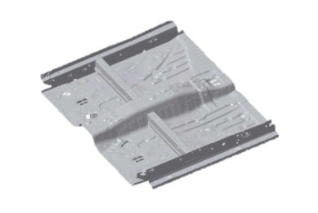
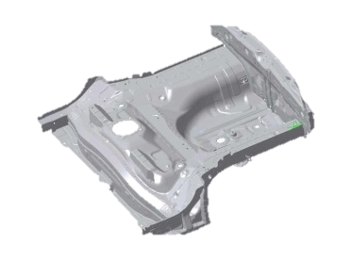
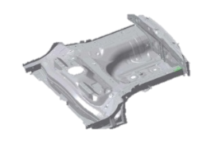
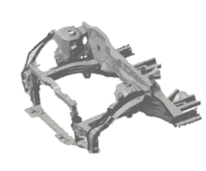
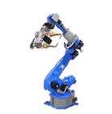
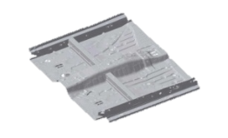
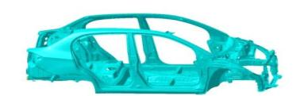
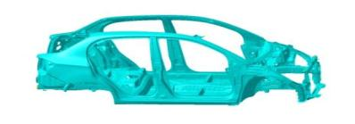
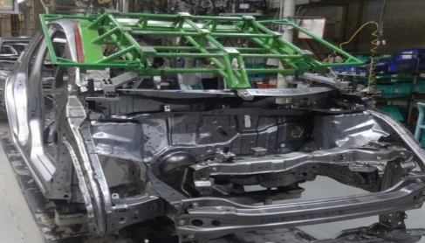
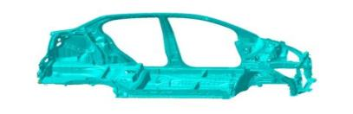
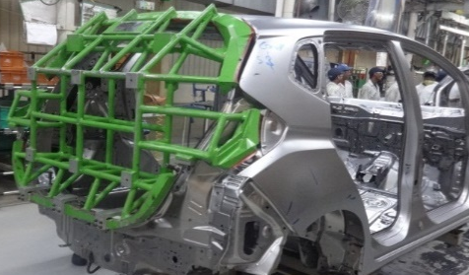
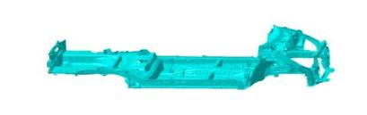
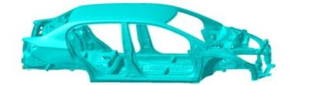
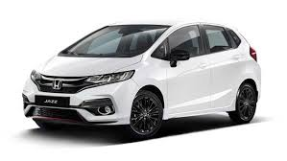
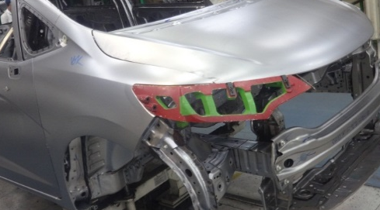
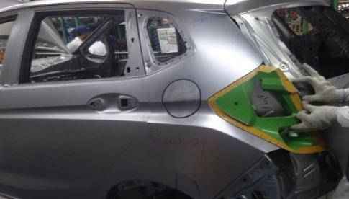

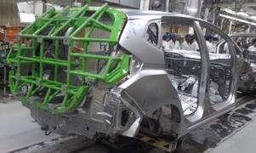
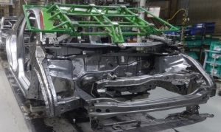
Weld Shop- Line Layout
PROCESS FLOW:
FRONT COMP
FRONT FLOOR
REAR FLOOR
FRONT WINDSHIELD INSPECTION
TAIL GATE INSPECTION
INSPECTION WITH CONVENTIONAL JIGS
A Zone
HEAD LIGHT INSPECTION
TAIL LIGHT INSPECTION
LOADING
PRESET
GW - AUTOMATION LINE
With Different processes and part variations → variation possibilities are there
Various equipment's are used to verify critical dimensions of car body→ To ensure CBU assurance from welding shop
CBU Assurance inside welding shop with Conventional tools
Head Light
Tail Gate
Front Windshield
ADEQUATE CONTROLS IN PLACE TO ENSURE STANDARDISED OUTPUT

Slide 14
Agenda
Innovation on Shop floor with 3D Printing
Line Layout & Importance of Q checking assists
Current SA & DA for 3D printing Introduction
Methodology and Scope Fixation
Project Execution & Implementation
Learning's & Benefits of 3D printing
Way Forward…..

Slide 15

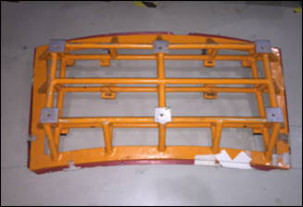
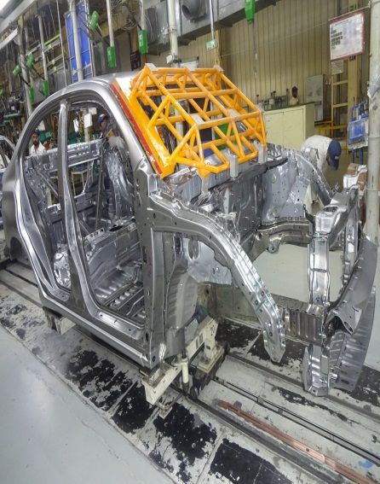

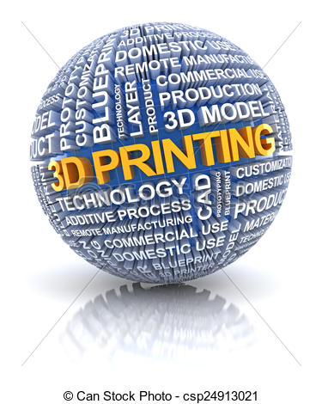

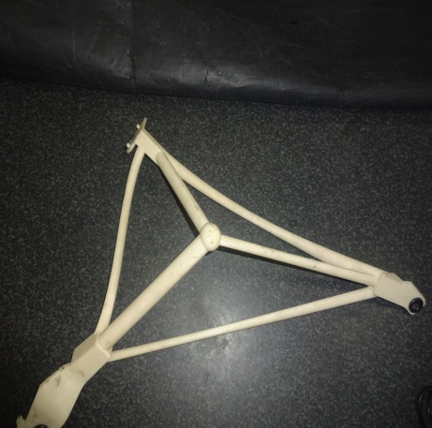
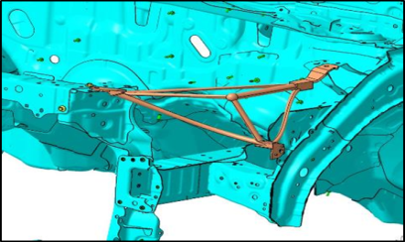
Weld Shop-Situation Analysis & Decision Analysis
VERIFICATION OF WINDSHIELD OPENING DIMENSIONS → SIMULATION @ ASSEMBLY
SA/DA - CONVENTIONAL Vs 3D PRINTING
Parameters | Conventional (SA) | 3D Possible Benefits (DA) | Final Judgment
S Safety | Damage possibility → made of metal & ciba More Fatigue | No Damage possibility → Robust Material Fatigue Reduced | Technology change trial from Conventional to 3D
M Management | Low → Ergonomics issue Heavy weight | High → ergonomics improvement Light weight → 60% Reduction
Q Quality | Accuracy challenge due to Machining | High accuracy → 3D Printing from 3D CAD data
C Cost | High cost | Low cost →40 ~ 50% Reduction
D Delivery | High | Low by 80% approx.
ROBUST
MOTIVATION
FRONT WINDSHIELD APERTURE
PILOT PROJECT FINALIZATION→ HEAD LIGHT 3 D
ACCURACY
COST
HEADLIGHT GABARI
LEAD TIME
PILOT PROJECT FINALSIED & FORECAST BENEFITS EXPERIENCED OF 3D PRINTING

Slide 16
Agenda
Innovation on Shop floor with 3D Printing
Line Layout & Importance of Q checking assists
Current SA & DA for 3D printing Introduction
Methodology and Scope Fixation
Project Execution & Implementation
Learning's & Benefits of 3D printing
Way Forward…..

Slide 17


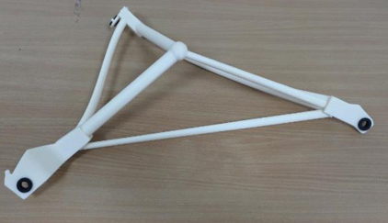
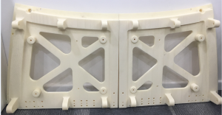
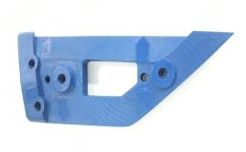

3D Printing Conceptualization
Methodology Adopted
1
Idea Generation | Seminar attended of 3D printing which gave the clue to use 3D printing for Ease of manufacturing
Understanding the 3D Printing concept | Met M/S Stratasys India team- Understood the Application & scope of 3D printing
Identification of Applicable area | Study of shop floor for identification of projects | 1)Apertures 4) Welding Jigs 2) Gabaris 5) Inspection Kengu 3) Fitment Jigs
Concept Finalization | Finalized the concept and printed a sample jig of Head light CD checking for actual realization of the same
Areas Identification for implementing in coming models | Areas identified in upcoming models for implementing this new technology | 1)Apertures 4) Welding Jigs 2) Gabaris 5) Inspection Kengu 3) Fitment Jigs
Line Trial in simple and complex jig done | Trials done in both simple & complex types and got satisfactory results
Implementation in New models | Implemented in two areas in new model
2
3
4
Head Light Mounting Pitch verification
Head Light Mounting Pitch verification
5
6
7
 | Months
 | 1 | 2 | 3 | 4 | 5 | 6 | 7 | 8 | 9 | 10 | 11 | 12 | 13 | 14 | 15 | 16 | 17 | 18 | 19 | 20
NEW MODEL A TIME LINE
3D PRINTING @ NEW MODEL
Nth Month
N-14
N-12
5
N-11
N-8
N-6
6
N-3
7
N-1
Trial part
received
Indent raised for
Model A parts
Receipt of
2 parts
Receipt of
all parts
Line
Trials
Implementation
in New Model
NEW MODEL TIMELINE MATCHED TO EXPERIENCE & HAVE REALIZATION OF THE NEW TECHNOLOGY

Slide 18
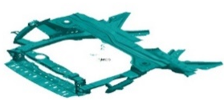
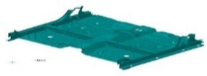
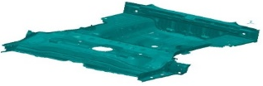
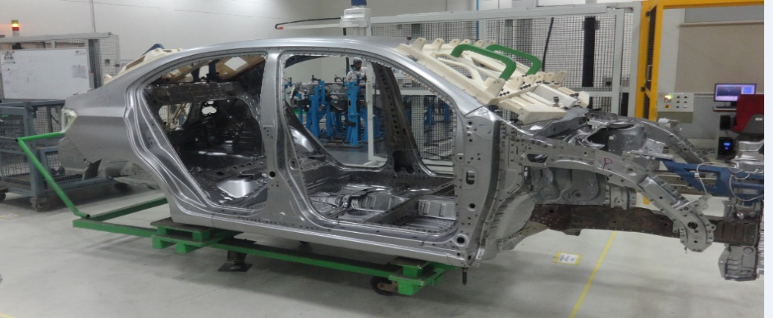

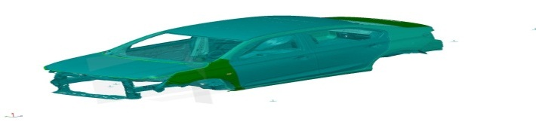
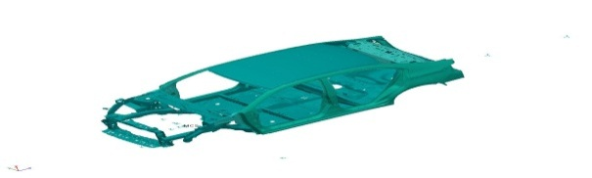
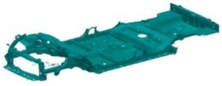
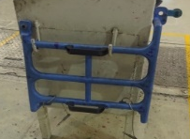


















Application areas in weld shop - Scope
SR. NO. | NAME OF TOOL USED | DESCRIPTION | ILLUSTRATION
1 | APERTURES | APERTURES ARE USED TO SIMULATE ASSEMBLY CONDITION OF CRITICAL PARTS ON WHITE BODY
2 | GABARI | GABARI ARE USED TO ENSURE CRITICAL PITCH ACCURACY OF A SINGLE ASSEMBLY PART LIKE HEADLIGHT, TAIL LIGHT ETC.
3 | FITMENT JIGS | FITTING JIGS ARE USED FOR ACCURATELY GUIDING THE FASTENERS FOR FITMENT.
4 | WELDING JIGS | JIG IN WHICH TWO OR MORE PARTS ARE WELDED TOGETHER TO FORM A SUB ASSEMBLY COMPONENT.
5 | INSPECTION KENGU | THESE ARE THE MASTERS FOR VERIFYING THE CRITICAL COMPONENTS LIKE DOOR S, BONNETS, TRUNK ETC.
Wb after all closures
Wb after GW
Wb after A Zone
METHODOLOGY USED IN WELD SHOP FOR CRITICAL DIMENSION VERIFICATION
METHODOLOGY USED IN WELD SHOP FOR CRITICAL DIMENSION VERIFICATION
Wb after GW
Wb after closures
Full wb with closures
Full wb with apertures

Slide 19
Agenda
Innovation on Shop floor with 3D Printing
Line Layout & Importance of Q checking assists
Current SA & DA for 3D printing Introduction
Methodology and Scope Fixation
Project Execution & Implementation
Learning's & Benefits of 3D printing
Way Forward…..

Slide 20






Project Execution - with conventional jigs
FRONT AREA OF CAR BODY
VERIFICATION OF CRITICAL DIMENSIONS & PARTS PITCH IN WELD SHOP TO
PREVENT ANY FITMENT CONCERN AT ASSEMBLY LINE
FRONT
.
FRONT WINDSHIELD FITMENT JUDGEMENT @ WELD SHOP
HEAD LIGHT FITMENT JUDGEMENT @ WELD SHOP
REAR
TAIL LIGHT FITMENT JUDGEMENT @ WELD SHOP
REAR AREA OF CAR BODY
Current conventional jigs are very heavy, excess manpower required, handling difficult, unsafe due to heavy weights
IMPROVEMENT POSSIBILITY SCOPE IN CONVENTIONAL JIGS
Notes:
20

Slide 21






Project Implementation- with 3D printed jigs
INTANGIBLE
FRONT AREA OF CAR BODY
VERIFICATION OF CRITICAL DIMENSIONS & PARTS PITCH IN
WELD SHOP TO PREVENT ANY FITMENT CONCERN AT ASSEMBLY LINE
FRONT
.
FRONT WINDSHIELD FITMENT JUDGEMENT @ WELD SHOP
HEAD LIGHT FITMENT JUDGEMENT @ WELD SHOP
REAR
REAR AREA OF CAR BODY
TAIL LIGHT FITMENT JUDGEMENT @ WELD SHOP
Modified 3D printed Jigs are light in weight, only 1 manpower Required,
easy handling and much safer
IMPROVEMENT REALISATION IN 3D PRINTED JIGS
Notes:
21

Slide 22







Implementation on shop floor
Head light LH
Trunk Lid
Tail light LH
Front Windshield
Tail light RH
Head light RH
Rear Windshield
Lid light
SUCCESSFUL EXPERIENCE OF 3D PRINTED TECHNOLOGY

Slide 23
Agenda
Innovation on Shop floor with 3D Printing
Line Layout & Importance of Q checking assists
Current SA & DA for 3D printing Introduction
Methodology and Scope Fixation
Project Execution & Implementation
Learning's & Benefits of 3D printing
Way Forward…..

Slide 24








Benefits-3D Printed Tools
AREA | FACTOR | ADVANTAGE | LEARNING | BENEFIT | OUTPUT
S | SAFETY WHILE USAGE & FATIGUE | Light weight Fixtures-Reduced to 7KG from 25 Kg | Impact of weight reduction on shop floor safety | Equipment (Jigs) Usage And Human Safety Improved Fatigue Reduced
Q | ACCURACY | Variation during Machining Operations minimised In 3D Printed Jigs | Impact of manufacturing processes on accuracy of jigs | Accurate Measurements as parts made as Per 3D Models
C | OVERALL COST | 40 ~ 50% Cost Reduced With 3d Printed Jigs | Costing of different materials Direction for cost saving in future | Cost Saving
 | MANPOWER COST | Low Weight Hence Manpower Reduced |  | Manpower Cost Saved
D | LEAD TIME | Reduced Manufacturing Time Hence Shorter Lead Time Better Manageable, Digital Inventory | Lead time difference with change of technology | Project Timeline Reduced
 | TACT TIME | Timely completion of work due to easy handling | Impact of ergonomics on cycle time | Line delay due to inspection reduced
M | OPERATOR MORALE | Easy Handling & Easy Movement Worker Comfort & Improved Ergonomics | Awareness about Focus items of shop floor management | High Motivation of Operators
WEIGHT REDUCTION
25KG
7 KG
Before
After
ACCURACY IMPROVED
Before
After
COST REDUCTION
MANPOWER REDUCTION
COST REDUCTION BY 50% & MANPOWER IN 1\3 RATIO
100%
50%
3
1
Before
After
Before
After
WIND SHIELD APERTURE DELIVERY TIME REDUCTION
60 DAYS
3 DAYS
Before
After
High motivation
Improved ergonomics
BENEFITS OF 3D PRINTING FOUND IN ALL VERTICALS OF SHOP FLOOR
3D - printing | jdg
Ergonomic (Net wt.)
Accuracy
Cost
Mfg. Lead Time
Ease of use

Slide 25
Agenda
Innovation on Shop floor with 3D Printing
Line Layout & Importance of Q checking assists
Current SA & DA for 3D printing Introduction
Methodology and Scope Fixation
Project Execution & Implementation
Learning's & Benefits of 3D printing
Way Forward…..

Slide 26














Way Forward
Assembly Frame:
Emblem Placement
Lock Fitting
Wind Shield cantering Jig
Body Protectors
Paint:
Stopper jigs
Decal Aliment Jig
EMBLEM PLACEMENT
BULK HEAD STOPPER
WIPER STOPPER
EMBLEM PLACEMENT
HOOD STOPPER
HOOD LATCH CD GABARI
BULK HEAD STOPPER
WELD:
Setting jig
Gabari
Aperture
Kengu
Welding jig
POPA:
Bumper Prototype – for Robo Trial
Bumper Carrying Jig to Paint shop- Before Production
HORIZONTAL DEPLOYMENT CAN BE DONE IN OTHER SHOPS ALSO

Slide 27
3D PRINTED JIGS AND FIXTURES
Optimizing manufacturing
COUNTERING MANUFACTURING CHALLENGES
Decreasing cost
Reducing cycle time
Increases and maintains product quality and repeatability
Increasing workforce safety
Enabling a more nimble manufacturing process
Minimize the possibility of human error
Permit the use of medium-skilled labor
Allow production of repeat orders without retooling
THANK YOU

