Slide 1
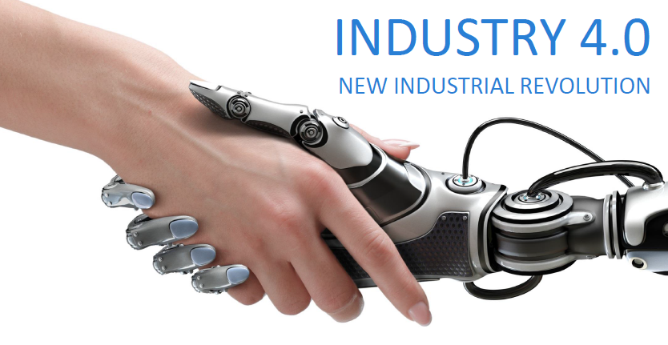
Smart Manufacturing for Inclusive and Sustainable Industrial Development
26 October 2018
René VAN BERKEL
UNIDO Representative
UNIDO Regional Office in India

Slide 2

Inclusive and Sustainable Industrial Development
Advancing economic competitiveness
Safeguarding the environment
Creating shared prosperity
Build resilient infrastructure, promote inclusive and sustainable industrialization and foster innovation
An industrial transformation towards factories that are fit for the future – which were already urgently needed yesterday

Slide 3
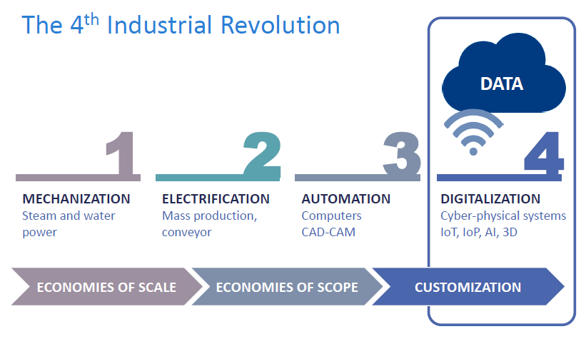
The 4th Industrial Revolution

Slide 4



The 4th Industrial Revolution
DECENTRALIZED DECISION-MAKING
Cyber-physical systems are independent and make uncomplicated decision on their own
INFORMATION TRANSPARENCY
Sensor data lets systems build virtual copy of the physical world
TECHNICAL ASSISTANCE
Systems aid humans in problem-solving and decision-making, assist them with unsafe, dangerous tasks
INTEROPERABILITY
Devices, sensors, machines and people connect and communicate
CHARACTERISTICS
TODAY
CYBER PHYSICAL PRODUCTION SYSTEMS
Internet of Things

Slide 5
Digitalization in Industry 4.0
Platform digital technologies that connect with the physical world of manufacturing
Augmented Reality
Blockchain Technology
Big Data & Analytics (AI)
Internet of Things
Rapid Prototyping
UNIDO, 2017

Slide 6
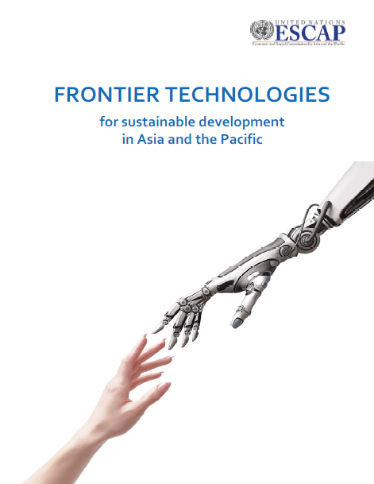
Unlocks Potential of Frontier Production Technologies
Biotechnology
Biochips
Stem cells
Bio-informatics
Systemic biology
Health monitoring
Personalized medicine
Regenerative medicine
Neuroethologies
Biocatalysis
Medical & bioimaging
Advanced Materials
Nanomaterials
Nano devices
Functional materials
Additive Manufacturing
Carbon nanotubes
Energy & Environment
Micro & nanosatellites
Power microgeneration
Hydrogen energy
Carbon capture & storage
Precision agriculture
Electric vehicles
Energy storage
Smart grids
Biofuels
Drones
Based on ESCAP, 2018

Slide 7



Industry 4.0: Smart Factory
Technical System
Technical machinery
Embedded System
Hardware & software
Cyber-Physical System
Merging of physical + virtual
Cyber-Physical-Production System
Application to manufacturing
Smart Factory
Network of people, machinery and resources
Source: Fraunhofer Austria

Slide 8

Producer Benefits of a Smart Factory
DRIVER FOR INNOVATION
INCREASED (RESOURCE) EFFICIENCY
INCREASED
PRODUCTIVITY
Smart factories are drivers for innovation
Digitalization allows for new business models, products and processes
Resource usage is optimized
Early detection and corrective action
Products can be designed and produced faster
Machines can be repaired quicker
Procurement processes are faster
+30%
+25%

Slide 9
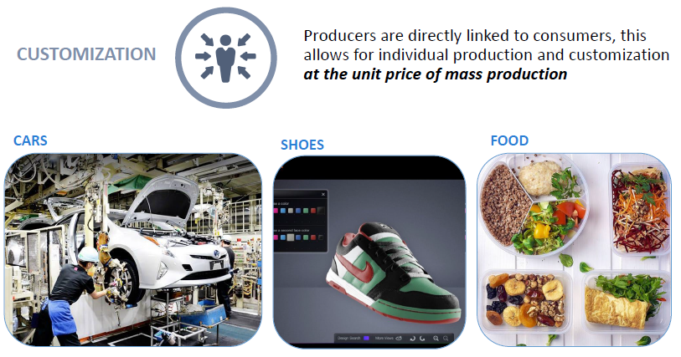
Consumer Benefits of a Smart Factory

Slide 10
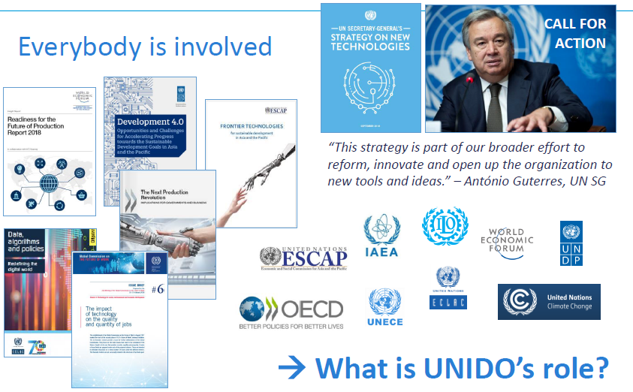
Growing Interest: opportunities & challenges

Slide 11
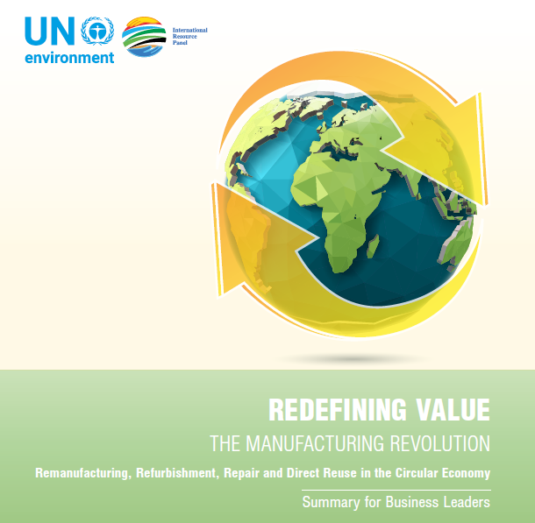
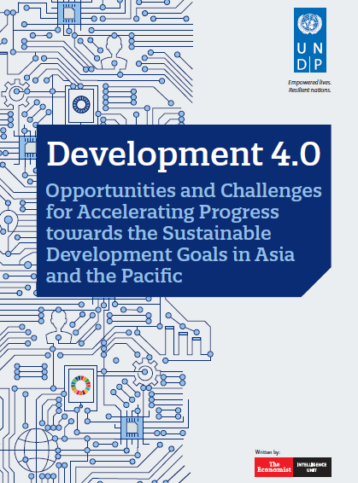
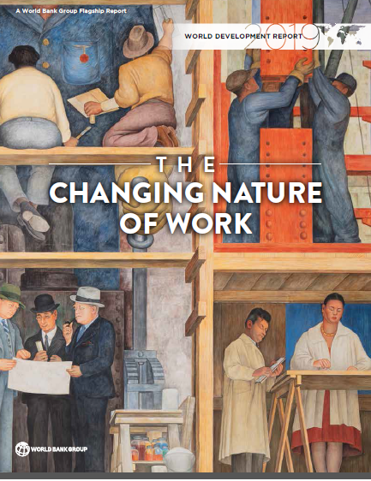
Solutions for Megachallenges?
Decarbonized and Circular Economy
World Free of Hunger and Extreme Poverty
Responsible Business Conduct and Governance
Decent Work for All

Slide 12
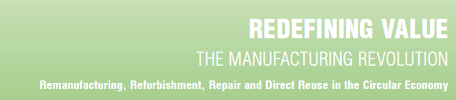
Decarbonized and Circular Economy
GO RENEWABLES
RELENTLESSLY PRACTICE EFFICIENCY
RECYCLE PERPETUALLY
Value recovery from all wastes
Maximize substitution of non-renewable resources
Improve efficiency of use of all resources
Closing the Loop
Dematerializing the Loop
Reinventing the Loop
Shift to extended business models focused on value creation, value preservation and value recovery

Slide 13

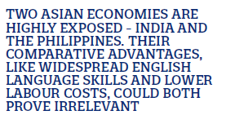
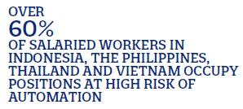
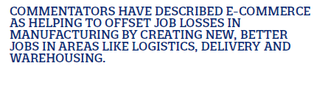
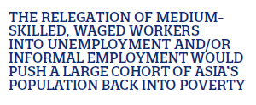
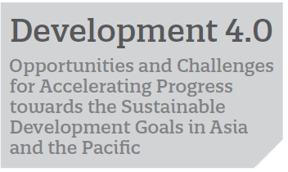
Employment and Future of Work
UNDP, 2018

Slide 14
Employment and Future of Work
Changing Skills
Labour market calls for advanced cognitive, socio-behavioural and adaptive, combinatory skills
New Business Models
Platform technologies allow ‘scale without mass through bandwidth’
PubLic Policy
manage the direction and effects of change
Invest in Human Capital
Improve in particular early childhood education for higher order cognitive and socio-behavioural skills in addition to foundational skills
Strengthen social protection
Solid guaranteed social minimum and strengthened social insurance, complemented with labour market reforms
Mobilize revenue
Creating fiscal space for public financing of human capital development and social protection
WorldBank, 2018

Slide 15
Implications for Developing Countries
Opportunities
Integration in Global Value Chains
Challenges
Demographic Change
Global net decrease in jobs; growing inequalities
Skills & Education
Polarization of workforce; (re-)education challenges
Investment
Labour cost will no longer drive FDI; reshoring of investment
Trade enables learning; upgrading industrial capabilities
Leapfrogging
Late comers take advantage of lower entry barriers
Sustainable Development
Twin benefit of enhanced productivity and resource efficiency

Slide 16
UNIDO Role in the Smart Industrial Revolution
    Establishing multi-stakeholder knowledge sharing platforms to create awareness on Industry 4.0 opportunities and challenges for pursuing inclusive and sustainable industrialization in developing countries
    Support governments and industry to work together with an aim to establish innovation-friendly policies, regulations and standards and to build an enabling digital Infrastructure and ensure digital Inclusion
    Sharing available tools and methods for innovation management and foster innovation hubs and networks
    Exploring methods and best practices to support SMEs digital transformation and bridging the gender digital divide
    Building awareness on the issues of new infrastructure, standards and policies that need to be developed or mainstreamed to correspond to the new technologies
KNOWLEDGE SHARING
POLICY SUPPORT
INNOVATION MANAGEMENT
SUPPORT TO SMEs
AWARENESS RAISING
Preparedness (improved understanding and foresight) → Observatory
Technical assistance (paving the way for deployment) → Centre of Excellence

Slide 17
Smart Transition to Smart Manufacturing
Nurture Manufacturing Excellence
Establish a manufacturing system that can benefit from digitalization
Foster Innovation
Create functional, end-to-end innovation ecosystem
Facilitate Investment
Modern industrial policy that attracts and de-risks investments

Slide 18
Nurture Manufacturing Excellence
Establish a manufacturing system that can benefit from digitalization
Tap underutilized potential of appropriate, clean technology and modern/lean manufacturing and management techniques, particularly in MSME segment
Create and strengthen enterprise level capabilities
Professionalize and institutionalize provision of business development services
Facilitate and encourage benchmarking and – collective - technology learning, including through e.g. diversified clusters

Slide 19
Foster Innovation
Create functional, end-to-end innovation ecosystem
Innovation component that:
Brings together research, education and innovation
Innovates by learning, adapting and redefining
Start up component to foster entrepreneurship and connect innovators with markets and investors
IDEA
Invention driven by new knowledge
PROTOTYPE
START UP
ENTERPRISE
Incubation driven by customer value
Acceleration driven by investor’ value
Growth driven by market demand

Slide 20
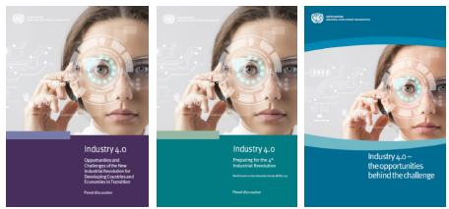

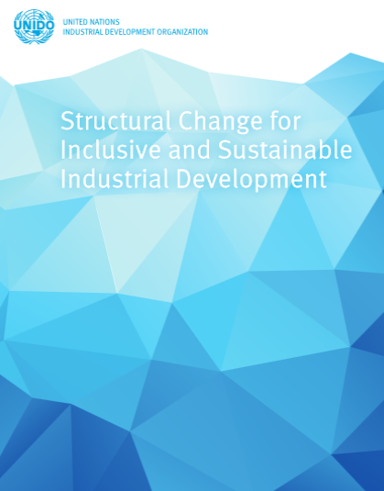
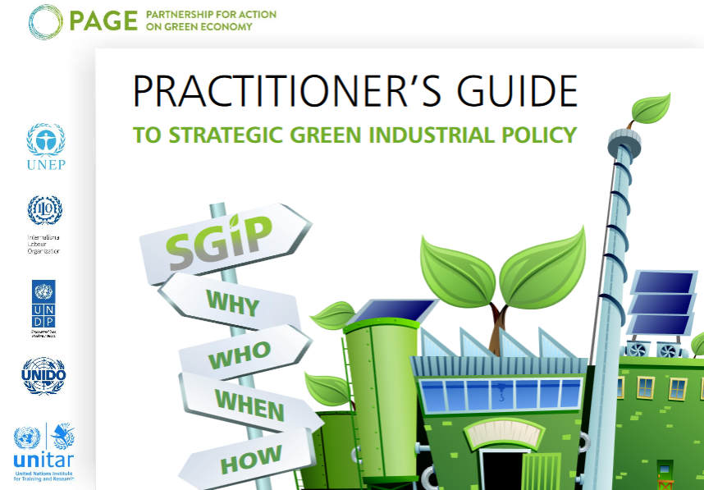
Facilitate Investment
Modern industrial policy that attracts and de-risks investments
Adaptive, predictive and transparent, that maintains a level playing field
Balance between specific support for prioritized sectors and cross-sectoral support to address systemic barriers
Public-Private-Development Partnerships to facilitate efficient development and implementation of effective policy focused on removing specific barriers to investment

Slide 21
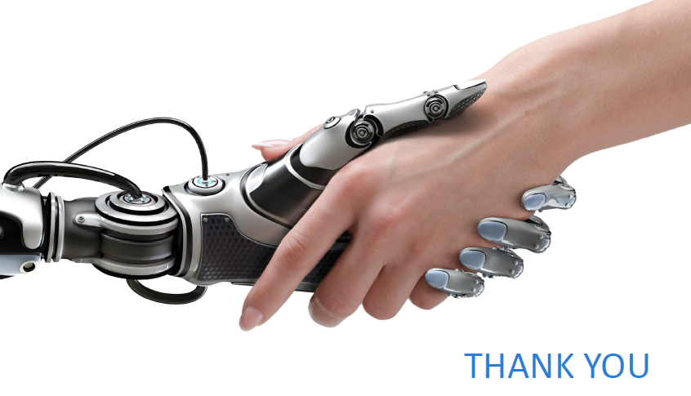
r.vanberkel(a)unido.org
www.unido.org

