Slide 1


4th Smart Manufacturing Summit
Rohit Rohilla
Manager- Production Technology

Slide 2
Fraunhofer in India – Highlights
Project cooperation with Core Group of Automotive Research (CAR) to the tune of nearly Euro1 Million.
MoU with ACMA , SIAM and NATRiP for the Automotive sector
MoU with BML Munjal University for setting up advanced qualification courses.
MoU with Ministry of New& Renewable Energy, extensive cooperation with Solar and Wind Energy Industry.
Contract with Ministry of Small Medium and Micro Enterprises for evaluation and upgradation of Tool Rooms.
Research contracts worth more than Euros 8 Million in the last 4 years ( largely Indian companies!).
MoU with Ministry of Heavy Industry to be the “Technology Resource Partner for Manufacturing in India”
More than 100 Projects at various levels of discussion and implementation and Top 30 Indian companies are already clients of Fraunhofer in India

Slide 3
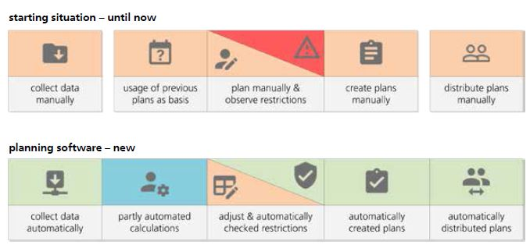
factories and supply chains of the future

Slide 4
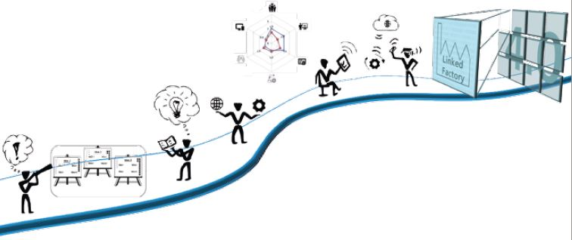
Smart Factory-Digitization and Automation
Design of Production System
Digitization While Adding Value
Resource Efficient Factory
Green Automobile Production
Production Planning in Automotive Supplier Industry
Digitization in Production
Connected Factory and Digital Twin
Machine Learning in Production
Automation & Monitoring
One System for Lot of Sensors.
Value Added by People in Production.

Slide 5






Smart Data Management
Smart Manufacturing and Smart Services
Public
Data
Smart Manufacturing
Data
Smart Services
Customer
Production
Networks
Human-Machine-Collaboration
End-to-End Customer Process
Commercial
Services
Smart Data
Management
Interoperability
Individualization
Logistics
Networks
Autonomous Systems
Ecosystem
Industrial
Services
Internet of Things
Ubiquity
Data from the
Value Chain
Legend:
Information flow
Material flow

Slide 6
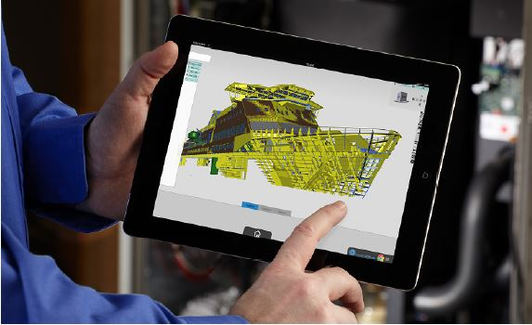
Complex 3D Data on All Devices (Instant 3Dhub)
Web-based software platform, bringing the visualization of 3D data to every device
Enables real time inspection of industrial plants.
Visible parts are calculated on server and transferred to the device.
Used by Daimler, Porsche and BMW at over 1000 workstation

Slide 7
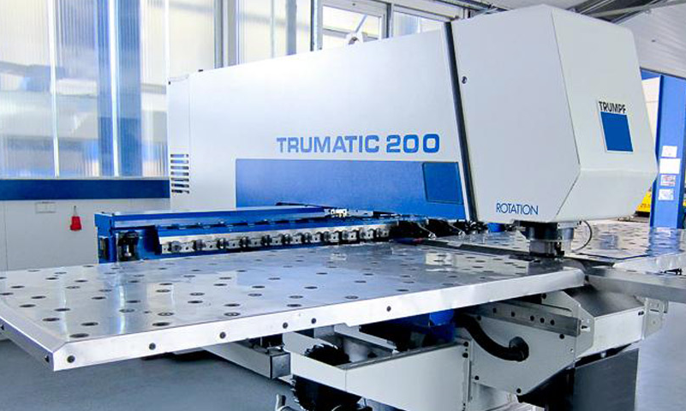
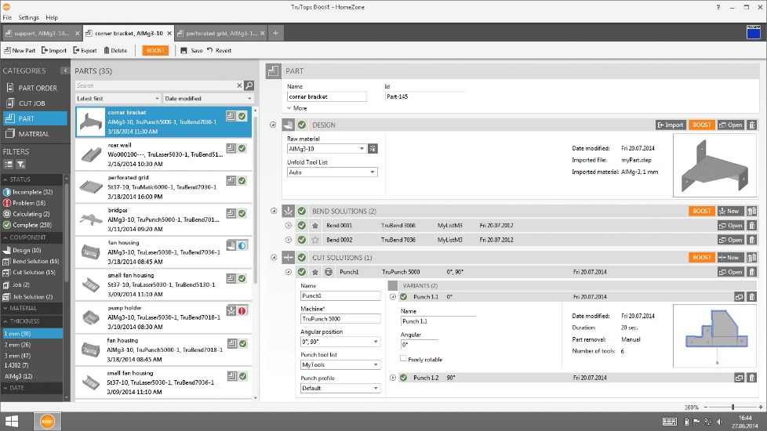
Industrial machinery manufacturers are offering app stores on top of their tangible products
Hybrid Products at TRUMPF
Tool Machine as a Tangible Product
Digital Value-Added Service
Image sources: ihs-gmbh.de (2016); silicon.de (2016).

Slide 8
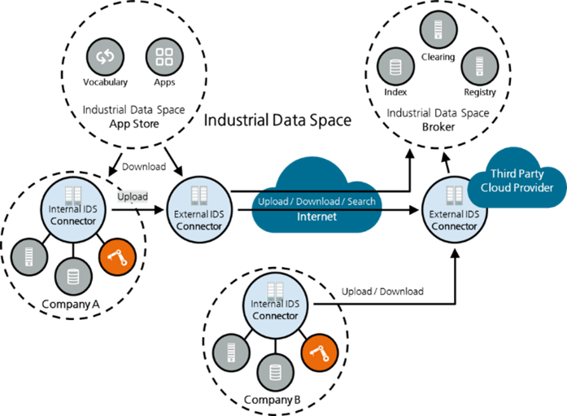
Data Sovereignty in the Industrial Data Space
Reference architecture of the Industrial Data Space
Software components enable all stakeholders (defined roles) to participate in IDS
The quantity of all (external) IDS connectors defines the Industrial Data Space
Internal IDS connectors are used to link data sources in the company, to transform and to improve them.

Slide 9
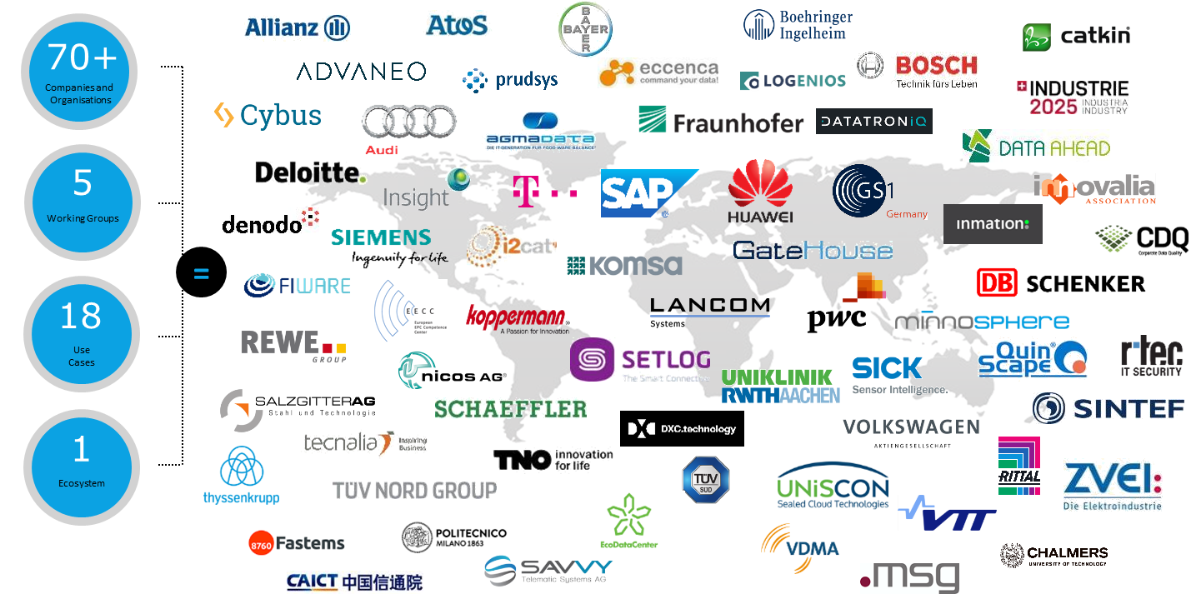

Use Cases and Industrial Data Space Association
70+ members in the Industrial Data Space Association
Quelle: www.industrialdataspace.org, March 2017

Slide 10



























Survey of Industry 4.0 initiatives worldwide for IDB
MAKE IN INDIA

Slide 11
Study on Indo-German collaboration opportunities in Industry 4.0
Commissioned by Bertelsmann Stiftung, Germany
Launched on November 22 in New Delhi
  Keynotes from German Ambassador Dr. Martin Ney and Mr. Atul Chaturvedi from DIPP
  100+ CxO-level attendees from reputable Indian and German industry, politics and associations
Now available under www.isst.fraunhofer.de

Slide 12


Fraunhofer supports SAMARTH Udyog
Supported by
SAMARTH Center of Excellence for Industry 4.0
Technology Partner
Lead: ISST
Start: 12/2017
Duration:
3 – 5 Years
Wave I
Wave II
Wave III
Awareness
Understanding
Training
Pilot projects
Benchmarking
Certification

Slide 13
Thank You For your Attension!
Fraunhofer India
Bangalore
Ph: +91 80 40965008
Web: www.fraunhofer.in
Email: rohit.rohilla@fraunhofer.in

