Slide 1




SMART MANUFACTURING:
Autonomous and Intelligent

Slide 2
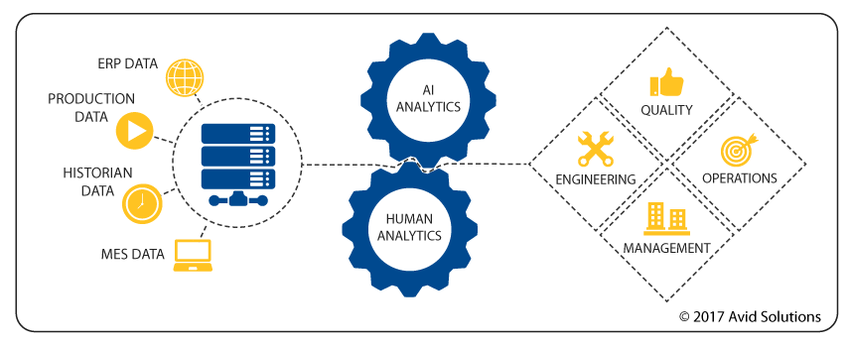

How Smart Manufacturing Works?

Slide 3



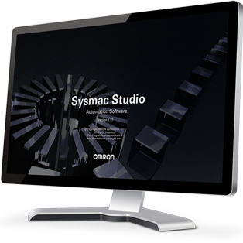


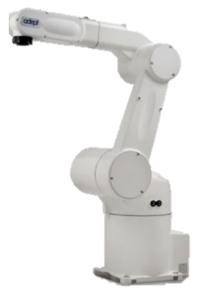
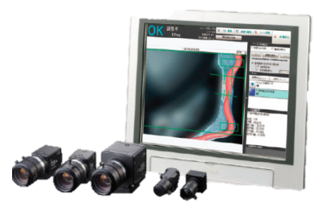
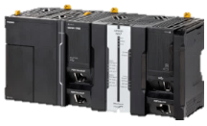
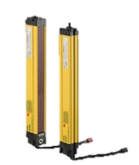
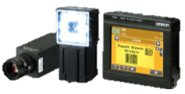
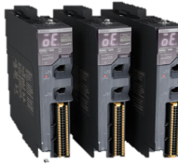
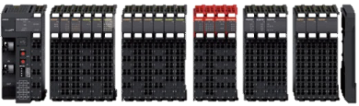
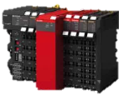
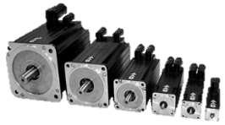
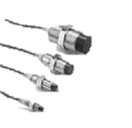

IPC
innovative-Automation
Ethernet-IP
Factory Automation
Vision system
Machine control
MQTT
Fixed robotics
EtherCAT
Machine Automation
Vision sensor
Multi-axis servo control
Machine safety
Distributed I/O
Sensor
Actuator
I/O Link
General purpose sensors
Advanced sensors
Notes:
We have it all down in the edge level. This Gilles can work on it and add more relevant sensors at the bottom.

Slide 6



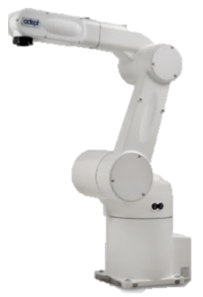
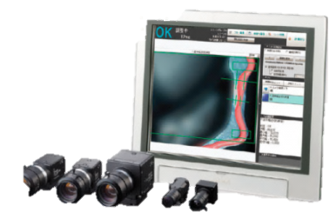
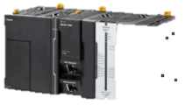
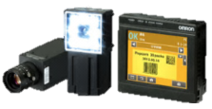
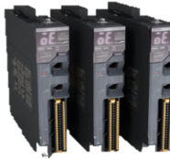
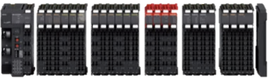
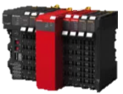
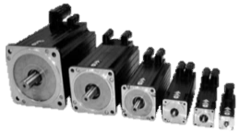

IPC
innovative-Automation
Ethernet-IP
Factory Automation
Vision system
Machine control
MQTT
Fixed robotics
EtherCAT
Machine Automation
Vision sensor
Multi-axis servo control
Machine safety
Distributed I/O
I/O Link
Sensor/Actuator
General purpose sensors
Advanced sensors

Slide 7
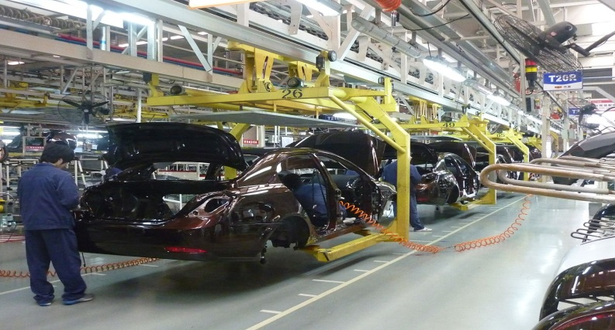
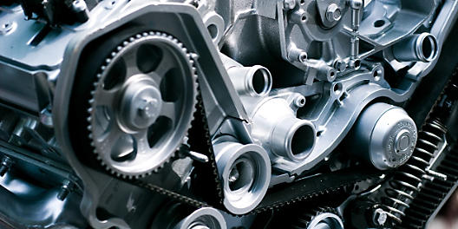
Case study
Customer Industry : Automotive ancillary company, India
Machine/ Application : Component assembly in multiple stations
Solution : Quality/Process data capture from each station

Slide 8
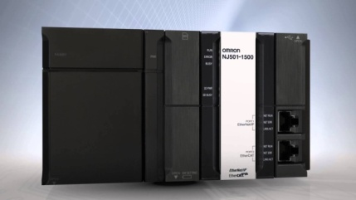



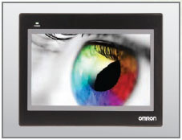
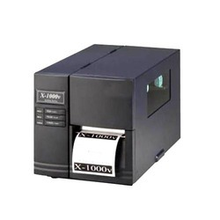
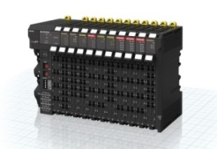




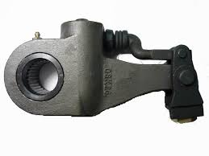

The first step – test case. One line
SERVER
DATA
NJ501-1320
Station 1
Station 2
Station N
2D CODE PRINTER
DATA
DATA
DATA
General purpose sensors
Complete Traceability

Slide 9

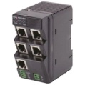



The Next Step – Learn. Apply. Multiply
Factory Location-III
Advanced analytics
DATA
Line II
Line III
DATA
DATA
Line I
DATA
DATA
Factory Location-II
Factory Location-I
DATA
DATA
Line II
Line III
Line II
Line III
DATA
DATA
DATA
Line I
Line I
DATA
DATA

Slide 10

The benefits
Reduced Recall impact - Quick response to quality complaints
Attracted new customers.
Improved quality proactively using data analytics
Notes:
This merger of the physical and virtual worlds (cyber physical systems - CPS) opens up new areas of innovation that will optimize the entire manufacturing industry to create higher quality products, improve productivity, increase energy efficiency, and sustain safer plant floors.
Furthermore, smarter factories also offer the opportunity to boost employment 2-4 times over the current national manufacturing workforce. As SM is adopted, new technology based manufacturing jobs will become available creating direct manufacturing and non- manufacturing positions.
Creating smarter factories will allow the India to remain competitive with manufacturing organizations abroad. New, overseas manufacturing facilities are being constructed with Smart Manufacturing technologies built-in. In order for the India to remain competitive, it needs to embrace Smart Manufacturing with people who have the desire to get in on the ground floor.
Ultimate objective its to make India renowned manufacturing hub for key Sectors. Companies across the globe would prefer to invest in India if the product quality is world class
Using India’ highly talented and skilled manpower to create world class zero defect products

Slide 11
The Implementation Mantra
Start with the big picture.
Chose a reliable partner.
Step by step approach works.
Notes:
This merger of the physical and virtual worlds (cyber physical systems - CPS) opens up new areas of innovation that will optimize the entire manufacturing industry to create higher quality products, improve productivity, increase energy efficiency, and sustain safer plant floors.
Furthermore, smarter factories also offer the opportunity to boost employment 2-4 times over the current national manufacturing workforce. As SM is adopted, new technology based manufacturing jobs will become available creating direct manufacturing and non- manufacturing positions.
Creating smarter factories will allow the India to remain competitive with manufacturing organizations abroad. New, overseas manufacturing facilities are being constructed with Smart Manufacturing technologies built-in. In order for the India to remain competitive, it needs to embrace Smart Manufacturing with people who have the desire to get in on the ground floor.
Ultimate objective its to make India renowned manufacturing hub for key Sectors. Companies across the globe would prefer to invest in India if the product quality is world class
Using India’ highly talented and skilled manpower to create world class zero defect products

Slide 12

Leverage Smart Manufacturing to not just
make in India
but
make world class in India
www.omron-ap.co.in

Slide 13

www.omron-ap.co.in

