Slide 1
Industry 4.0 and Cognitive Manufacturing
Oct 2018

Slide 2
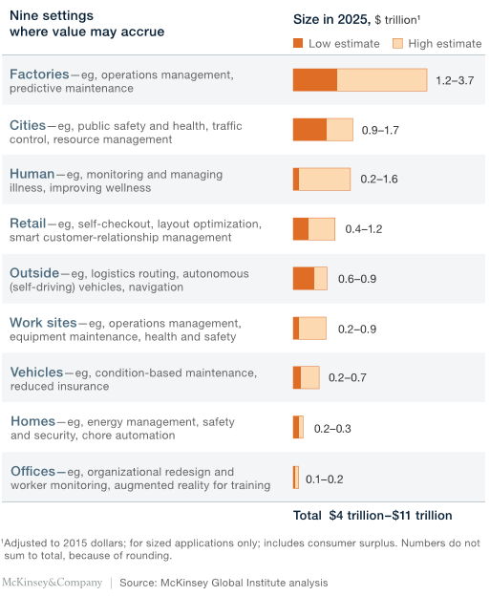
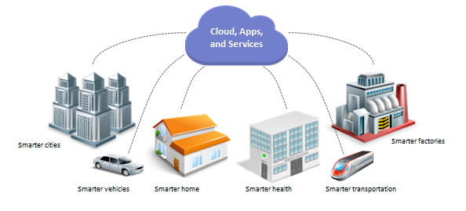
There is a perfect digital Storm brewing in Operations & Manufacturing
The rapid evolution of technology is creating a lot of excitement and questions around what to do… we are in a point where dot.com stood in the 90’s
All coming together to create a perfect storm…
this is just the Cloud, not the storm
Inexpensive Sensors
Computing Power
Cloud
Mobility
Social
Big Data & Analytics
Cognitive
Open Platforms
Internet of Things (IoT)
Circular Economy
Millennials
Influencing factors for digitalization of Manufacturing
Market for IOT in sectors

Slide 3

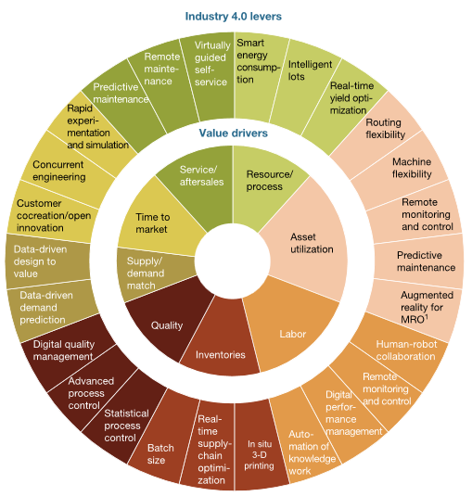


Indian Manufacturing is well poised to embrace the challenge for Ind 4.0
Market Drivers
Bold Moves
Trends
Ind 4.0 levers
Uncertainty in commodity prices
Expand existing plant capacity or consolidate volumes
Attract & Retain talent
Products to Services and Risk Sharing
Focus on Cost Takeout
Build Partner ecosystem & Collaboration
Mass Customization
Cyber physical Systems
Increase revenue and CSAT by value added services
Facility Rationalization Digitalization
Develop applications across value chain taking data from physical world
Integrated Information flow
Decouple L0 to L4 systems & ensure streamlined data flow
Changing customer demand

Slide 4
IBM Point of View for Ind 4.0 & Operations Excellence create a Cognitive Value Chain
Core Focus on Structured Ind 4.0 Solutions
Cognitive Solutions
Secure, Open & scalable IOT Platform
Industry specific Solutions
Rapid ROI & Data based decision making
Predictive Maint
PPA
Cognitive Equip Advisor
Predictive Quality
Prescriptive Quality
VI
Acoustic Insights
Plant Advisor
IOT for Safety
Building Insights
Energy Management
Watson Engagement Advisor
Dialog with end users for answers to questions for products & Services
Watson Explorer Providing search, navigation & discovery over structured and unstructured data
Decision Sciences ( Predictive , Prescriptive and Cognitive APIs )
Watson Discovery Advisor
Developing new knowledge areas where consensus does not exist
Watson Analytics
Predictive and Prescriptive Analytics for analyzing & modelling
Data Storage / Analytics - Data Lake ( Structured & Unstructured)
Data Acquisition
Watson APIs
Ability to consume APIs in 24 areas for Cognitive reasoning
Asset Availability & Upkeep
Process Optimization
Smarter Resources
Smarter Facilities
Operations Excellence Consulting Campaign from Digital Solutions
Operational Excellence Consulting

Slide 5
Some case studies for India customers
IOT for Operations excellence
Worker Safety
Major OEM in India
Mobile Asset tracking
Major OEM in India
Process & Visual Quality
MRF / MSIL
Cognitive Planning & Scheduling
Largest Auto OEM
Manufacturing Visibility
Transformer major
Filling Efficiency Solution
Paint Major
Other IOT Connected Solutions
Connected Car
Largest Auto OEM
Connected Water Purifier
CPG Major in india
Energy Management
Pharma major

Slide 6
Thank You

