Slide 1
Digital Manufacturing:
Global Trends

Slide 2
Technology is enabling the 4th industrial revolution
Digital transformation
Design & Engineering
Physical
Production assets
Raw materials and products
Preventive maintenance
Digital
Smart products
Service ecosystems
Connected customers
Supply Chain
Production
Customer
Marketing
Sales
Services
Modern manufacturers are embracing customer centricity,
innovating faster, and becoming more agile
Notes:
In the past manufacturing was linear and purely physical. We were focused on the customer at the end of the sales cycle. We did not have the ability to center the entire manufacturing process around the customer and support an ongoing relationship.
Today, for the first time, technology has outpaced the evolution of business processes. Smart products have existed for some time, but now it’s possible for these products to deliver real value. The proliferation of the cloud and big data and the continuous connection of smart products has created a greater opportunity to improve customer connections and differentiate your business. Now, you can listen to social sentiment, analyze customer product usage, determine long-term quality and deliver new services to your customers.
With the convergence of physical and digital, many manufacturing companies are embracing digital transformation, leading to the rise of the 4th Industrial Revolution. Transforming to a digital business enables you to disrupt the market with new products and services. While simply designing a better product is worthwhile, the real value from this digital transformation is an expanded business model. Instead of products, you can offer a product as a service.

Slide 3
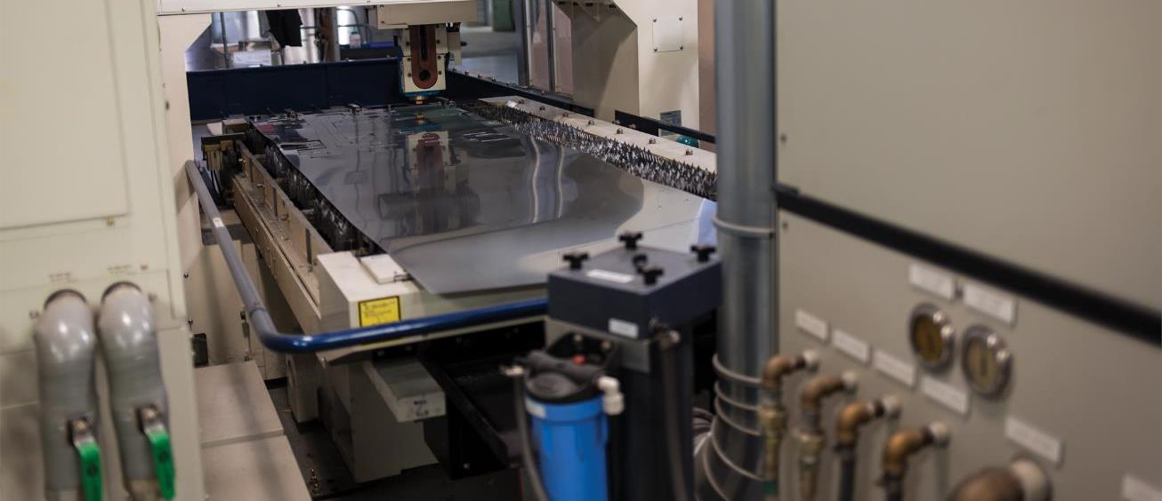
Technologies driving the Factory of the Future
Connectivity and Interoperability
Sales and Marketing
Customer Services
Seamless System Integration
Customer Services
Supply
Chain
Architecture to accommodate existing systems
Customer Product
Modeling and Simulation
Manufacturing Floor
Engineering/
R&D
Safety and Security
Notes:
The implementation of the Factory of the Future requires technologies to support the seamless integration throughout whole factories production networks or ecosystems.
In the past, industrial automation was driven by a “set it and forget it” mentality. Today, technology is changing that mindset. The factory of the future may be a green field ground up design or a transformation of existing infrastructure. Connectivity and interoperability are paramount to success. A world of disparate protocols and systems becomes a synergistic hyperconnected network. Machine to machine communication becomes machine to machine to people communication.
Seamless integration of automation, engineering and business systems with a common data source drive disruptive digital transformation. Twenty-year-old automation systems enabled by IoT technology provide never realized insights about operation, productivity and health. Our investments in technologies like OPC-UA allow us to seamlessly interface to new and legacy systems.
Simulation via the digital twin is a key component of the factory of the future. The twin provides the ability to simulate and iterate through the end to end stages of design, production and service. The has matured to a digital representation of the plant floor, supply chain and product lifecycle driving new levels of efficiency and productivity.
Safety and security reach new levels. Worker safety is impacted by technologies like cognitive services. Facial recognition preventing unauthorized equipment operation. Cyber and physical security are elevated protecting intellectual property, data, and physical assets. The defense in depth strategy addresses the full factory from digital assets to plant floor sensors.

Slide 4

Delivering excellence in digital manufacturing
HoloLens
Azure IoT Suite
Cortana Intelligence Suite and Cognitive Services
Microsoft 3D Tools and Windows 10 IoT Core
Collaborative equipment
Ecosystem
Interaction
CRM
SRM
ERP
…
Automotive solutions
Process interoperability (IT)
Machine Learning, Stream Analytics, and Edge analytics
Information
Flow (OT)
Industry 4.0 Design Principles
Vertical integration | Horizontal integration | End-to-end engineering
Extensive partnerships across digital ecosystem
Trusted | Secure | Compliant
Platform interoperability across the cloud continuum
Notes:
Transformation is happening now. And manufacturers are digitizing using technologies such as digital twin, intelligence, IIOT.
In manufacturing, the intelligent factory is quickly becoming a reality as IoT-based sensing and cognitive situational awareness continues to improve the speed of operations. These technologies each offer tremendous potential for value creation within the organization. But it is when these capabilities come together to enable vertical and horizontal integration that the ultimate collaboration across organizations will achieve true value co-creation in the extended business network.
Microsoft’s overall mission is to empower every person and every organization on the planet to achieve more. In the discrete manufacturing industry, Microsoft’s goal is to help our customers amplify value creation and drive sustained improvement. We are delivering on these ambitions and making it a reality today.
First, we achieve breakthrough productivity with intelligent, mixed reality and cognitive services by bringing together human, machine, and AI.
Second, we build a broader ecosystem on partnerships that includes telecommunications, network, and software partners among others.
Third, we deliver a highly flexible and more robust software platform that help the hyperconnected world interoperate in hybrid models that provides the foundation for not just an Internet of things, but an Internet of things, people, and services working together.
And finally, we know heightened security across these intelligent systems is fundamental. Microsoft builds comprehensive security into its products and services by design to help our customers protect their data across the physical and virtual worlds. At Microsoft, we have a commitment to trust—spanning transparency, privacy, compliance, and security—and we believe we have a unique approach to delivering on that commitment.
Unlike other software providers, Microsoft brings all of these components together into one holistic offering for our customers as a platform for accelerated digital transformation.
A critical example is the digital twin. One of Gartner’s Top 10 Strategic Technology Trends for 2017, a digital twin is a virtual model of a process, product or service. This pairing of the virtual and physical worlds allows analysis of data and monitoring of systems to head off problems before they occur, prevent downtime, develop new opportunities, and even plan for the future by using simulations.

Slide 5
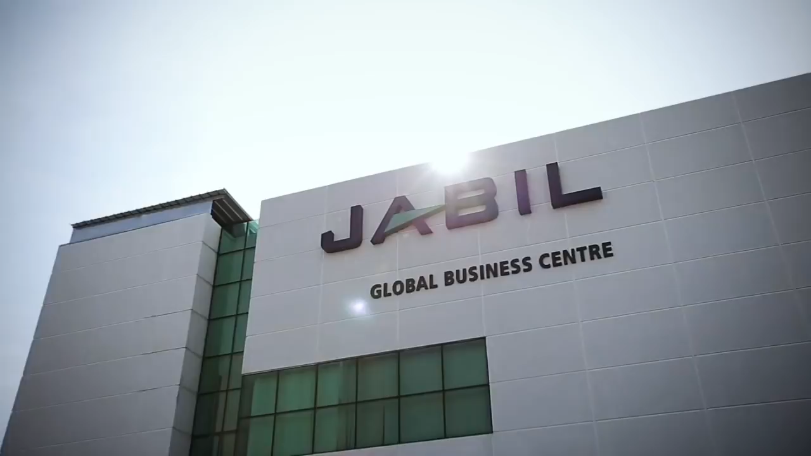

Slide 6
Journey Map
1 | Connected
2 | Predictive
3| Cognitive
  Essentials
  IoT cloud infrastructure: Components, protocols, gateways, ingestion, processing, storage
  Security: Local and cloud architecture including encryption, and identity and authentication
  Digital transformation design: Tech selection, piloting, capability building, and scalability
  Remote monitoring
  Leverage IoT stack, data factory/mart, to consolidate data into real-time visuals
  Mobile Worker
  Mobile access to information, training and communication.
  Connected Field Service
  Augmented reality: Enhanced and remote maintenance using HoloLens
  Predictive Maintenance
  Data requirements, model design and training, ongoing analytics, outputs
  Asset Performance Management
  Predictive quality: track incoming material specs, operations performance, and other factors to predict yield and quality.
  Supply Chain Visibility
  Real-time supply chain network that links siloed business application, customer & supplier data; Rapid identification of operational bottlenecks
  Big Compute
  Analyze and simulate complex high-fidelity models
  Digital Twin
  Data collected from the asset and its environment under multiple performance conditions, you can model the replica into 3D virtualizations to maintain, troubleshoot, and repair equipment; validate design or process innovation; or audit product quality

Slide 7
Modern Workplace
Convergence of IT & OT scenarios
Information Technology
Operational Technology
Communication (Skype for Business)
Collaboration
Outlook, SharePoint, Yammer, co-author
Teams, Group
StaffHub, Stream
Product engineering
Logistics
Mail & Social
(Outlook,
Yammer)
Intelligence
PowerBI, Excel, My Intelligence,
Delve,
Factory
Authoring
(Word, Excel,
PowerPoint,
OneNote)
Mobility
Anytime, anywhere, Managed App
Multi-platform
Plant management
Smart Building,
Smart Office Space
Sites &
Content
(OneDrive,
SharePoint, Delve)
Trust
Compliance, Privacy, Threat Intelligence Transparency,
data governance
Operations
Environmental sensors
Identity
Analytics
(PowerBI,
MyAnalytics)
Business Process
PowerApps,
Flow, Graph
Natural User
Experiences
(End User)
Personal
Productivity
& Insights
Digital Enterprise
(Dynamic Teams,
Collaboration)
Office Equipment
Services
Smart Connected
Things
(IoT Enabled Services)
Dynamic Value
Networks
Notes:
#1: Modern workplace. The workplace itself is transforming — from changing employee expectations, a widening skills gap, more diverse and globally distributed teams, and an increasingly complex threat environment. With more than 100 million monthly active users of Office 365 commercial, 500 million plus Windows 10 monthly active devices and 500 million LinkedIn members, we are in a unique position to empower people and organizations to succeed in a rapidly evolving workplace. The experiences and tools we build will unlock the creator in all of us and enable seamless teamwork not just in the workplace, but also at school and at home across all the devices people use — from the phone to the laptop to mixed reality headsets to the whiteboard, inclusive of Surface and third-party devices. New scenarios — like those enabled by Microsoft Teams — will redefine how work gets done and help foster employee engagement and culture. Creativity and teamwork span our commercial, education and consumer opportunities just as they span devices, cloud services and the power of the network. The design and architecture will deeply embody both simplicity and security. The integration across the Microsoft Graph, the underlying data model of the user’s experience, and the LinkedIn Network, will make it possible for every professional in any business or functional role to be much more productive in getting things done.

Slide 8

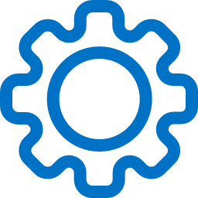
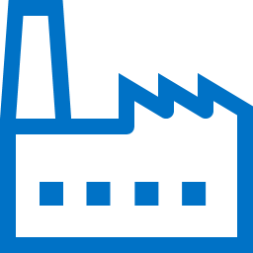


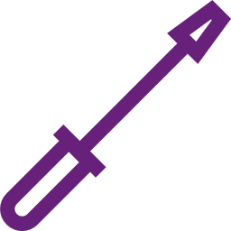

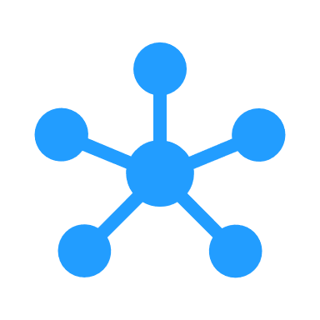




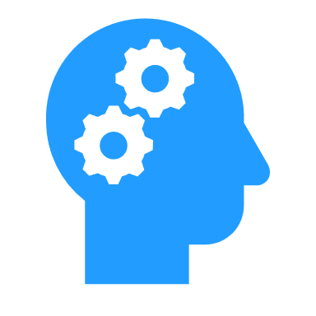



Next Generation Supply Chain
Lifecycle
Engineering
R & D
Plan Product,
Source parts
Manufacture
Deliver
Product to
Channel
Customer
Purchase
Activation
Usage
&
Telemetry
Contact support to
resolve
Repair units
Capture feedback
Supply Chain Data
External data
Digitized Infrastructure
Transforming Supply Chain performance
Visibility through advanced analytics
Social
Environmental
Economic
Algorithmic decisions through machine learning
Intelligent Digital Supply Chain
Data Driven Organization
Notes:
Data first – deep functional expertise
Man – Machine harmony
Analytical not operational

Slide 9
Addressing Skills Needed for Digital Transformation
Future skillsets
ABCs of Digital Skills*
Complex problem solving
Critical thinking, system analytics
Creativity, active learning
People & communication skills, cultural agility
Artificial Intelligence
Big Data
Cloud computing
INDIVIDUAL
Focus on rebalancing the workforce to attain key digital talent.
Place higher emphasis on attracting and retaining the best talent, and retraining and outsourcing others in the workforce.
Focus on creating a flexible work source model
ORGANIZATION
*Source: LinkedIn, The Digital Workforce of the Future. Data as of August 2017.
Notes:
We (along with IDC Asia/Pacific) believe that future skillsets that individuals needs to possess include:
Complex problem solving
Critical thinking, system analytics
Creativity, active learning
People and communication skills, cultural agility
And as the pace of digital transformation accelerates, organizations are also seeking talents to meet their technological requirements, especially in AI:
LinkedIn’s recent study outlined the ABCs of digital talents, and the top in demand skills are Artificial Intelligence, Big Data, Cloud Computing
In fact, AI is no longer a domain for highly advanced industries or countries, especially where organizations need to mine data in real-time.
More importantly, there needs to be a focus on retraining and building out talent that is equipped with AI ready skills.
At an organization-level, business leaders should also relook at how their workforce is built for digital transformation.
In light of this, reskilling, upskilling and continuous learning will be of outmost importance.

Slide 10

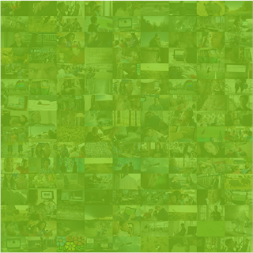
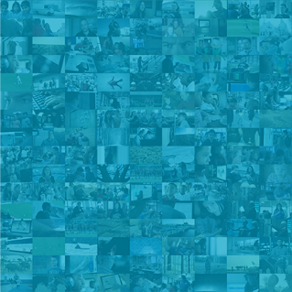

Our mission
Empower every person and every organization on the planet to achieve more
Notes:
Q&A
Thank you.

