Slide 1
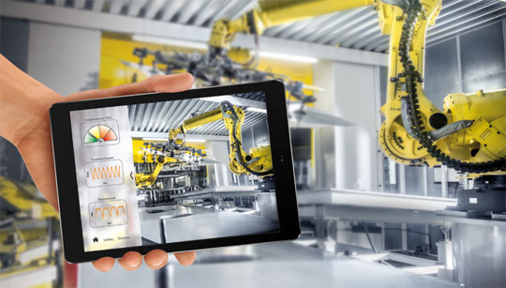
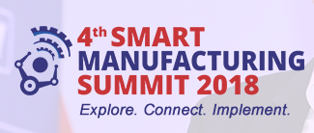
Industry 4.0
&
Hero MotoCorp
Vijay Sethi
October 26th , 2018

Slide 2
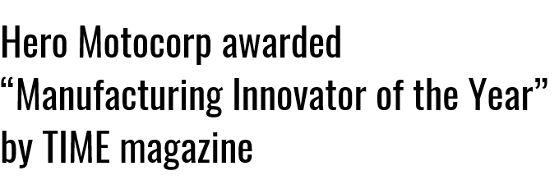
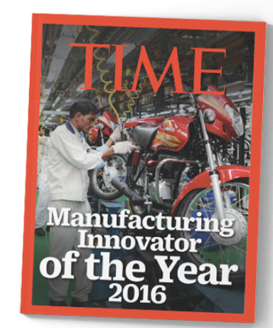
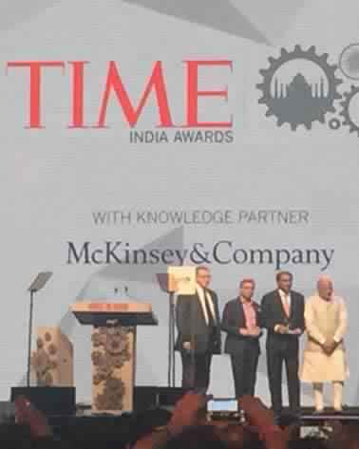
MUMBAI - FEBRUARY 13, 2016 - 'MAKE IN INDIA WEEK'.

Slide 3

One of the key reasons was

Slide 4

On Innovation and
Steps on a journey to….

Slide 5
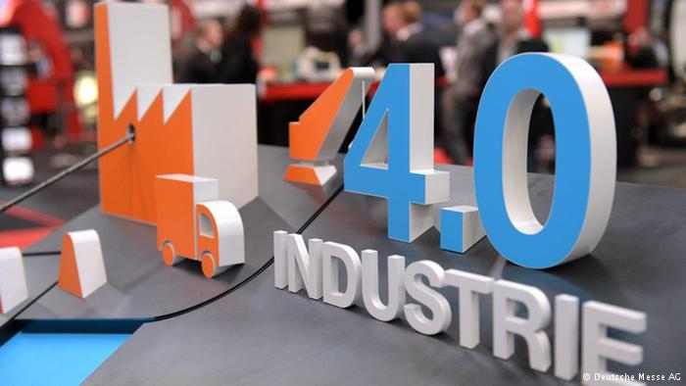

Slide 6


Slide 7
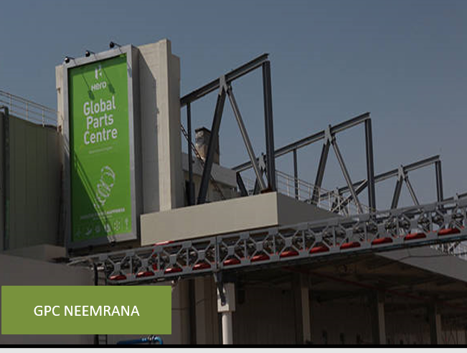

Slide 8

DIGITAL TWIN AT HALOL

Slide 9
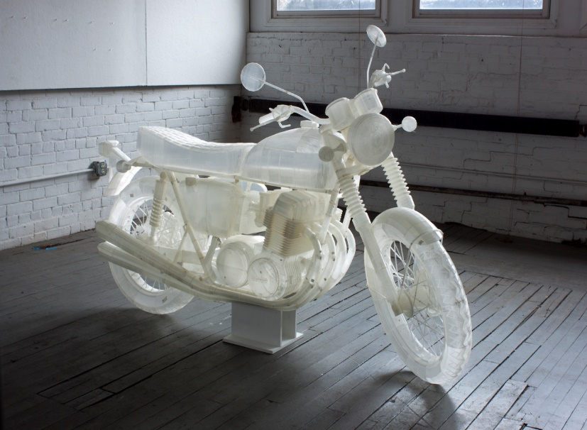
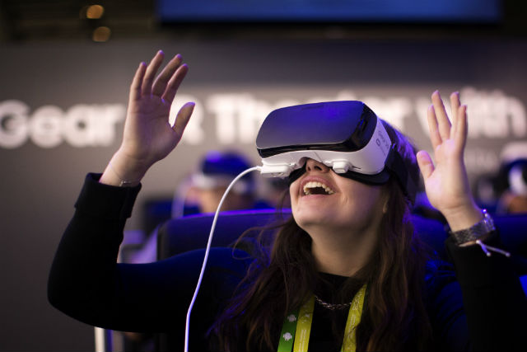
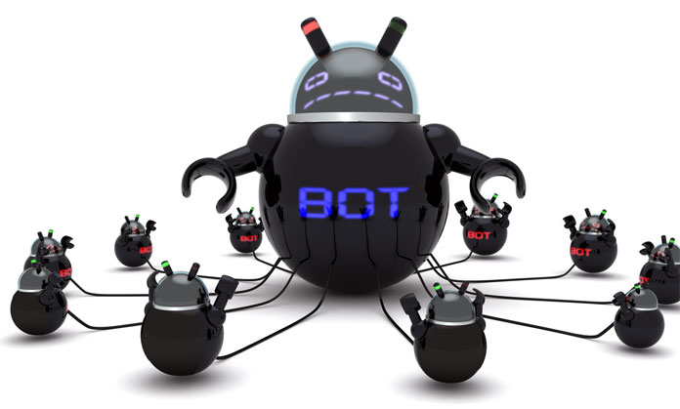


Slide 10
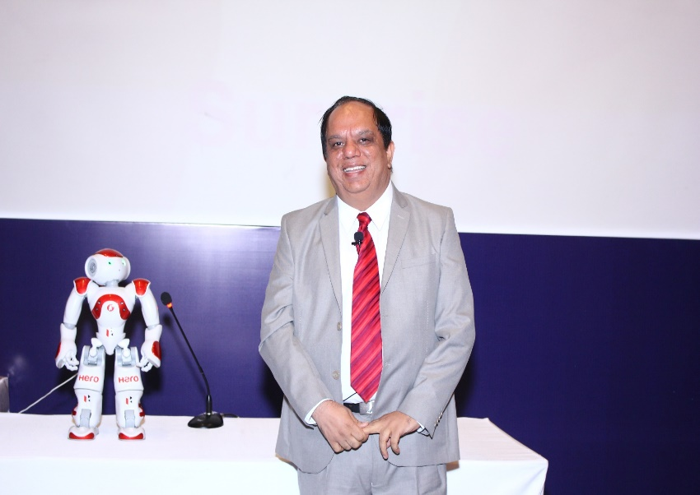

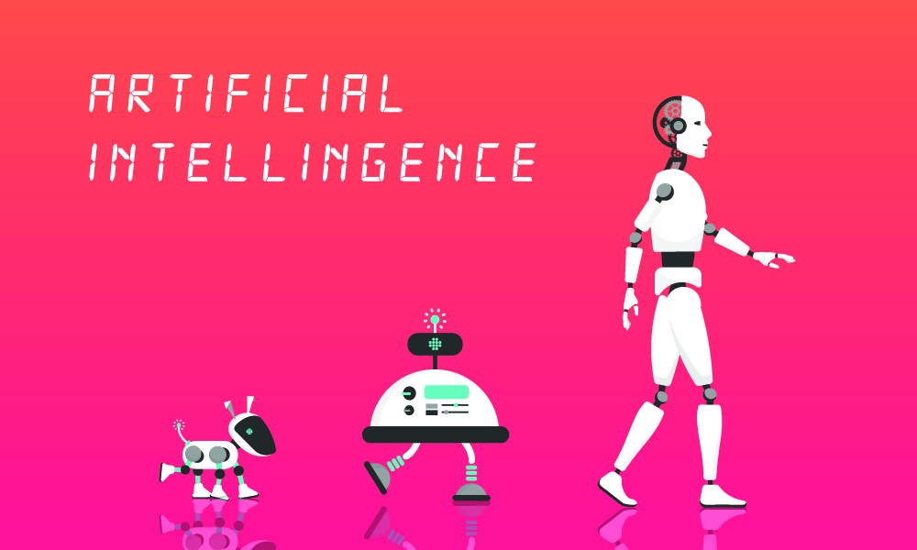


Slide 11
But, What is Industry 4.0
&
Why is it Relevant

Slide 12
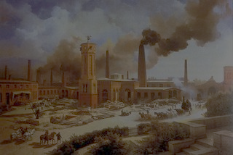
Industry 1.0: Steam power - Enabled mass production and took industry away from people’s homes and into factories.

Slide 13
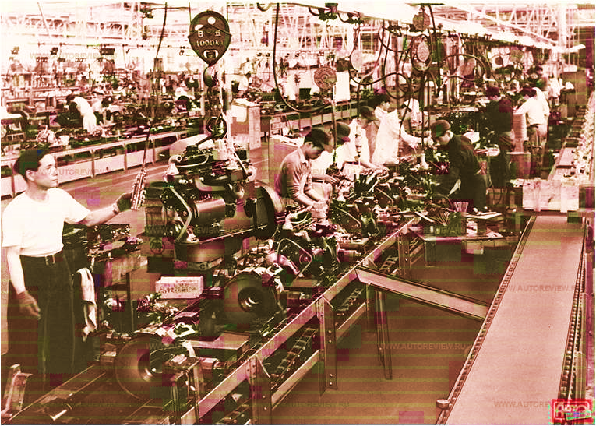
Industry 2.0: Electricity – Increased productivity and made it possible to keep factories working 24 hours a day.

Slide 14
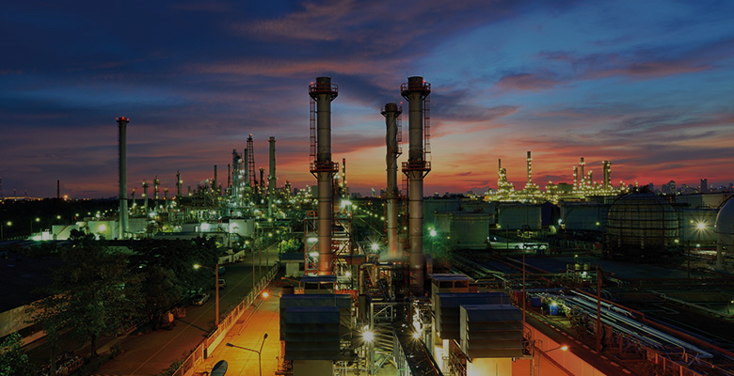
Industry 3.0: IT -
Provided the means to automate certain elements of production and create more efficient processes.

Slide 15
The fourth industrial revolution will take what was started in the third with the adoption of computers and automation and enhance it with smart and autonomous systems fuelled by data and machine learning.

Slide 16
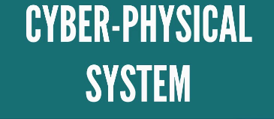

Slide 17
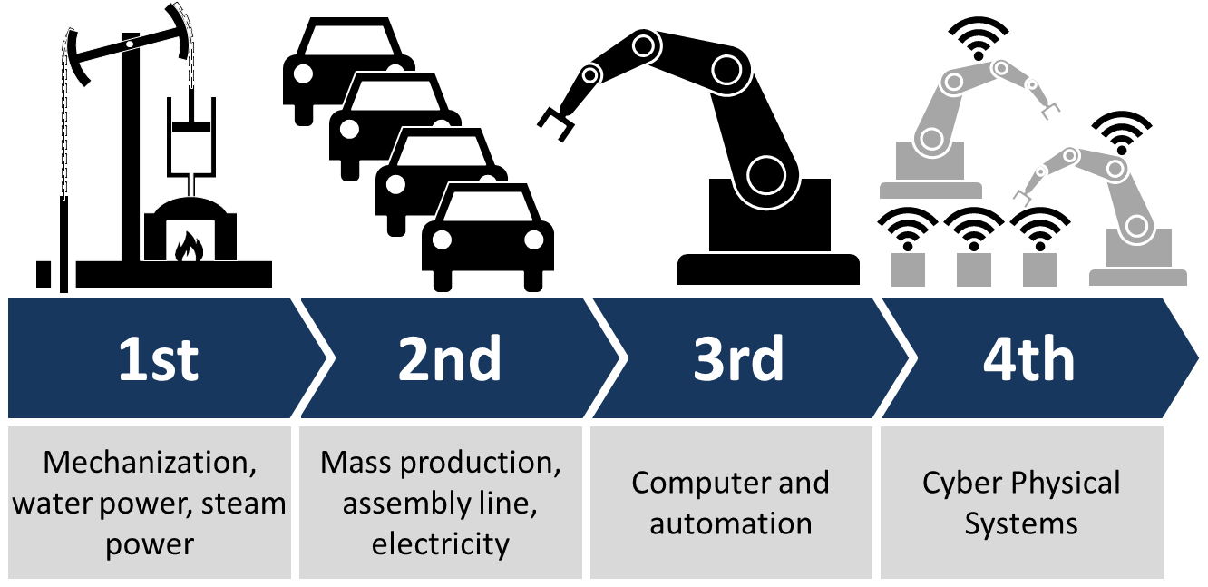
Journey to Industry 4.0
1780s
1900s
1970s
Today

Slide 18

Journey of Industry 4.0 is about
“Data Driven Manufacturing”
OR
“Smart Manufacturing”

Slide 19
… with an aim to Enhance….

Slide 20
In Process Quality
Cost Competitiveness
Supply Chain efficiency and collaboration with partners
Adherence to
Processes
Time to
market
Customer Delight
Productivity
…….and many others
Design
Capabilities
Product Quality

Slide 21

Industry 4.0 Targets all these
Industry 4.0 targets all these

Slide 22


Slide 23
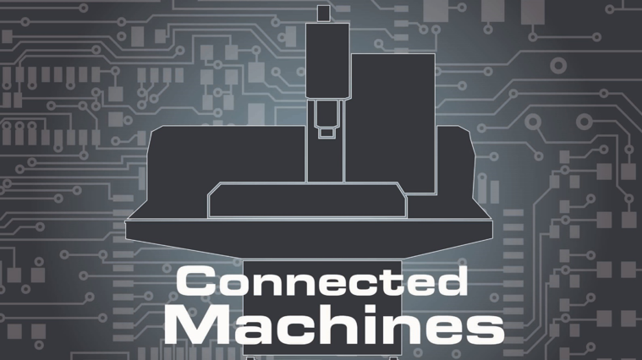
Connected machines can provide a tremendous volume of data that can help predict maintenance, performance and other issues, by identifying patterns and insights that are impossible for a human to do in a reasonable timeframe – using AI / ML etc

Slide 24
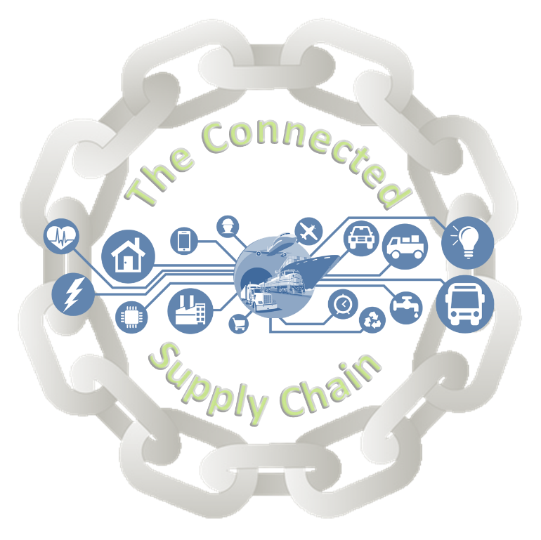
A connected supply chain can help adjust and accommodate when new information is presented – be about routes, weather etc.

Slide 25
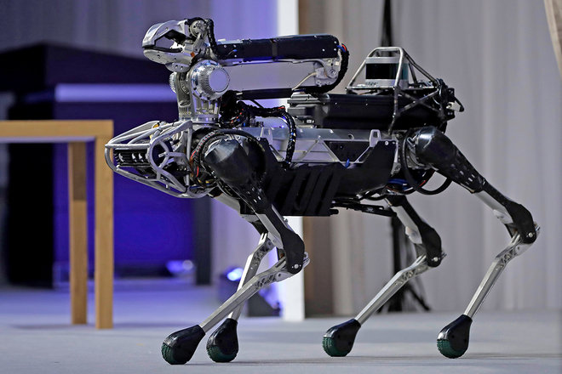
Robots with AI can help reduce costs and improve safety and accuracy in warehouses - From picking products at a warehouse to getting them ready to ship

Slide 26
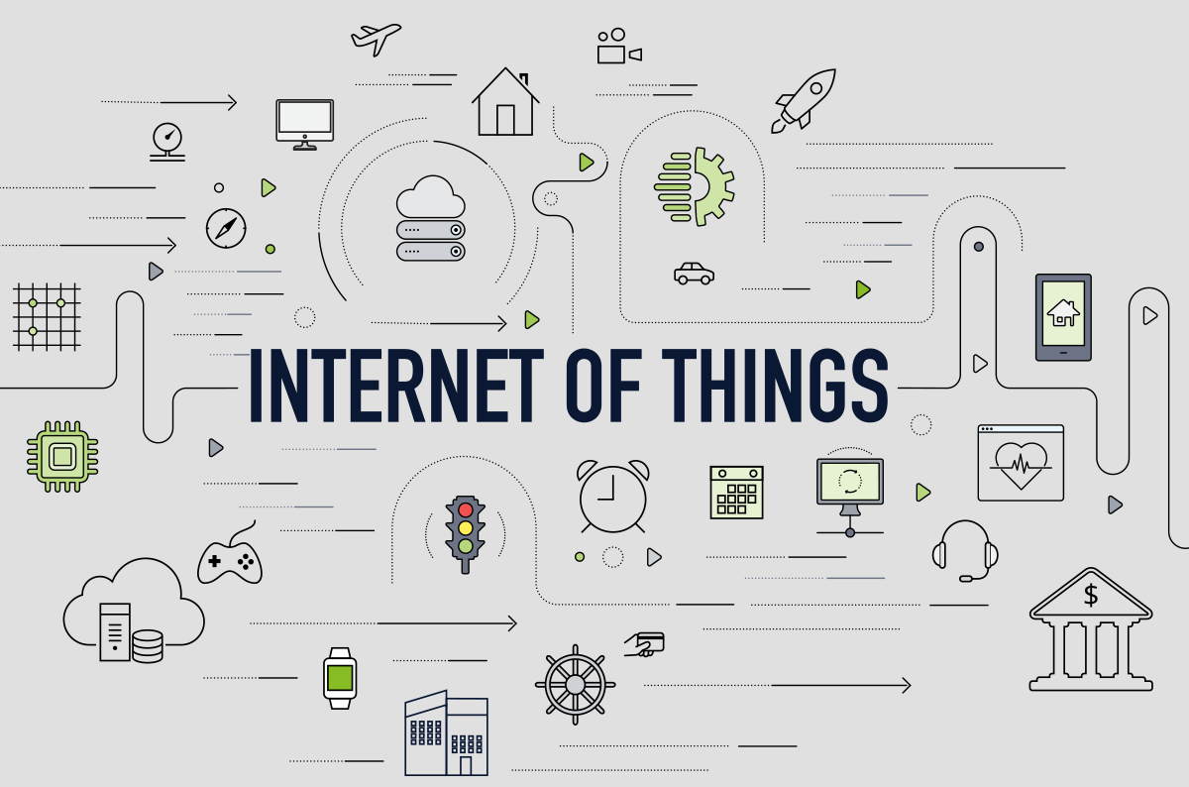
IOT can help manage / diagnose / optimise machines / products / manufacturing setups remotely

Slide 27
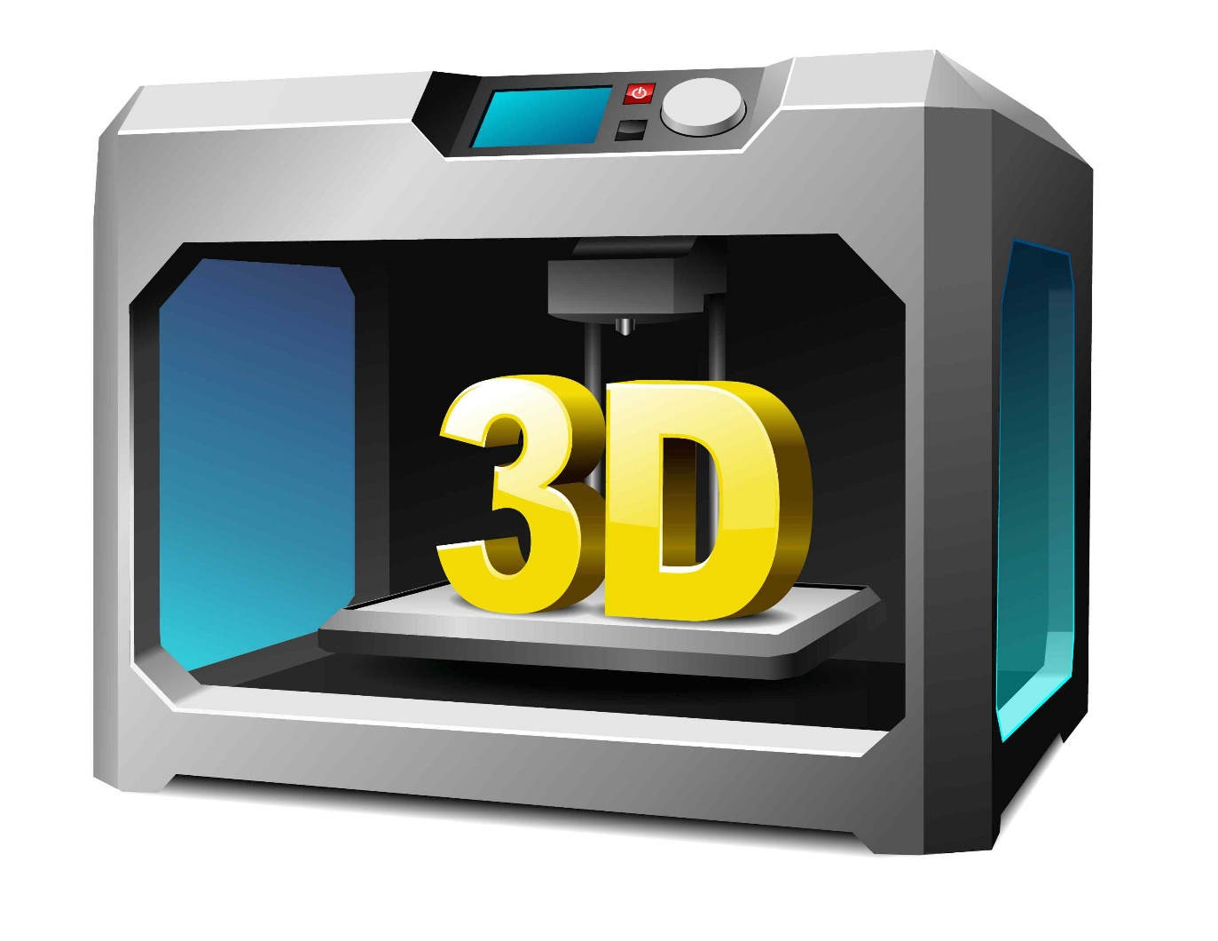
Can help organizations move from
Mass Production to low cost
Mass Customization

Slide 28

AR / VR Can help in diagnosis, training, trouble shooting

Slide 29

This also means

Slide 30
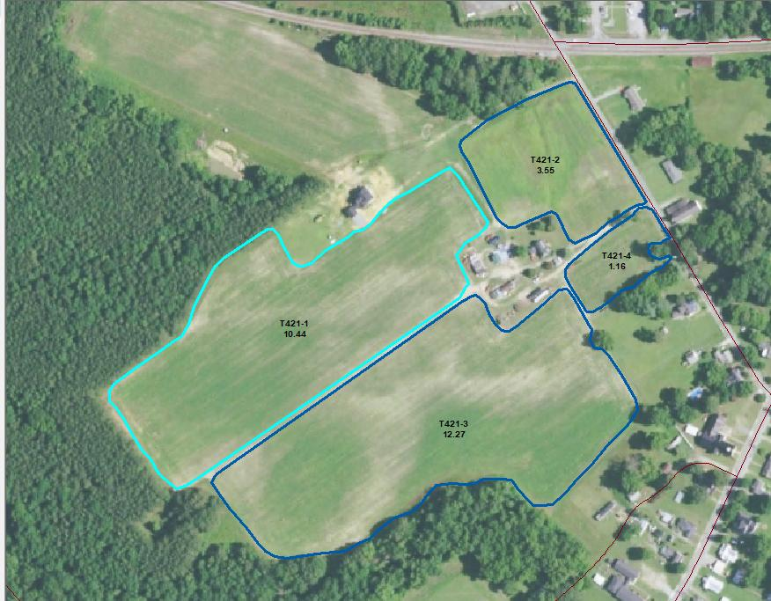
Boundaries between systems like ERP, MES, PDM CRM etc disappear - all elements of manufacturing, including product lines, services, and basically the entire environment will be connected

Slide 31
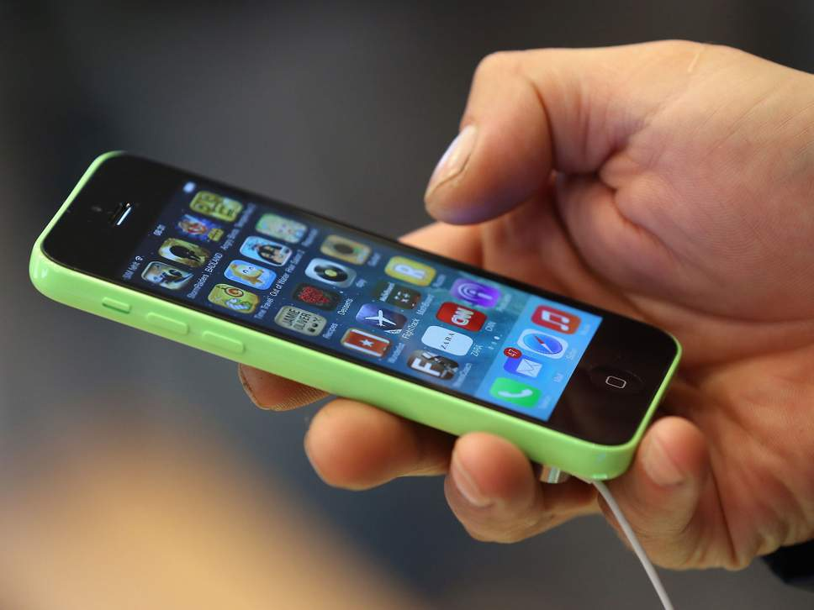
A mobile device becomes the primary interface for everything

Slide 32

It needs a huge amount of

Slide 33


Slide 34


Slide 35
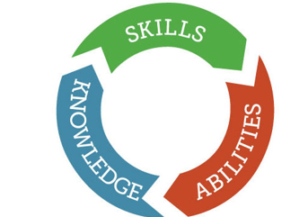
Competency
Enhancement

Slide 36

for Industry 4.0 to succeed

Slide 37
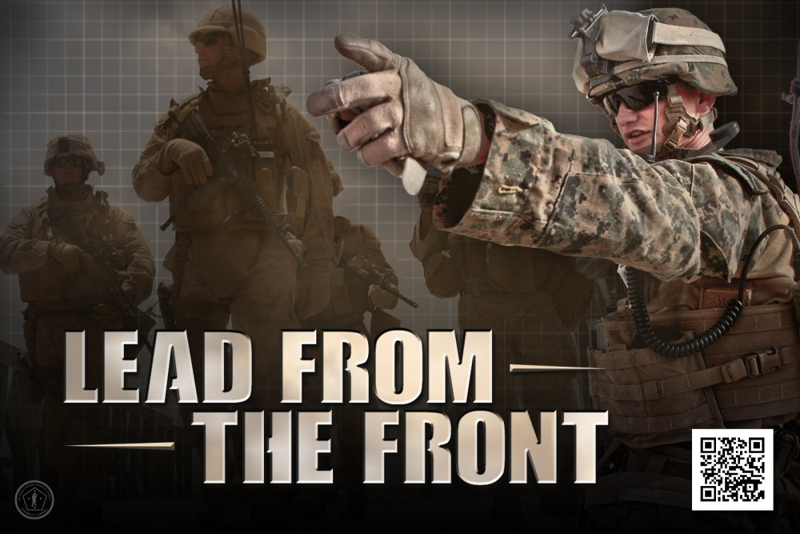
CIOs need to

Slide 38



Slide 39


Slide 40


Slide 41



Slide 42


